Slide 1

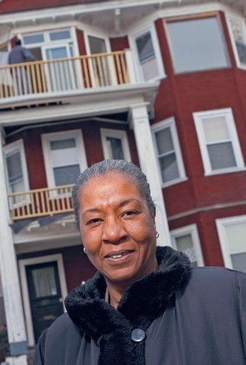
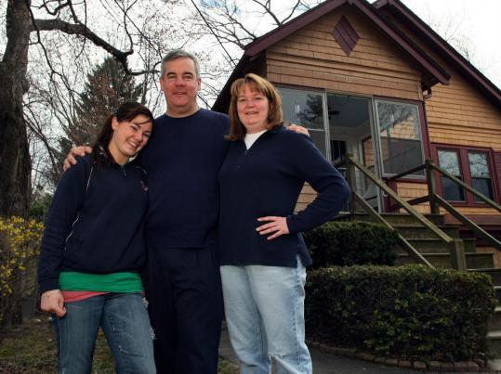
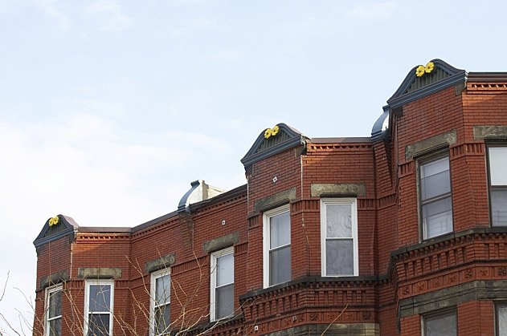
Stabilize Urban Neighborhoods (SUN) A Boston Community Capital Initiative to Address the Foreclosure Crisis Presented by: Elyse D. Cherry, CEO Boston Community Capital echerry@bostoncommunitycapital.org December 10, 2009
July 2009

Slide 2

Stabilize Urban Neighborhoods (SUN) Overview
SUN uses the decline in real estate prices in low-income neighborhoods to:
Purchase foreclosed properties at a discount
Resell to existing occupants
SUN staves off neighborhood blight and destabilization by preventing vacancies caused by foreclosure and evictions.

Slide 3

Our Goal: Keep homeowners and tenants in their homes.
Designed to complement other neighborhood stabilization efforts which focus on vacant housing stock – the only program in Massachusetts focused on keeping existing residents in place

Slide 4
Reduce Risk
Create close relationships with community partners
Purchase foreclosed homes at a steep discount
Sell at prices consistent with neighborhood median incomes
Develop new mortgage loan instruments
Underwrite 30-year fixed rate mortgages with payments < 38% of household income
Build portfolio reserves to protect against loan losses and market declines

Slide 5
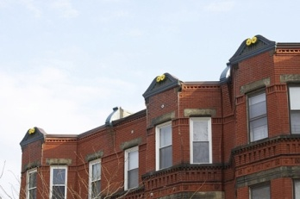
Avoid Moral Hazard
Prevent windfalls with zero percent, non-amortizing, shared appreciation second mortgage
Screen applicants for evidence of hardship, predatory mortgages, and income eligibility

Slide 6
Understand the Challenge
Reviewed 700 title histories of foreclosed properties
Focus groups with foreclosed homeowners in Boston, Fall River, and New Bedford
Individual conversations with homeowners, advocacy organizations and community groups

Slide 7
Routes to Foreclosure
Multiple refinances add costs and fees
First-time homeowners unable to afford monthly payment after “teaser” rate expired
Bad underwriting: homeowners approved for loans they could not afford
Short-term personal or family crisis (e.g. car accident or spouse’s illness) compromised ability to keep payments current

Slide 8
Borrower Needs
Fixed-rate, appropriate mortgages with an affordable monthly payment
Automatic deposit of paychecks and automatic withdrawal of mortgage payments
Budgeting assistance
Upfront reserves
Financial education re: mortgages and costs of owning and maintaining a home

Slide 9
SUN Offers Mortgage Products Designed to Meet These Needs
30-year fixed rate mortgages with automatic withdrawals that coincide with payday
Financial reserves built through closing escrows and bi-weekly payment (one extra payment/year)
Financial counseling and peer support

Slide 10
Example Mortgage Refinancing
Original mortgage: $200,000
BCC purchases mortgage from foreclosing lender for $100,000
BCC borrows from its funding sources $100,000
This is secured by 80% of the new mortgage amount
BCC provides a new 1st mortgage to homeowner for $125,000
25% mark-up from purchase price of $100,000*
30 year fixed-rate mortgage
If borrower defaults in year one, BCC assumes the default risk. Thereafter, the lender assumes the risk.
BCC also takes a “shared appreciation” second mortgage on the property
When the property is sold or refinanced, BCC receives 37.5% (percentage of old mortgage written down) of the gain.
* Based on BCC’s underwriting of homeowner’s ability to pay based on traditional
underwriting criteria. This mark-up provides additional reserves.

Slide 11

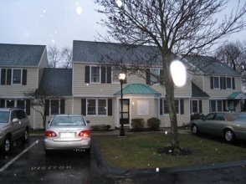
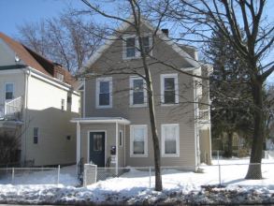
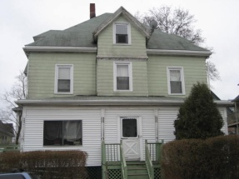
SUN Initiative Sample Loans
Property Address | 50 Summit St Hyde Park | 51 Victoria Heights Hyde Park | 4374 Washington St #1 Roslindale | 13 Gaston Street Dorchester
Description | Resale to owner | Resale to owner | Sale to tenant | Resale to owner
Original Mortgage (plus penalties) | $250,000 | $350,000 | $325,000 | $350,000
Rate | 11.50% | 11.25% | 10.25% | 11.50%
Monthly Payment | $2,533 | $2,522 | NA* | $2,500
Foreclosure Date | 5/15/2008 | 8/1/2007 | 11/14/2007 | 2/19/2008
NSP Purchase Price | $159,000 | $123,559 | NA* | $100,000
Resale Price | $198,000 | $154,408 | $55,000 | $125,000
Cash from Borrower | $6,600 | $6,232 | $15,000 | $6,320
Aura Mortgage Amount | $201,099 | $161,930 | $40,000 | $158,221
Mortgage Rate | 6.50% | 6.50% | 7.50% | 6.50%
Monthly Payment | $1,506 | $1,545 | $678 | $1,444
Reserves** | $1,411 | $3,130 | $990 | $2,665
Term | 30 years | 30 years | 15 years | 30 years
* NSP did not purchase this property, but provided mortgage to existing tenant to purchase it.
** Reserve amounts vary based on property type and annual taxes.

Slide 12
BCC Commitment
NSP Residential, a new entity created to acquire properties
Aura Mortgage Advisors, a licensed mortgage broker and lender
Loan policies and procedures; staffing in place
Board of Directors approved $3.7 million in initial internal funding
To date, we have purchased or financed over 40 units; pipeline of >80 individuals

Slide 13
Taking SUN to Scale
$50-75 million investment will support refinance of 300-500 loans in the next 18-24 months
Revolving line of credit
$3.5 million already committed to cover first losses; subsequent risk of default to be borne by the investor; BCC maintains servicing
Secondary market sales once sufficient scale is reached

Slide 14
For more information, contact:
Elyse D. Cherry, CEO
Boston Community Capital
echerry@bostoncommunitycapital.org

