Slide 1
Inflation Reduction Act's Clean Vehicle Credits
An In-Depth View
Policy webinar
6 April 2023
Kristin Dziczek
Policy Advisor

Slide 2
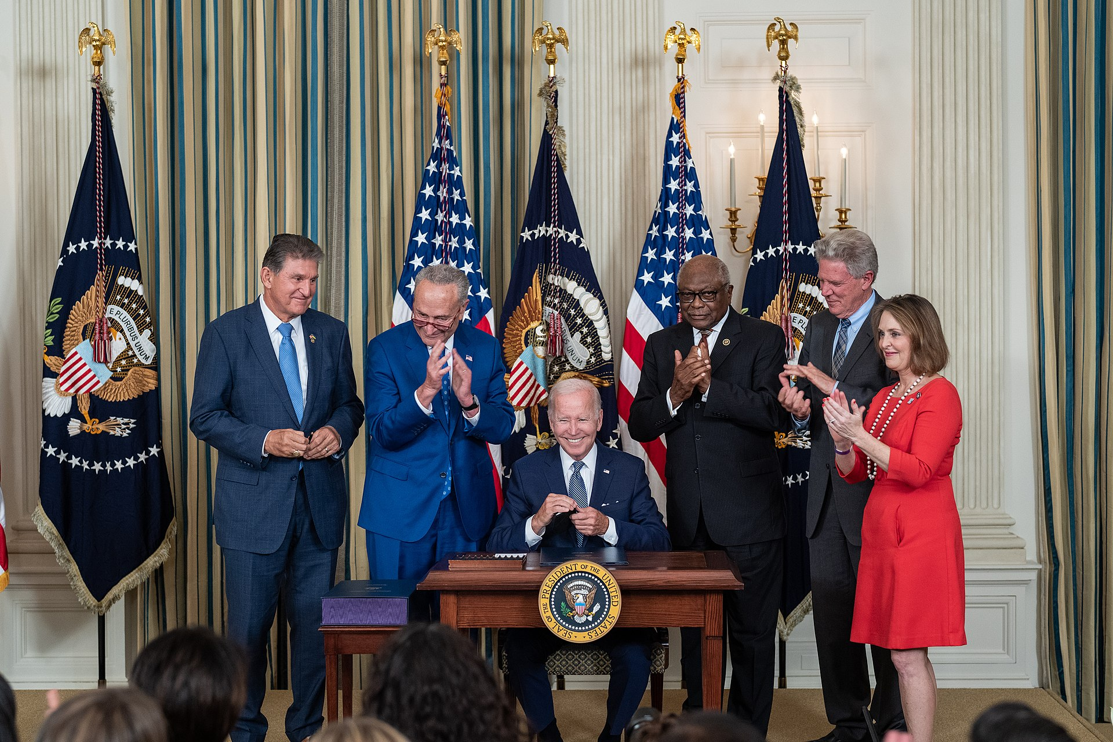

Inflation Reduction ACT
PL 117-169 Signed
16 August 2022
IRS Clean Vehicle Credits
Public Law 117-169
16 August 2022 Guidance
12 December 2022 Guidance
29 December 2022 Guidance
29 December 2022 White Paper
3 February 2023 Guidance
31 March 2023 Guidance
Source: whitehouse.gov

Slide 3
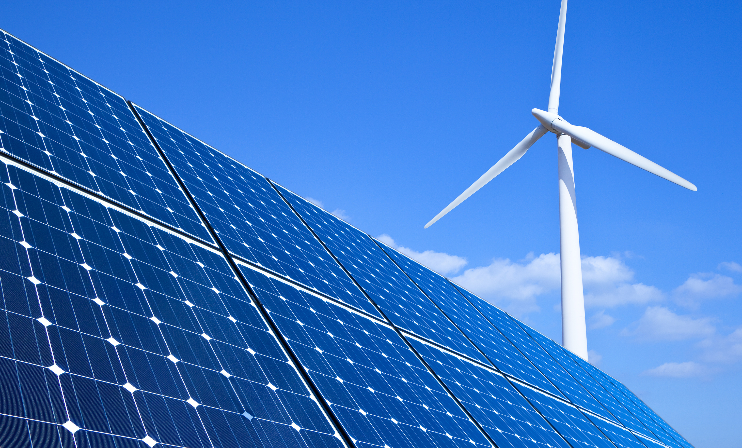

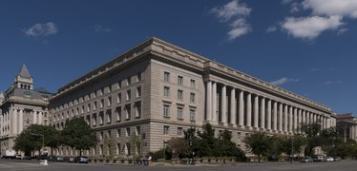

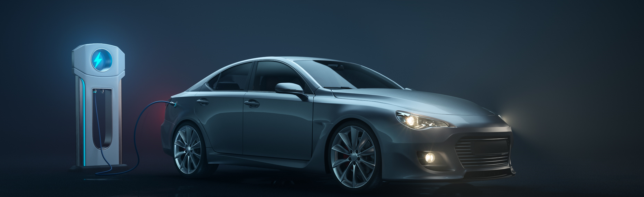
Inflation Reduction Act
The IRA has many aspects
Prescription Drug Prices
Corporate Taxes &
Tax Enforcement
Climate Change
Clean Energy Manufacturing
Clean Vehicle Incentives*
* BEV, PHEV, FCEV
Image Source: Microsoft
Notes:
Climate, health care, and tax package
Focus on:
Purchase new & used clean vehicles
Lease clean vehicles
Invest in new manufacturing capacity
Convert existing manufacturing capacity to produce clean vehicles, parts, & components
Produce battery cells, modules, & packs
Mine, refine, process, & recycle critical minerals
Over a period of 10 years, the law is estimated to RAISE revenue from:
Prescription drug price reform—including a $35 price cap on insulin
Imposing 15% corporate minimum tax rate for companies with $1B+ annual income
Imposing a 1% excise tax on stock buybacks
Implementing a 2-year extension on the limitation on excess business losses, and
Increased tax enforcement
And SPEND revenue on:
IRS modernization and increased tax enforcement
Extended Affordable Care Act subsidies
Deficit reduction
Energy security
Climate change
Drought resiliency in western states
“Climate-smart” agriculture
USDA lending reforms
Forest protection
Urban heat island reduction
Coastal habitat protection
And clean energy
Solar investment tax credits
Nuclear power
Home energy efficiency upgrades and supply improvements
Advanced manufacturing
And clean vehicles

Slide 4



Inflation Reduction Act
IRA incentives are
an alphabet soup of
IRS tax code sections
& government programs
30D
New Retail Clean
Vehicle Tax Credits
45W
Commercial Clean Vehicle Tax Credits
25E
Used Retail Clean Vehicle Tax Credits
45X
Manufacturing
Tax Credits
48C
Advanced Energy
Project Credit
ATVM
Advanced Vehicle Technology Program
DMCG*
Domestic Manufacturing Conversion Grants
* I don’t think anyone uses this acronym
Image Source: Microsoft
Notes:
Since the 30D guidance just came out last week, we’ll start by comparing the two programs for new vehicle purchases…

Slide 5


Requirement | 30D New Clean Vehicle Credit (up to $7,500)* | 45W Commercial Clean Vehicle Credit (<14K) (up to $7,500*,**) | 25E Used Clean Vehicle Credit (up to $4,000 or 30% price)
Qualified manufacturer | ☑ | ☑ | ☑
Clean Air Act compliant vehicle | ☑ | ☑ | ☑
GVW < 14K pounds | ☑ | ☑ | ☑
Battery >= 7 kWh | ☑ | ☑ | ☑
Purchaser must have tax liability | ☑ | ☑*** | ☑
Vehicle must be sold by a dealer | ☑ | ☑ | ☑
Not for resale | ☑ | ☑ | ☑
Original use | ☑
Assembled in North America | ☑
Price caps (30D: MSRP $55K cars, $80K others; 25E: Transaction price $25K) | ☑ |  | ☑
Modified Adjusted Gross Income Caps (30D: $300K Married/$225K Head of Household/$150K Single; 25E: half of 30D $150K/$112.5K/$75K) | ☑ |  | ☑
$3,750 if meet critical mineral content targets | ☑
$3,750 if meet battery component content targets | ☑
No critical mineral or battery components source from a foreign entity of concern | ☑
Must be for business use |  | ☑
At least 2 years old |  |  | ☑
First resale after 16 August 2022 |  |  | ☑
Inflation Reduction Act
Comparing 30D, 45W, & 25E
*30D & 45W can be used for leased vehicles.
**45W: leased vehicles count; law also contains tax credits up to $40K for vehicles with GVW > 14K pounds
***45W tax credit can be carried forward to a year in which the entity has a tax liability
Image Source: Microsoft
Source: Federal Reserve Bank of Chicago analysis of PL 117-169
Notes:
“The IRA made a number of amendments to section 30D. In general, the purpose of these amendments is to promote the purchase and use of new clean vehicles by lower and middle-income Americans, to promote resilient supply chains and domestic manufacturing, to strengthen supply chains with trusted trading partners, to protect against improper credit claims, and to achieve significant carbon emissions reductions.”
Up to $7,500—the lesser of 30% of base price or 15% of the PEV incremental cost (whichever is lower)
Leasing companies qualify & may pass along some of the benefit to leasee
* Vehicles <=14K pounds; there is also a credit of up to $40K for vehicles with GVW > 14K pounds
The things circled in red – that’s what industry was waiting for guidance to proceed.
I’ll get us started by reviewing what is in the IRA re: critical minerals, battery components, and foreign entities of concern and leave it to the panelists to get into what we learned on March 31st.

Slide 6
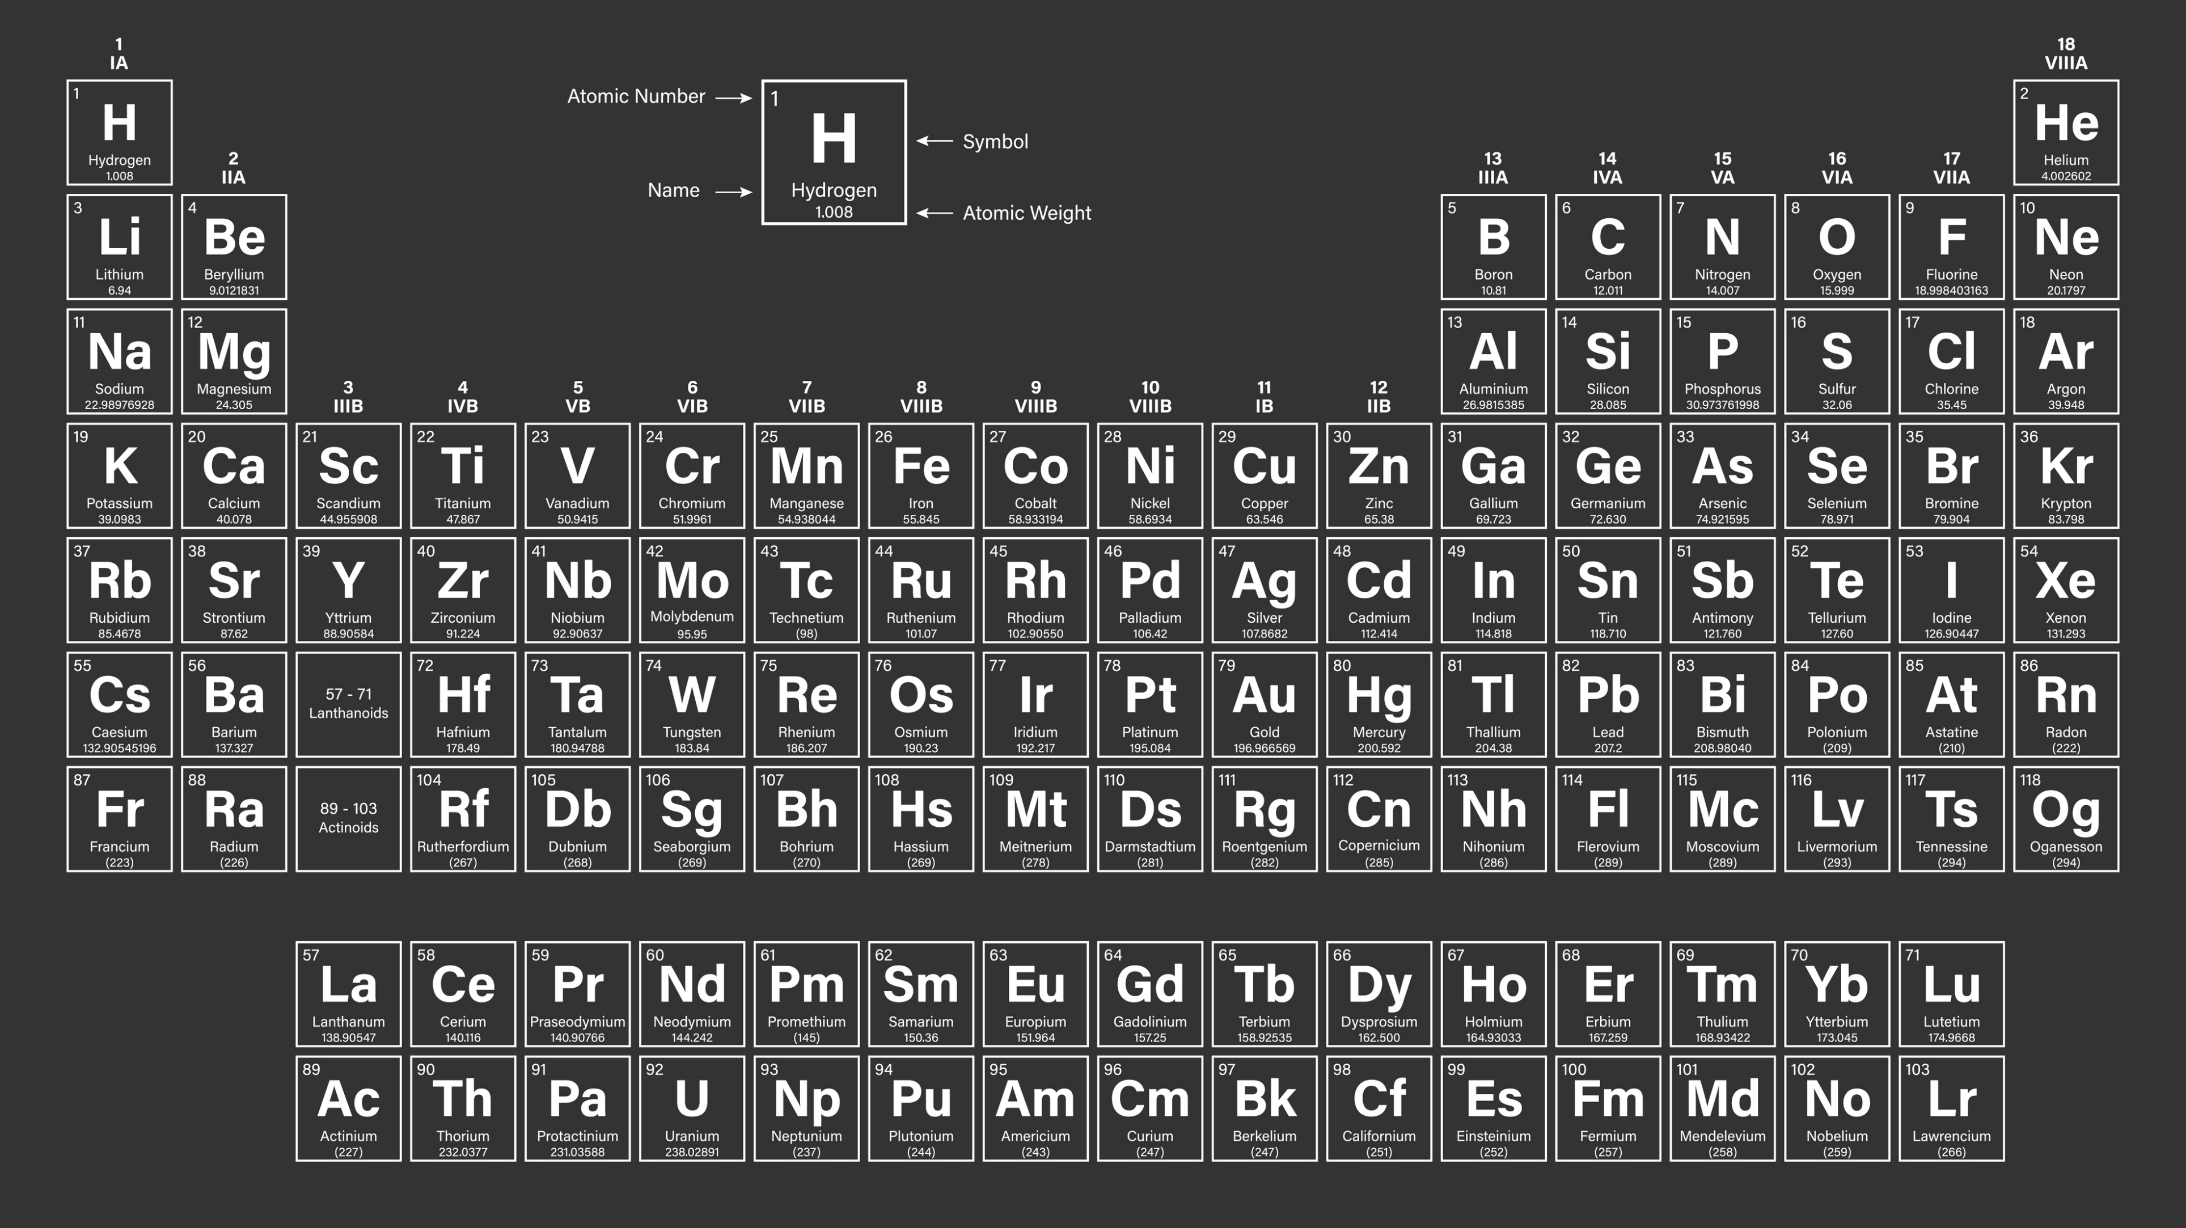
Inflation Reduction ACT 30D
* Graphite
“Critical Minerals”
& Others
(i) extracted or processed in the United States, or in any country with which the United States has a free trade agreement in effect, or
(ii) recycled in North America
*
BaSO4
Barite
CaF2
Fluorspar
Image Source: Wikimedia Commons; critical minerals & other from PL 117-169
Notes:
50 (48/118)
25 “critical minerals” (elements & compounds) Aluminum, Antimony, Barite, Beryllium, Cerium, Cesium, Chromium, Cobalt, Dysprosium, Europium, Fluorspar, Gadolinium, Germanium, Graphite, Indium, Lithium, Manganese, Neodymium, Nickel, Niobium, Tellurium, Tin, Tungsten, Vanadium, Yttrium
25 Others (minimum 99% purity by mass):
Arsenic, Bismuth, Erbium, Gallium, Hafnium, Holmium, Iridium, Lanthanum, Lutetium, Magnesium, Palladium, Platinum, Praseodymium, Rhodium, Rubidium, Ruthenium, Samarium, Scandium, Tantalum, Terbium, Thulium, Titanium, Ytterbium, Zinc, Zirconium

Slide 7

Inflation Reduction ACT: 30D
Critical minerals content requirements
 | <2024 | 2024 | 2025 | 2026 | 2027 | 2028 | 2029 | 2030 | 2031 | 2032
Critical Minerals (Sourced from U.S. or free trade agreement countries) | 40% | 50% | 60% | 70% | 80%
 |  |  | ↑ Starting 1January 2025, no critical minerals can be extracted, processed, or recycled by a foreign entity of concern
Australia, Bahrain, Canada, Chile, Colombia, Costa Rica, Dominican Republic,
El Salvador, Guatemala, Honduras, Israel, Japan, Jordan, South Korea, Mexico, Morocco, Nicaragua, Oman, Panama, Peru, & Singapore
Image Source: Microsoft
Notes:
(ii) Free trade agreements in effect. The countries with which the United States currently has a free trade agreement in effect are: Australia, Bahrain, Canada, Chile, Colombia, Costa Rica, Dominican Republic, El Salvador, Guatemala, Honduras, Israel, Japan, Jordan, South Korea, Mexico, Morocco, Nicaragua, Oman, Panama, Peru, and Singapore
Japan executive agreement Microsoft Word - word for website (ustr.gov)
The term “critical minerals” means any of the following: (a) cobalt; (b) graphite; (c) lithium; (d) manganese; and (e) nickel.
Expected EU executive agreement
Let’s now turn to battery components. First, what is a battery component?

Slide 8

Inflation Reduction ACT: 30D
So, what are battery
components?
Electrode active materials
  Cathode
  Anode & anode foils
  Solid metal electrode
  Separator
  Electrochemically active materials including solvents, additives, and electrolyte salts that contribute to the electrochemical processes necessary for energy storage
Battery cells
that can store at least 12 Wh of energy
Battery modules
  2 or more battery cells configured electrically in series or parallel to create voltage or current, or
  No cells but with aggregate capacity of not less than 7 kWh (or in a FCEV, not less than 1 kWh)
Image Source: Microsoft
Notes:
Components are everything that goes into a battery pack—but not the pack itself
Active materials = stuff inside a battery cell
Cell = single unit that converts chemical energy to electrical energy
Module = collection of cells connected in series or parallel fashion
Pack = a group of 2 or more modules and protection systems that will be installed in a vehicle
There was still a lot of questions re: battery components left unanswered by the legislative text…but, here are the threshholds
3/31 guidance says: “Battery components would include, but not be limited to, a cathode electrode, anode electrode, solid metal electrode, separator, liquid electrolyte, solid state electrolyte, battery cell, and battery module. Constituent materials would not be considered a type of battery component, although constituent materials could be manufactured or assembled into battery components. Some battery components could be made entirely of inputs that do not contain constituent materials. Battery components would include any piece of the assembled battery cell that contribute to electrochemical energy storage.”

Slide 9

Inflation Reduction ACT: 30D
Battery components content requirements
 | <2024 | 2024 | 2025 | 2026 | 2027 | 2028 | 2029 | 2030 | 2031 | 2032
Battery Components (North American assembled) | 50% | 60% |  | 70% | 80% | 90% | 100%
 |  | ↑ Starting 1January 2024, no battery components can be manufactured or assembled by a foreign entity of concern
Image Source: Microsoft
Notes:
So, now, let’s look at what is a “foreign entity of concern”?

Slide 10



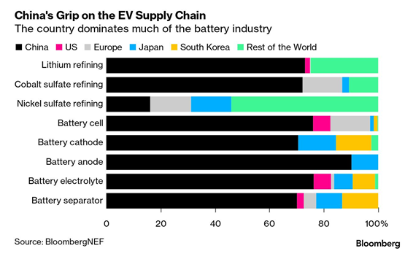









“These rules will be addressed in future guidance.”
Countries of Particular Concern
The most recent Countries of Particular Concern designations were made by the Secretary of State on November 30, 2022:
Burma, People’s Republic of China, Cuba, Eritrea, Iran, the Democratic People’s Republic of Korea, Nicaragua, Pakistan, Russia, Saudi Arabia, Tajikistan, and Turkmenistan.
Foreign Entity of Concern Definition: Section 40207(a)(5) of the Infrastructure Investment and Jobs Act, “owned by, controlled by, or subject to the jurisdiction or direction of a government of a foreign country that is a “covered nation” (defined in 10 U.S.C. 2533c(d)(2))
Source: Countries of Particular Concern, Special Watch List Countries, Entities of Particular Concern - United States Department of State
Flag sources: Wikimedia Commons
Notes:
It’s a list kept by the U.S. State Department of countries involved in “(1) torture; (2) prolonged detention without charges; (3) forced disappearance; or (4) other flagrant denial of life, liberty, or security of persons.”
“China’s dominance in the battery industry is focused on mid-stream and downstream production. Chinese chemical production of Class 1 raw materials stood at 80 percent of total global output in 2019. China is the world’s major processor of lithium carbonate into lithium hydroxide, cobalt into cobalt sulphate, manganese refining, and uncoated spherical graphite refining. China’s ownership of the chemical conversions needed to produce batteries has ensured that the global supply of battery raw materials flows to China for value-added production.” 100 day report
“For battery material manufacturing and cell fabrication, the United States has less than 10 percent of global market share for capacity across all major battery components and cell fabrication. Comparatively, China has over 75 percent of global cell fabrication capacity – largely driven by state investment in raw material processing, component and cell manufacturing, and EV deployment support, among other state interventions. For battery pack manufacturing, the United States has built up a manufacturing footprint largely to service North American EV production demand; however, the United States still lags behind other markets as domestic demand comprised only 12 percent of global EV demand in 2020 compared to roughly 40 percent in China and 40 percent across Europe.” 100 day report
Kicked it to the U.S. Department of Energy which also manages entity of concern for nuclear materials. Advise forthcoming?
Now, that was all on the product side, let’s look at the manufacturing incentives:

Slide 11

Inflation Reduction Act
Review of Major Manufacturing Incentive Provisions
45X
Manufacturing
Tax Credits
48C
Advanced Energy
Project Credit
ATVM
Advanced Vehicle Technology Program
DMCG
Domestic Manufacturing Conversion Grants
Production credits for solar, wind, batteries, minerals etc.
Electrode active materials
Battery cells ($35/kWh)
Battery modules ($10-45/kWh)
Applicable critical minerals
(10% costs incurred)
$10B in tax credits for qualifying projects
Establish, expand, or re-equip facilities to produce a wide variety of clean energy products:
  BEV/PHEV/FCEVs
  Energy storage
  Fuel cell equipment
+$3B to an existing direct loan program
No longer capped at $25B
Establish or expand facilities to produce:
  Advanced technology vehicles
  Components with low or zero emissions
Grants for re-equipping, expanding, or establishing a manufacturing facility in the U.S. to produce:
  HEV
  PHEV
  BEV
  FCEV
Notes:
45X electrode active materials = cathode, anode, electrolyte
Phase out 25%/year between 2030-2033 when credit ends (critical minerals manufacturing not subject to phase out)

Slide 12
Inflation Reduction Act
Timeline &
Process
ADD: Minerals & battery components content rules
Treasury Guidance
12 & 29 December 2022
NPRM Announced
31 March 2023
Critical Mineral & Component Content Into Effect
18 April 2023
Bill Signed
16 August 2022
Program Start Date
1 January 2023
NPRM Published
17 April 2023
Comments Due
~16 June 2023
NEW: North American assembly (8/16/2022)
OLD: Up to $7,500 based on previous 30D battery capacity
NEW: MSRP & MAGI caps
Lifting 200K/company cap
Notes:
What was released 31 March 2023 was an “unpublished” notice of proposed rulemaking.
This is not an interim final rule—and even then, a lot can change before it gets to be a rule…Many questions remain:
When will we know about entities of concern?
Will the Japan deal (and future EU deal) be ftas for purposes of 30D?
“Taxpayers may rely on these proposed regulations for vehicles placed in service prior to the date final regulations are published in the Federal Register, provided the taxpayer follows the proposed regulations in their entirety, and in a consistent manner.”
While our panelist may not have all the answers, I know of no better individuals to help all of us understand the known knowns and the known unknowns of the IRA clean vehicle tax and manufacturing incentives.

Slide 13


David Schwietert
Chief Policy Officer
Alliance for Automotive Innovation
Andrew Koblenz
Executive Vice President, Legal & Regulatory Affairs and General Counsel
NADA
Notes:
Andrew D. Koblenz is the National Automobile Dealers Association's (NADA) executive vice president of legal and regulatory affairs, representing NADA and dealer interests before federal agencies, and its general counsel. He supervises a staff of attorneys who specialize in franchise and state law, corporate law, and federal regulatory affairs. Prior to his current position, Koblenz was NADA’s vice president of industry affairs from June 2001 to February 2006, where he directed the activities of NADA's Industry Relations and Industry Analysis Departments, as well as the association's American Truck Dealers (ATD) Division.
Brad Markell is the Executive Director of the AFL-CIO Industrial Union Council (IUC). The AFLCIO is the national labor federation of the United States, with 58 affiliated unions representing 12.5 million workers. The IUC is the manufacturing arm of the AFL-CIO, with 12 unions representing over 1 million members directly in manufacturing. Brad also directs the federation’s climate and energy policy work at the national and international levels, including leading several labor delegations to UNFCCC meetings, and the AFL-CIO’s work with the Energy Future Initiative known as the Labor Energy Partnership.
David Schwietert is the chief policy officer at the Alliance for Automotive Innovation. Together with the broad membership of auto innovators, Schwietert works to develop intelligent solutions that advance the association’s legislative and regulatory agenda when it comes to a cleaner, safer, and smarter future. Before joining the Alliance for Automotive Innovation, Schwietert was the interim president and CEO of the Alliance for Automobile Manufacturers. Prior to joining the Auto Alliance in 2015, Schwietert worked in the U.S. Senate for over 15 years and held various policy positions, including staff director of the U.S. Senate Committee on Commerce, Science, and Transportation.

Slide 14
Discussion
Inflation Reduction Act's Clean Vehicle Credits
30D
New Retail Clean
Vehicle Tax Credits
25E
Used Retail Clean
Vehicle Tax Credits
45W
Commercial Clean
Vehicle Tax Credits
45X
Manufacturing
Tax Credits
48C
Advanced Energy
Project Credit
ATVM
Advanced Vehicle
Technology Program
DMCG
Domestic Manufacturing Conversion Grants

Slide 15
Requirement | 30D New Clean Vehicle Credit (up to $7,500) | 45W Commercial Clean Vehicle Credit (<14K) (up to $7,500*) | 25E Used Clean Vehicle Credit (up to $4,000 or 30% price)
Qualified manufacturer | ☑ | ☑ | ☑
Clean Air Act compliant vehicle | ☑ | ☑ | ☑
GVW < 14K pounds | ☑ | ☑ | ☑
Battery >= 7 kWh | ☑ | ☑ | ☑
Purchaser must have tax liability | ☑ | ☑ | ☑
Vehicle must be sold by a dealer | ☑ | ☑ | ☑
Not for resale | ☑ | ☑ | ☑
Original use | ☑
Assembled in North America | ☑
Price caps (30D: MSRP $55K cars, $80K others; 25E: Transaction price $25K) | ☑ |  | ☑
Modified Adjusted Gross Income Caps (30D: $300K Married/$225K Head of Household/$150K Single; 25E: half of 30D: $150K/$112.5K/$75K) | ☑ |  | ☑
$3,750 if meet critical mineral content targets | ☑
$3,750 if meet battery component content targets | ☑
No critical mineral or battery components source from a foreign entity of concern | ☑
Must be for business use |  | ☑
At least 2 years old |  |  | ☑
First resale after 16 August 2022 |  |  | ☑
Inflation Reduction Act
Comparing 30D, 45W, & 25E
* 45W: leased vehicles count; law also contains tax credits up to $40K for vehicles with GVW > 14K pounds
Notes:
Up to $7,500—the lesser of 30% of base price or 15% of the PEV incremental cost (whichever is lower)
Leasing companies qualify & may pass along some of the benefit to leasee
* Vehicles <=14K pounds; there is also a credit of up to $40K for vehicles with GVW > 14K pounds
The things circled in red – that’s what industry was waiting for guidance to proceed.
“The IRA made a number of amendments to section 30D. In general, the purpose of these amendments is to promote the purchase and use of new clean vehicles by lower and middle-income Americans, to promote resilient supply chains and domestic manufacturing, to strengthen supply chains with trusted trading partners, to protect against improper credit claims, and to achieve significant carbon emissions reductions.”
I’ll get us started by reviewing what is in the IRA re: critical minerals, battery components, and foreign entities of concern and leave it to the panelists to get into what we learned on March 31st.

Slide 16
The views expressed here are those of the authors and do not necessarily represent or reflect the views of S&P Global Mobility. S&P Global Mobility makes no representation or warranty of any kind, express or implied, regarding the contents or data herein. The completeness and accuracy of the S&P Global Mobility data or statements thereto are not warranted. Any S&P Global Mobility data or reference is not and shall not constitute or is intended to constitute financial advice in any way whatsoever. S&P Global Mobility data and information shall not be relied upon for any investment activities.

