Slide 1
The Inflation Reduction Act and Clean Vehicle Credits
Federal Reserve Bank of Chicago Webinar
April 6, 2023

Slide 2
Our Members

Slide 3
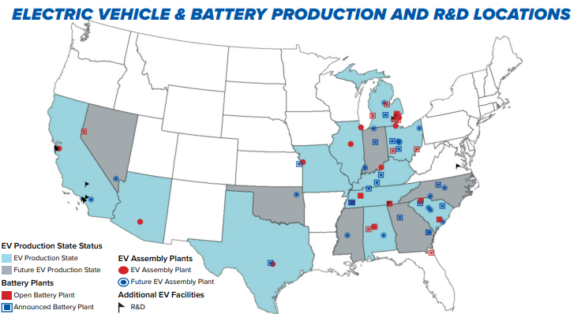
The Future Is Electric
With the right complementary policies in place, the auto industry is poised to accept the challenge of driving EV purchases to between 40 and 50 percent of new vehicle sales by the end of the decade.
-Auto Innovators (Aug. 5, 2021)
$110 Billion in U.S. Investment by automakers and battery partners since 2017
$1.2 Trillion Global EV Investment by 2030
Battery manufacturing capacity set to grow 424% by 2025
https://www.autosinnovate.org/posts/communications/The%20Future%20Is%20Electric%20Infographic

Slide 4
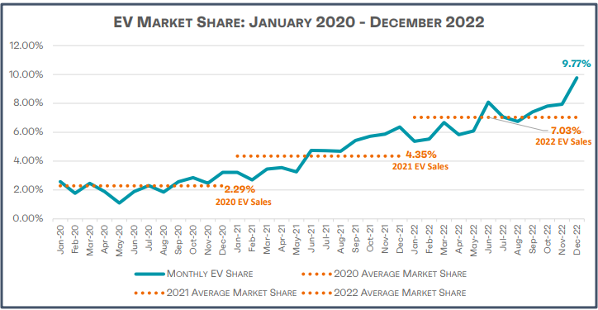
Growing EV Sales
https://www.autosinnovate.org/posts/papers-reports/get-connected-2022-q4

Slide 5
Possible Combined U.S. EV Requirement
Biden Executive Order goal (14037)

Slide 6
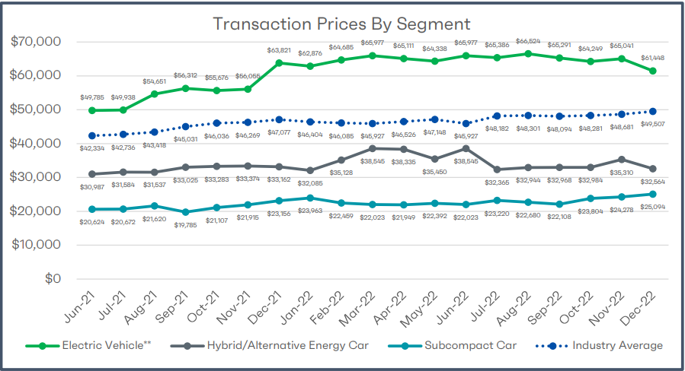
Vehicle Affordability
https://www.autosinnovate.org/posts/papers-reports/get-connected-2022-q4

Slide 7
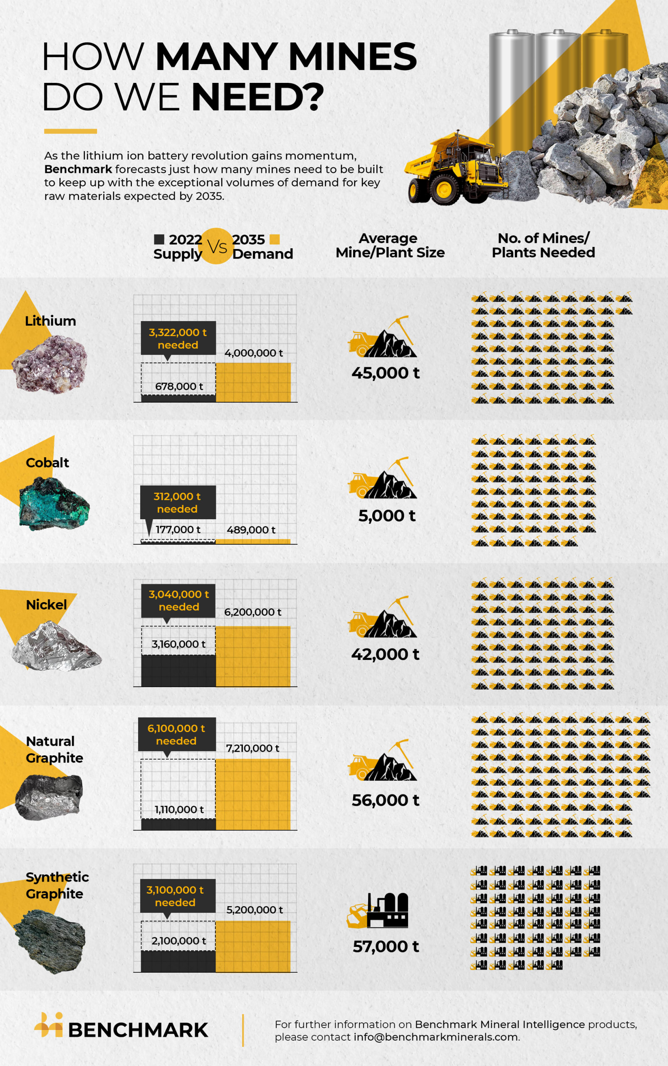
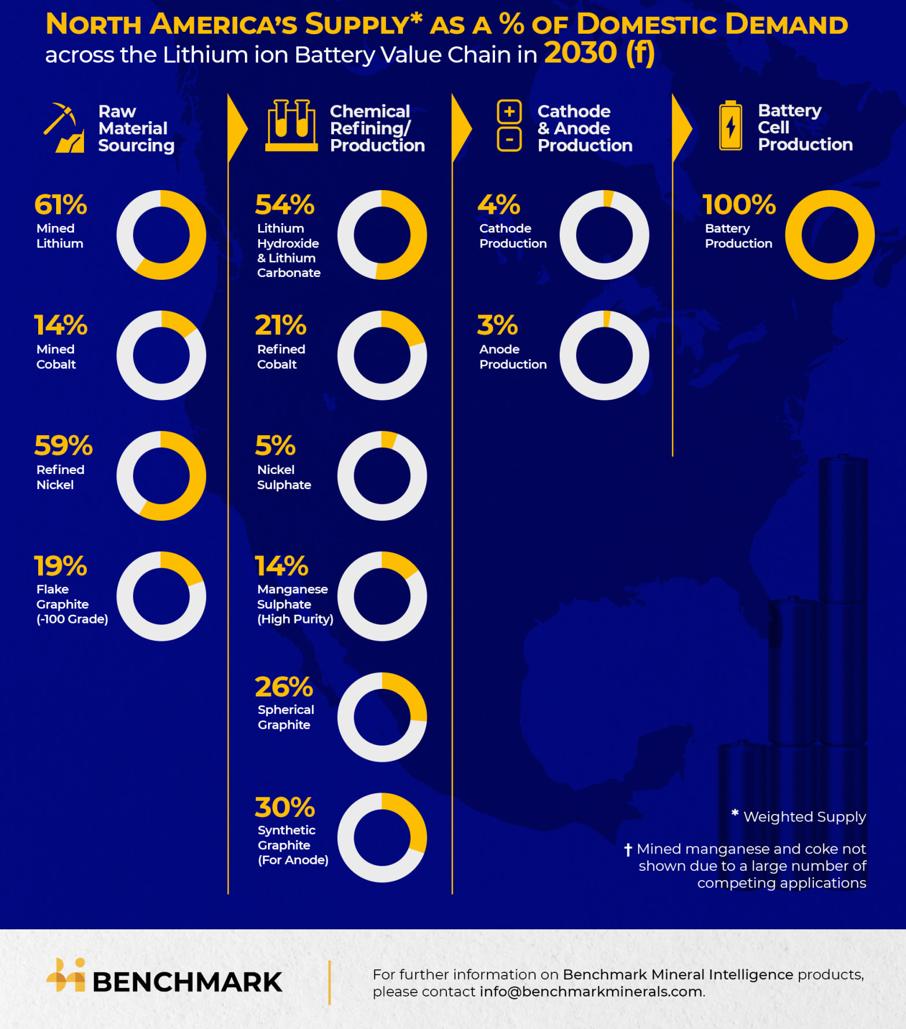
Supply Chain – Still A Challenge
Benchmark Minerals Intelligence, “Can North America Build a Battery Supply Chain?” (Nov. 17, 2022)
https://source.benchmarkminerals.com/article/can-north-america-build-a-battery-supply-chain
Benchmark Minerals Intelligence, “More than 300 new mines required to meet battery demand by 2035”
https://source.benchmarkminerals.com/article/more-than-300-new-mines-required-to-meet-battery-demand-by-2035
Notes:
Quick perspective on supply chains
Benchmark Minerals Intelligence projects that 100% of N. American demand for battery cells can be met locally, but raw material sourcing, chemical refining, and active material production are projected to be challenges.
Only 3% of the demand for anodes and cathodes is expected to be met with domestic supply by the end of the decade
Setting aside whether the supply chain can be localized, Benchmark Minerals also projects that globally, over 300 new, additional mines will be needed to meet raw materials needs by 2035
Lithium requirements = 74 new lithium mines (45K tonnes)
Without recycling = 62 new cobalt mins of (5,000 Tonnes)
Since mines take at least five years to build these mines will need to be in operation by 2033, “That’s around 59 lithium mines up and running in just over 10 years,”

Slide 8
IRA Supply Chain Incentive
Advanced Manufacturing Production Credit – Section 13502 (45X)
Provides credits to those who produce materials used for clean energy production in trade or business
Materials eligible for such credits as outlined in this section are those used to produce: Electrode Active Materials
Battery Cells ($35 kWh)
Battery Modules ($10-45 kWh)
Applicable Critical Minerals (10 percent of costs incurred)
Plus: Solar Modules, Wind Turbines and Offshore Vessels, Structural Fasteners, etc…
Includes phase-outs on these credits beginning in 2030, which impose a reduction of 25 percent per year between 2030 and 2033, when the credit becomes completely phased out (however, the phase-out does not apply to the credits for critical minerals).

Slide 9
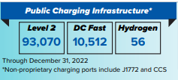
Refueling Infrastructure
Alternative Fuel Refueling Property Credit (30C)
    Extends the federal income tax credit on the cost of any qualified alternative fuel vehicle refueling property through 2032 (85 % ethanol, natural gas, CNG, LNG, LPG, hydrogen, biodiesel, electricity).
    Six percent base rate and thirty percent bonus rate (prevailing wage requirements) and otherwise 30 percent regardless.
    Allowable on costs up to $100,000 of the cost of each alternative refueling property at a location.
  Bipartisan Infrastructure bill
  $5 billion in Formula funding for States over 5-years
  $2.5 billion in competitive grant funding
Notes:
Lifts the one project per property limit and also extends the tax credit to bidirectional charging, which allows for electricity to flow to and from the grid or home and the connected electric vehicle.
Beginning in 2023, the credit will only be available for projects located in certain designated geographies (low income census tracts or non-urban areas).

Slide 10
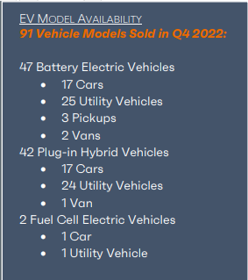
Summary of Recent Treasury Guidance
30D tax credit is effectively a consumer tax credit wrapped in industrial policy.
We are currently at the “high water mark” for number of eligible vehicles
  43% - or 39 out of 91 EVs for sale in the U.S. are currently eligible for $7,500 credit

Slide 11
Summary of Recent Treasury Guidance (continued)
It remains to be seen how many vehicles will qualify for 30D tax credit (100%, 50%, or Zero) once content requirements kick-in on April 18, 2023.
Automakers providing IRS with monthly VIN reports to confirm 30D eligibility
Centralized FuelEconomy.gov website will assist consumers and dealers
60-Day comment period will allow for potential changes before finalization
No question that various programs in the Inflation Reduction Act will help to bolster domestic supply chains and battery production – but this all takes time.

Slide 12
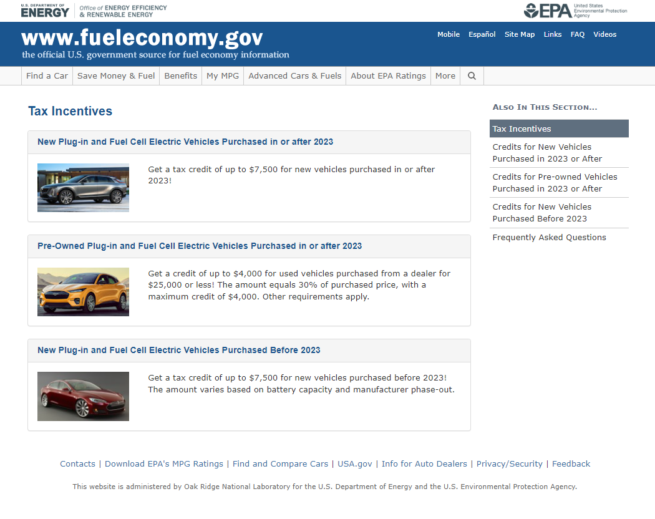
Federal Government Website for Eligible Vehicles
https://fueleconomy.gov/feg/taxcenter.shtml

Slide 13
Dave Schwietert
dschwietert@autosinnovate.org

