Slide 1
What is the
Federal Reserve?
Q&A with a
Fed Ambassador

Slide 2
Why is the Federal Reserve important to YOU?

Slide 3
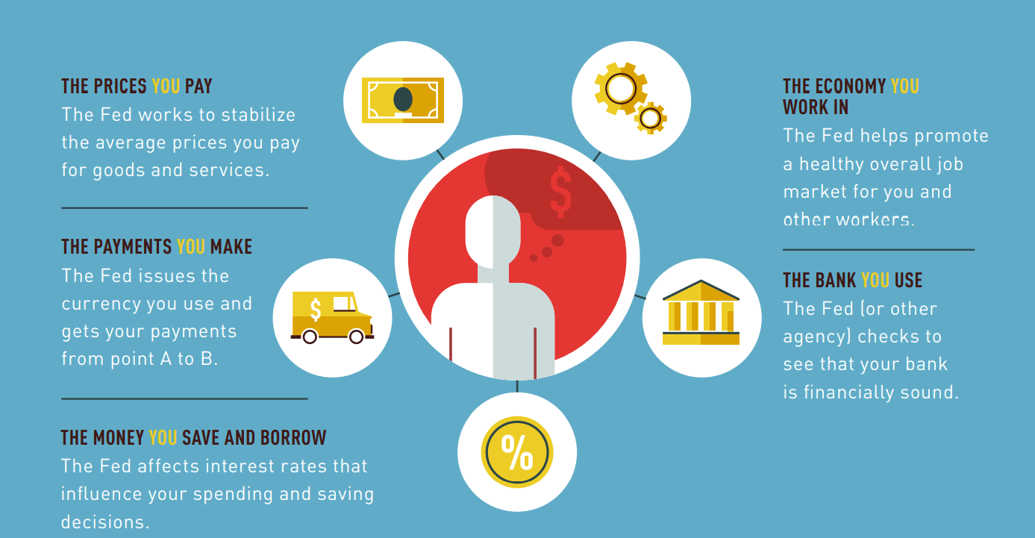

Slide 4
What We Will Cover Today
Main roles of the Federal Reserve and what we are working on now
Money Museum
Career information

Slide 5
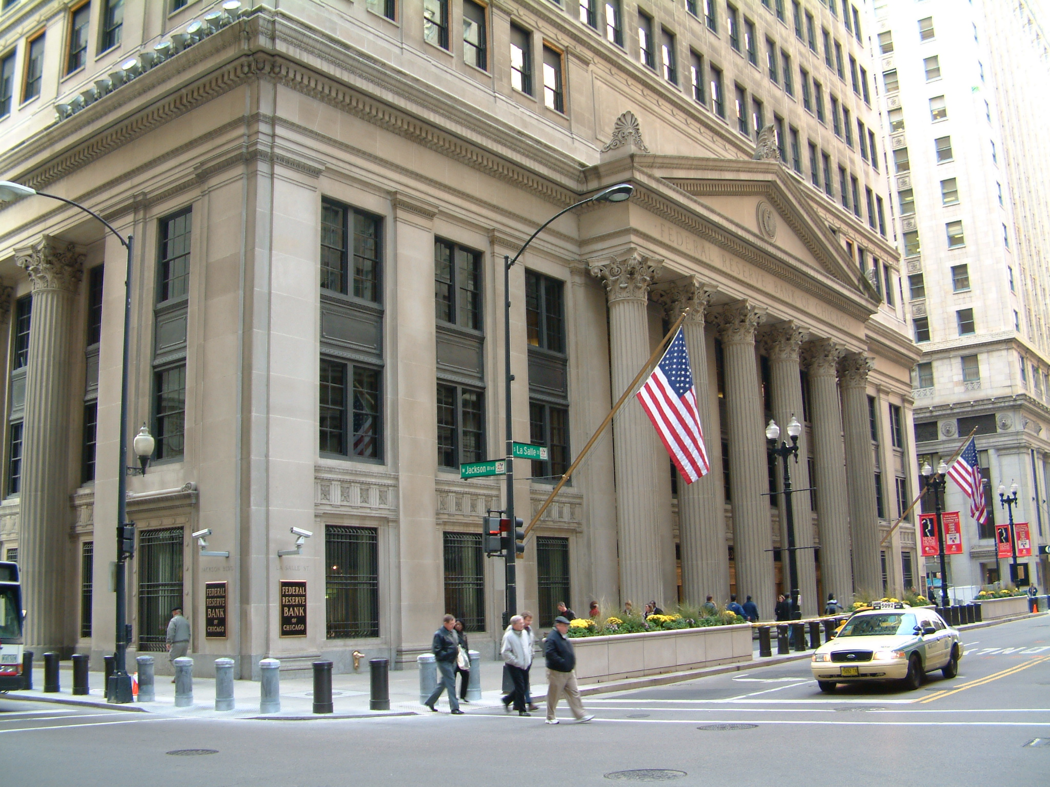
Notes:
This is the Federal Reserve Bank of Chicago – it is located downtown in the financial district of Chicago.
The Chicago Federal Reserve is one of 12 Banks that make up the Federal Reserve system.

Slide 6
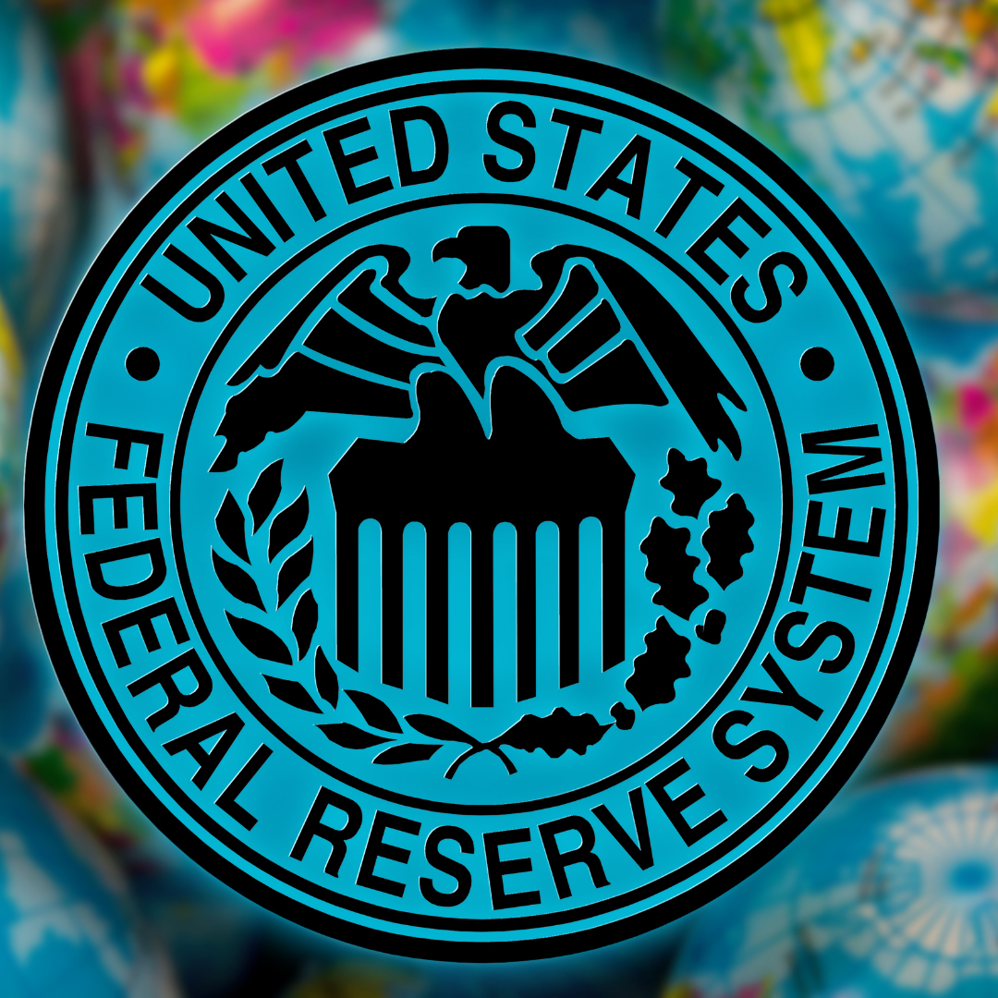
What is the Federal Reserve?
Central bank of the United States
“Bank of banks”
Chicago Fed is one of 12 Federal Reserve Banks that make up the Federal Reserve System
Notes:
The Federal Reserve is the independent central bank of the USA.
We are the Bank of the US Government and the “Bank of banks.” Individuals do not have accounts here, but banks do.

Slide 7
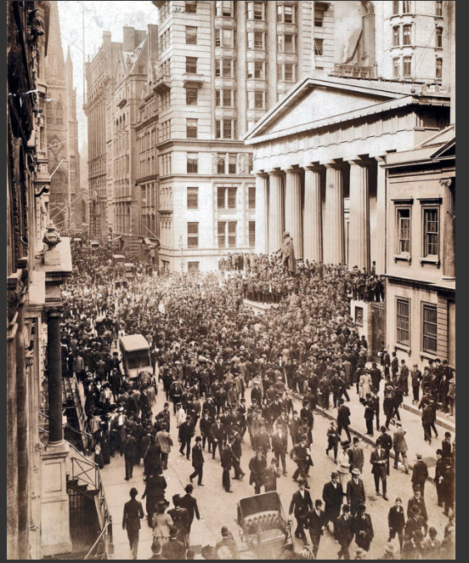
Early 1900s:
Runs on banks
Bank panics
1913:
Notes:
How were we founded? Congress passed the Federal Reserve Act in 1913 to create the Central Bank after there had been a series of bank panics and recessions. This was a way to stabilize the banks and to stabilize the economy.
The photo we see here is from a “run” on a bank in 1907 where there are many people outside of a bank on the sidewalk trying to get their money out, all at once. This created a problem because banks typically only have a fraction of their money on hand, while the rest is loaned out for profit. Once one bank is mistrusted, it can cause a ripple effect and the run on one bank can lead to a “bank panic” where everyone tries to withdraw their money from banks. This is what happened in 1907, here, and had been happening frequently in the early 1900s.
Without a Central Bank, there was no way to quickly change the money supply in response to the demand.
One of the important functions of central bank is to act quickly as a lender to banks when they need it. The Central Bank is called “lender of last resort.”
(Starting in 1933, another organization, the Federal Deposit Insurance Corporation or the FDIC, insures the money you put in a bank so that you will always be able to withdraw it, even if a bank closes.)

Slide 8
Early 1900s:
Runs on banks
Bank panics
1913:
Notes:
How were we founded? Congress passed the Federal Reserve Act in 1913 to create the Central Bank after there had been a series of bank panics and recessions. This was a way to stabilize the banks and to stabilize the economy.
The photo we see here is from a “run” on a bank in 1907 where there are many people outside of a bank on the sidewalk trying to get their money out, all at once. This created a problem because banks typically only have a fraction of their money on hand, while the rest is loaned out for profit. Once one bank is mistrusted, it can cause a ripple effect and the run on one bank can lead to a “bank panic” where everyone tries to withdraw their money from banks. This is what happened in 1907, here, and had been happening frequently in the early 1900s.
Without a Central Bank, there was no way to quickly change the money supply in response to the demand.
One of the important functions of central bank is to act quickly as a lender to banks when they need it. The Central Bank is called “lender of last resort.”
(Starting in 1933, another organization, the Federal Deposit Insurance Corporation or the FDIC, insures the money you put in a bank so that you will always be able to withdraw it, even if a bank closes.)

Slide 9
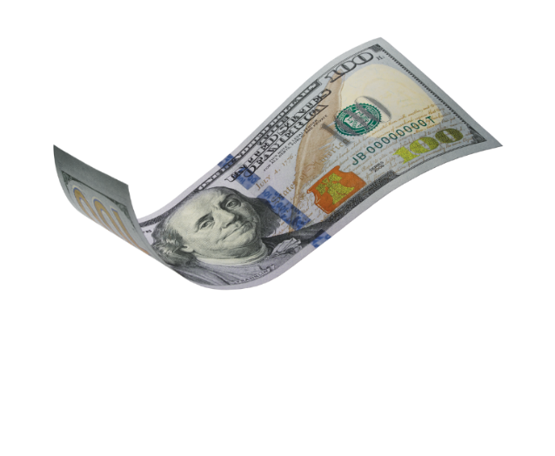
Let’s talk about banking! Q: As a customer, what would you would most like to do today if you went to a bank?
Please respond A, B, or C in the chat box.
Deposit and withdraw cash
B. Save your money and earn interest
C. Get a loan (to start a business, buy a car, buy a house)
Notes:
Now, let’s talk more about banks and how the Federal Reserve is like, but different from, other banks.
First, I have a poll question for you. Please respond in the chat box.
Thanks for your responses. It’s interesting to see how you all are responding!
These three services are all ones that banks give to their customers. To help us understand how the Federal Reserve works, the Federal Reserves provides these services to banks themselves.
It’s a place for banks to deposit and withdraw cash, they can save money (reserves) and earn interest with the Federal Reserve (the Fed gives them a percentage of how much they save) and they can also take out loans from the Federal Reserve.

Slide 10
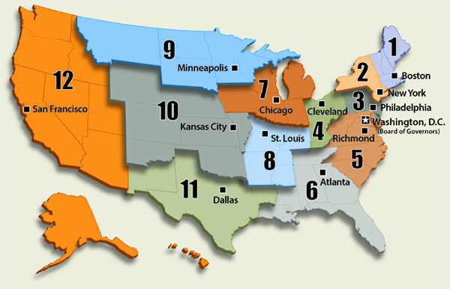
Q: What do you first notice about the map?
Type words or phrases into the chat box. There are no wrong answers.
Notes:
Congress created a central bank where there wouldn’t be one location of power. Different regions report on the economy in different areas to decide what’s best for the country as whole. Our Board of Governors is located in Washington, D.C.
When you look at this map, what do you observe in terms of where the Banks are located? Any word or phrase is fine. There aren’t wrong answers- tell me what you are observing first by typing it into the chat box.
Yes, great--cities. Yes, there’s definitely more banks on the East Coast! That’s because when we were founded in 1913, that was where they considered the hubs of economic activity, and more populations in the east. These cities were located on train lines, so it would make it easier to transport money to them and use them as hubs. We still have the same main 12 banks that we had in 1913.

Slide 11
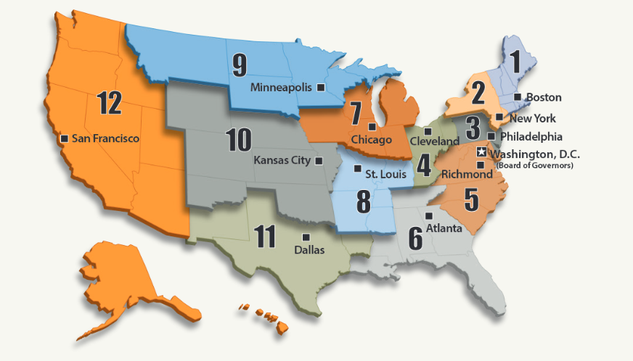
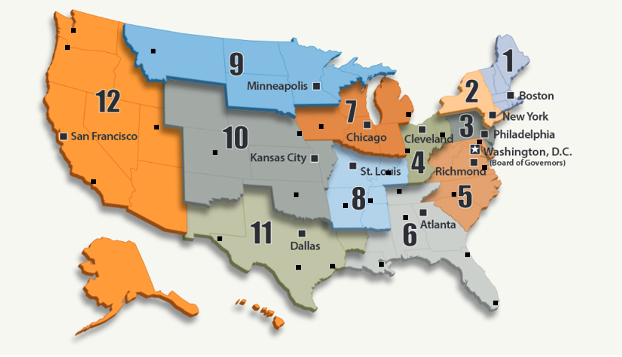
Notes:
We still have the same main 12 banks that we had in 1913. However, now, branches have been added to help out the banks that have more land to cover. So for San Francisco, for example, even though it covers a really wide area, it has LA, Phoenix, Portland, Salt Lake City and Seattle as branches—all part of the SF Fed, in addition to the SF location.
In Chicago, our area has an office in Des Moines, IO and a branch in Detroit in addition to our location in Chicago.

Slide 12
Federal Reserve: Independent Within the Government
Federal
Independent
Located in Washington, DC
Notes:
The Federal Reserve is independent within the government.
The President of the United States chooses the Board of Governors in Washington DC. Those selections for the Board are approved by Senate.
But the 12 Reserve Banks are independent, and the Presidents of the 12 Banks are not chosen by the Executive office but are chosen by the Boards of our individual Banks. That means that I am a “Bank” employee and I am not considered a Federal employee.
We’ll get into the Federal Open Market Committee a bit later in the presentation.

Slide 13
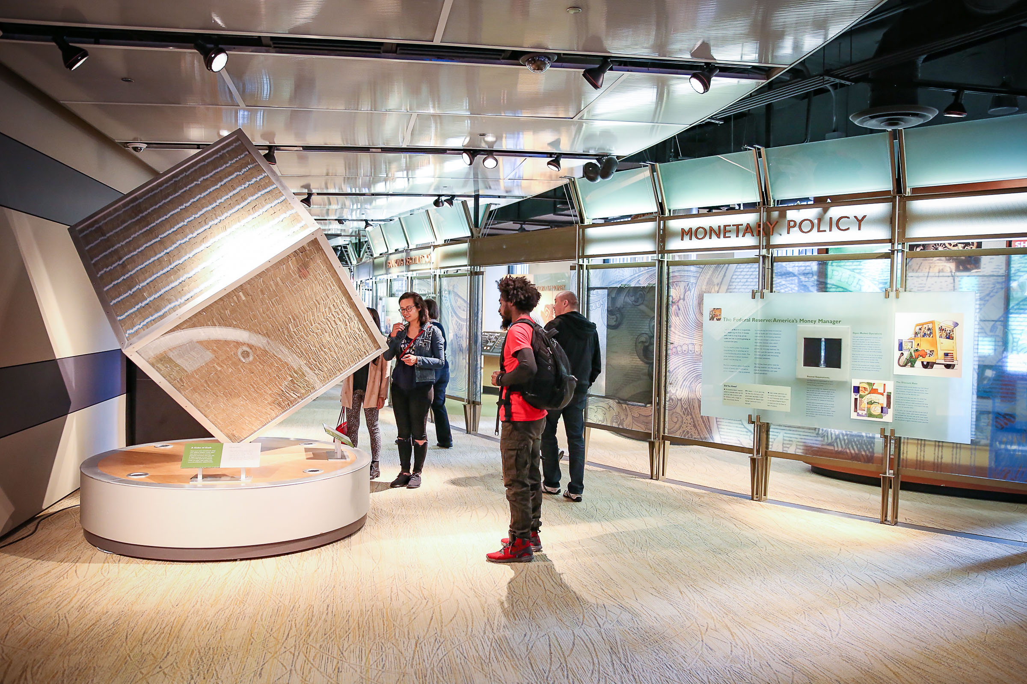
Roles of the Federal Reserve
Payment Services
Bank for banks
Keeping banks safe
Supervision and Regulation
Growing the economy
Monetary Policy
1
Notes:
We will be talking about three main roles today.
Our job is broken up into three main categories:
Payment services, conducting bank oversight, and influencing the growth of the U.S. economy, or what we call monetary policy. Let’s start with payment services.

Slide 14
Payment Services
Notes:
Let’s look a little more this first role: payment services. The Federal Reserve works on electronic payments for banks, check collection, and cash services.

Slide 15
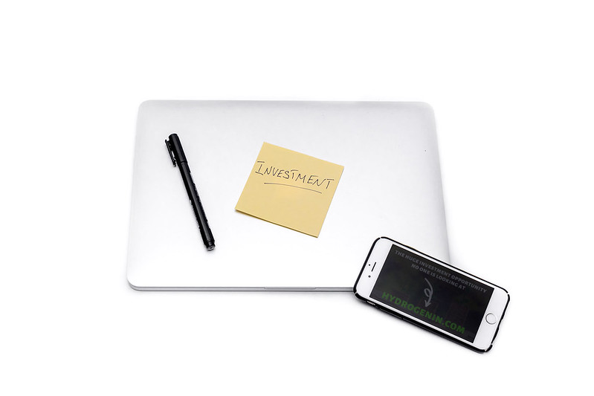
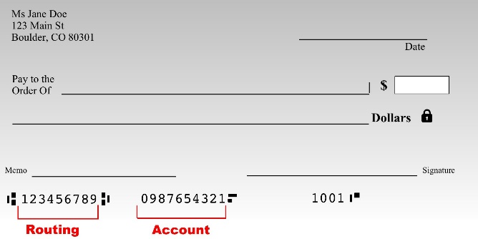
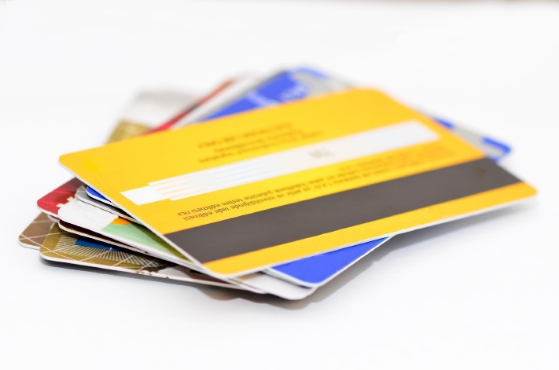
Q: Which of these would you most like to use to pay for things? TypaymentsPaymthese are you most likely to use on a typical day?
Type your answer in the chat box.
A.
B.
C.
D.
1
Notes:
OK, let’s talk about payments. But first, a poll. Which of these are you most likely to use on a given day?
I’m not surprised that no one mentioned checks.
That is a trend we’ve been noticing throughout the classes we’ve been working with—and it is true within the US too.
We are still using a lot of cash and credit or debit cards, but as a country we are using less checks than before. That means that the Federal Reserve has decreased the amount of people assigned to work on processing checks.

Slide 16
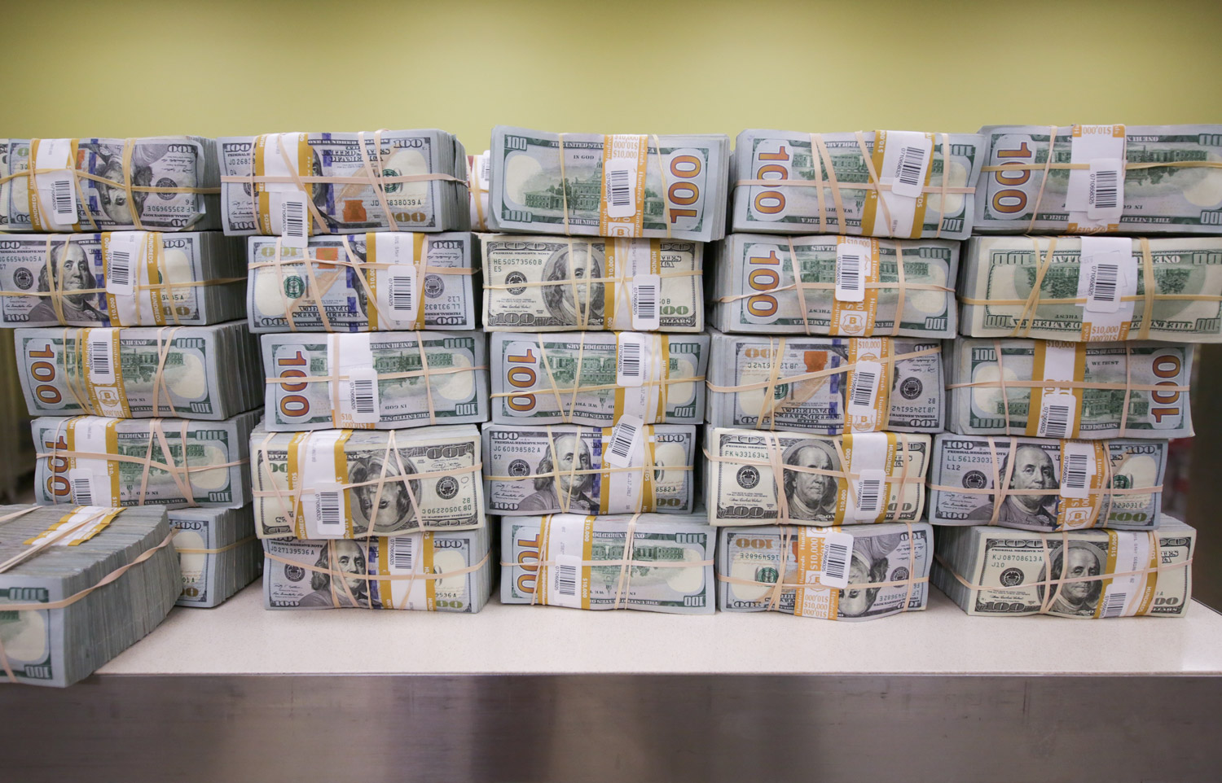
Notes:
I know that many of you mentioned you use cash. We’re going to now look at how the Fed deals with cash as the Bank for banks.
When banks have excess cash, they deposit it at their Federal Reserve bank or branch. They arrive in armored trucks to our doors.
Between both Chicago and Detroit cash processing centers, we have been processing130 million dollars/day.

Slide 17
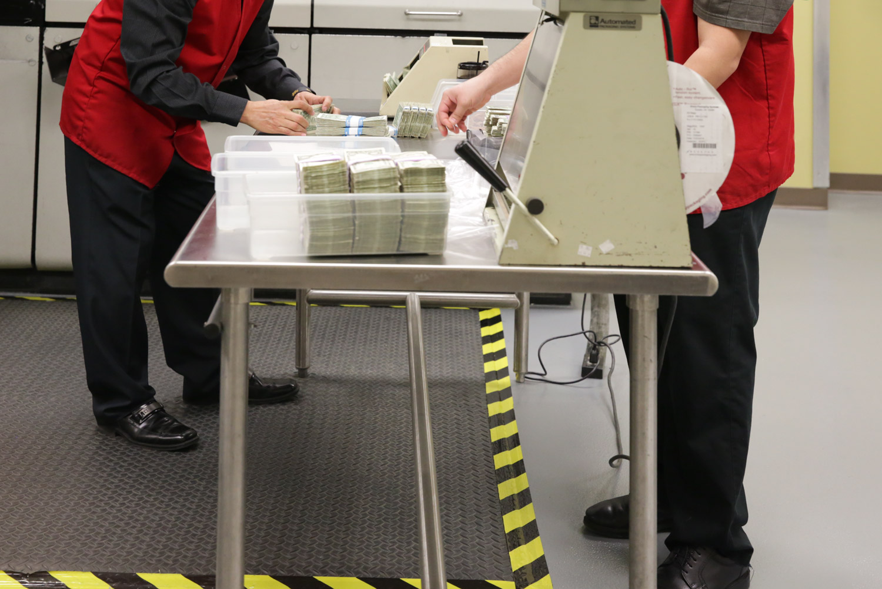
Notes:
First, our workers count the bills to make sure that it’s the amount the bank said it was.

Slide 18
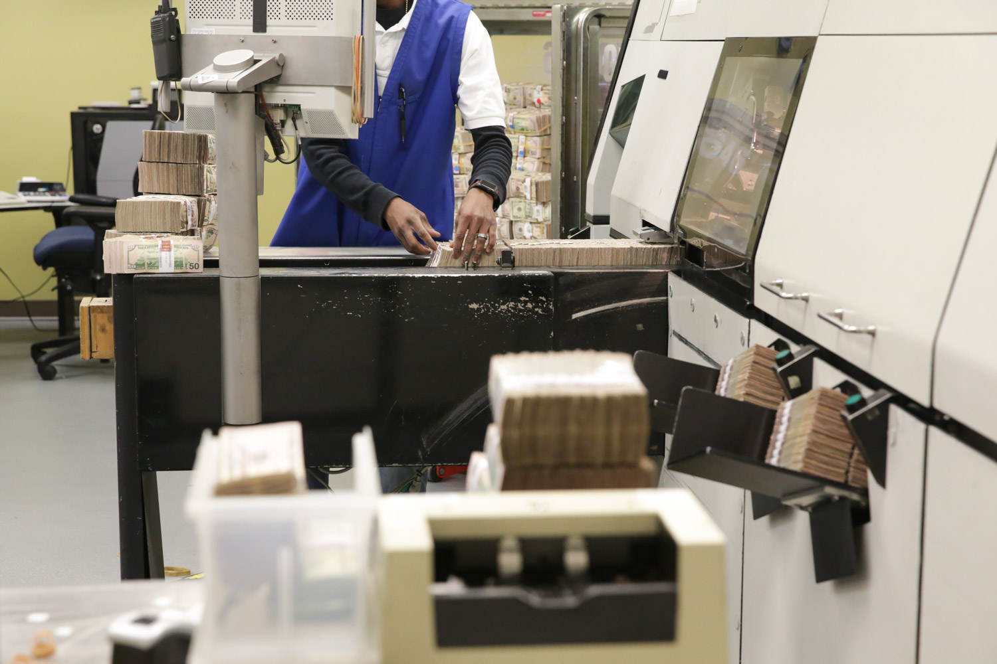
Notes:
Then we run the cash through high-processing machines so that we can separate out the cash that is fit to be circulated.

Slide 19
What factors might make a bill “unfit” for circulation?
Type the letter to your answer in the chat box.
Worn out, old
Torn
Written on
All of the above
Notes:
Then we run the cash through high-processing machines so that we can separate out the cash that is fit to be circulated.
What factors might make a bill “unfit” for circulation?
You’re right if you said “all of the above.”
With the ones that are worn out, old, torn, or written on, we go ahead and destroy those.

Slide 20
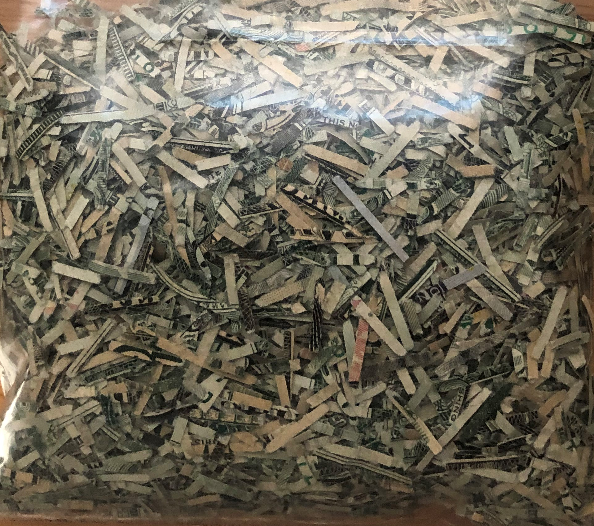
Notes:
Here’s what the shredded bills look like.
In 2020, we’ve been shredding around 4.8 million dollars/day out of the 130 million/day that we process.
Don’t worry – although that may sound like a lot-- we replace the shredded money with new money that we order from the Treasury Department. It is printed in Washington DC, and in Fort Worth, TX at the Bureau of Engraving and Printing.
We store all the cash in the vault, which is a storage room, so that the new cash is ready to go.

Slide 21
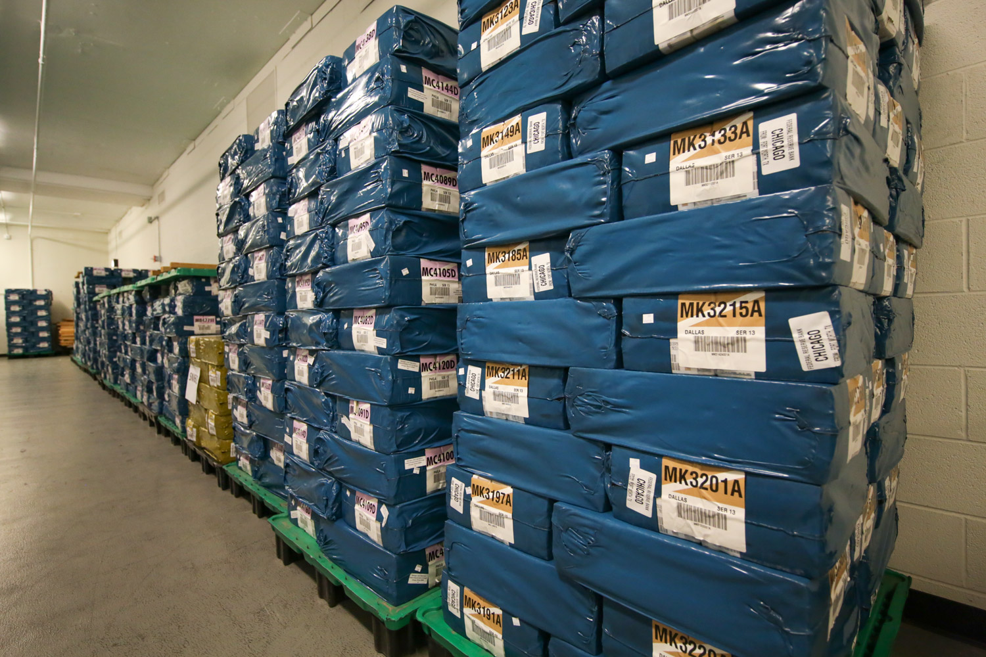
Notes:
This is what the new money looks like from the Treasury Department/Bureau of Engraving and Printing
It is shrink wrapped and in the vault there.
It looks a little different than what I first imagined the vault might look like – stacks of cash!

Slide 22
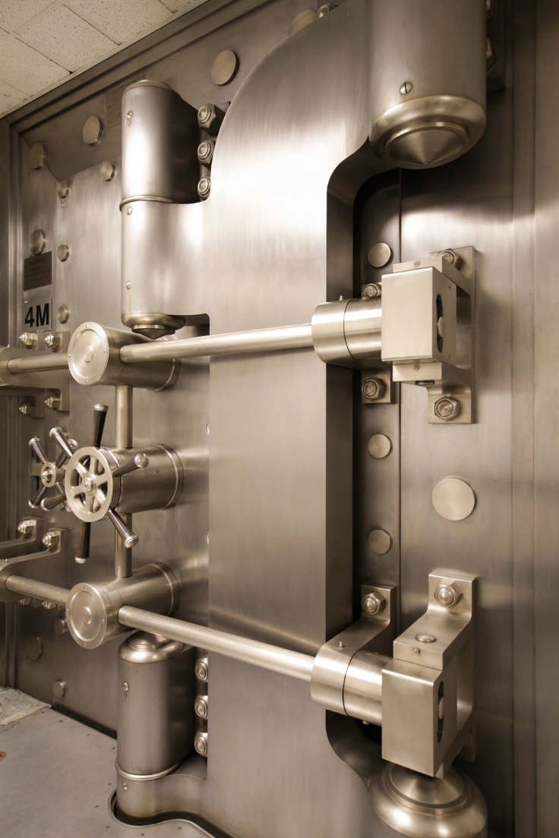
Q: How much money is stored in the Chicago Federal Reserve vault?
Please respond A, B, or C in the chat box.
Millions
B. Billions
C. Trillions
B. Billions!
Notes:
OK, now time for another poll: how much money is stored in our vaults?
If you said in the billions, that’s right. The number fluctuates, but it is in the billions. It is currently around 9 billion right now.
This is the door to the vault.
We need to keep an adequate reserve so that when the banks need to withdraw currency for their customers, we have it on hand.

Slide 23
Q: How much money is stored in the Chicago Federal Reserve vault?
B. Billions!
Notes:
If you said in the billions, that’s right. The number fluctuates, but it is in the billions. It is currently around 9 billion right now.
This is the door to the vault.
We need to keep an adequate reserve so that when the banks need to withdraw currency for their customers, we have it on hand.

Slide 24
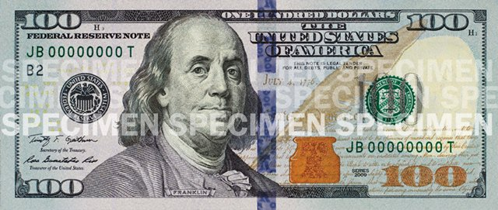
What details stand out to you on this bill to help determine if it is real?
Type words or phrases in the chat box.
Notes:
Another job in the cash department, besides separating out the unfit bills, is to separate out the counterfeit bills and send them to the secret service.
On average we are finding about 17 counterfeit bills a day.
The machine scans for every security feature.
Let’s look at a couple more…

Slide 25
Watermark
Security ribbon
Color-changing ink
Notes:
Another job in the cash department, besides separating out the unfit bills, is to separate out the counterfeit bills and send them to the secret service.
On average we are finding about 17 counterfeit bills a day.
The machine scans for every security feature.
What security features stand out to you? (Type into the chat box.)
Yes, the blue line is a 3D image. When you look at it straight on, it shows the number 100 multiple times. Then when you tilt it, you see the number 100 morph into liberty bells.
The watermark you can see if you shine a light behind the bill. In this case, it is another image of Benjamin Franklin. It is an image that is pressed into the fabric of the paper.
You can also see color-changing ink. This is on the number “100” in the lower righthand corner as well as the liberty bell image in the ink pot. When you look at it straight on, the color is copper-orange. When you tilt the bill, the color is green.
Another fun feature, that I’ve circled in red, is that B2 number. The B2 number represents which of the banks the bill was issued from – in this case the Federal Reserve Bank of New York. If it said G7, that would mean it was from the 7th district, the Federal Reserve Bank of Chicago.
We’ve been talking now a lot about being the “bank for banks” and working with cash.
Let’s turn now to talk about how we are also conduct bank oversight—we are testing the Banks to make sure that they are healthy.

Slide 26
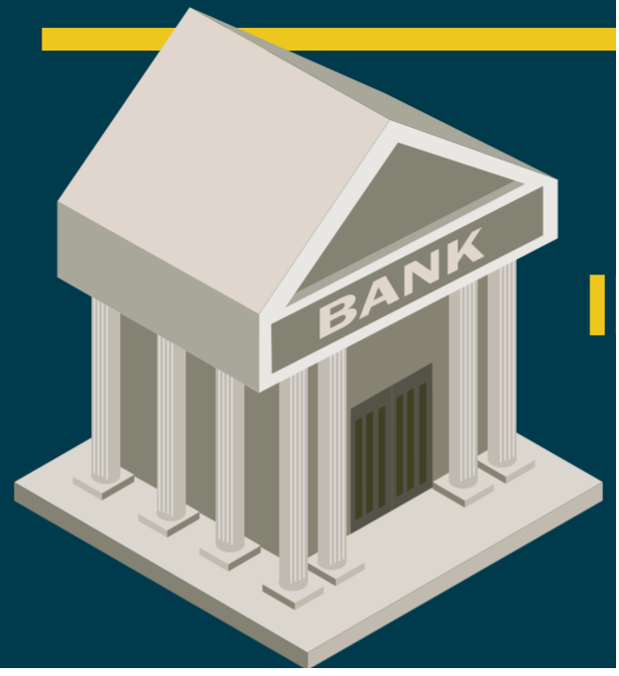
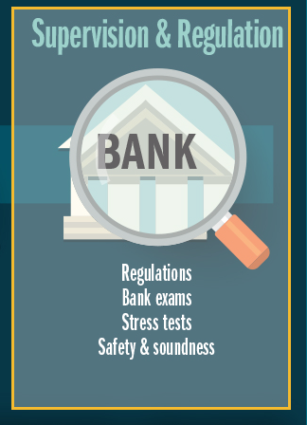
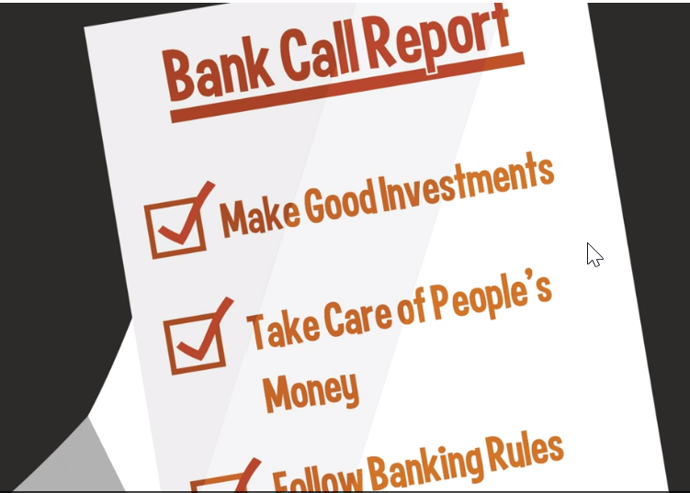
Conducting Bank Oversight
Notes:
The single largest group of employees at the Chicago Fed works in this area (about 1/3 of staff.) 500 out of 1,500 people who work for the Chicago Fed are in this department.
The Federal Reserve are like referees, making sure the banks are following the rules.
What are some things that you might want to find out as a bank examiner?
Are deposits safe?
Is the bank making good investments with people’s money, and taking care of it?
If the bank gets a poor rating, then they get guidance, and then if they do not make corrections the bank may need to close.
The FDIC insures that whatever money you had in the bank is still available to you, though, up to $250,000.
Our job is to protect consumers
They look to see that the bank is judging whether to give out loans to people based on the person’s ability to repay the loan, not based on their religion, race, neighborhood, or any other factors.
They also make sure the bank is posting the correct interest rates– and people can file complaints to the Federal Reserve if something is amiss.
We are one financial regulator among other agencies who also perform bank examinations including:
Office of the Comptroller of the Currency (OCC)
Federal Deposit Insurance Corporation (FDIC)
We supervise and regulate:
Bank-holding companies
State-chartered member banks of the Federal Reserve
Foreign branches of member banks
Foreign banks operating within the United States

Slide 27
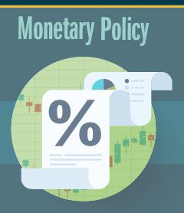
Influencing the Growth of the Economy
Notes:
-Often how you hear about the Fed in the news – changing interest rates
-Dual mandate/goals from Congress in conducting this policy: stable prices and full employment

Slide 28
Dual Mandate from Congress
Stable prices
Full employment
Notes:
Stable prices – the goal is to have prices remain stable so that people can plan and make good financial decisions for their future. Knowing what to expect when it comes to how much things will cost in the future helps people to make better financial decisions.
(The goal of the Fed is for prices to go up at a 2 % rate of inflation, on average. That means if you buy something today for $100, we’d want for it to be around $102 next year. Not $80. Not $200.)
Full employment – the goal is for anyone who wants a job, to be able to have a job.

Slide 29
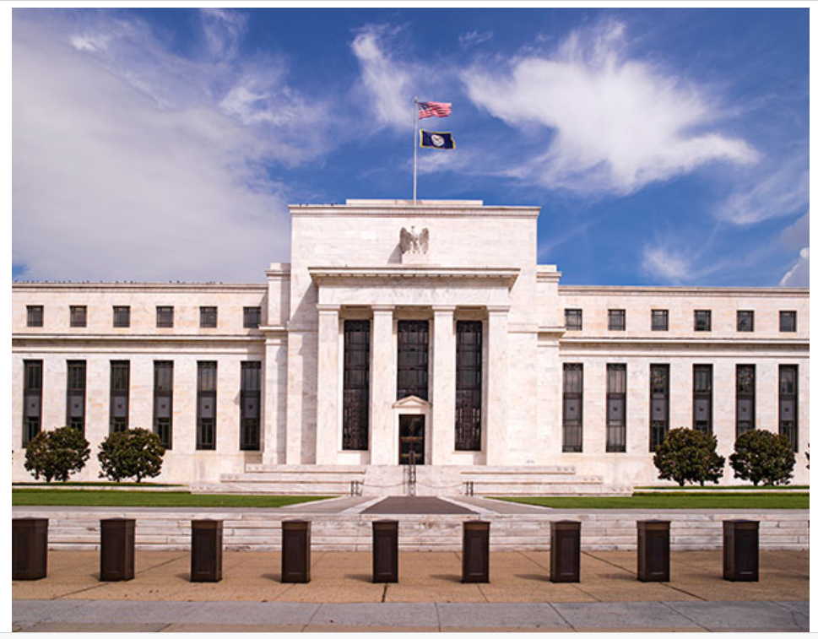
Q: If you were making decisions on monetary policy, what would you be most concerned about?
A. Stable prices
B. Full employment
C. Other

Slide 30
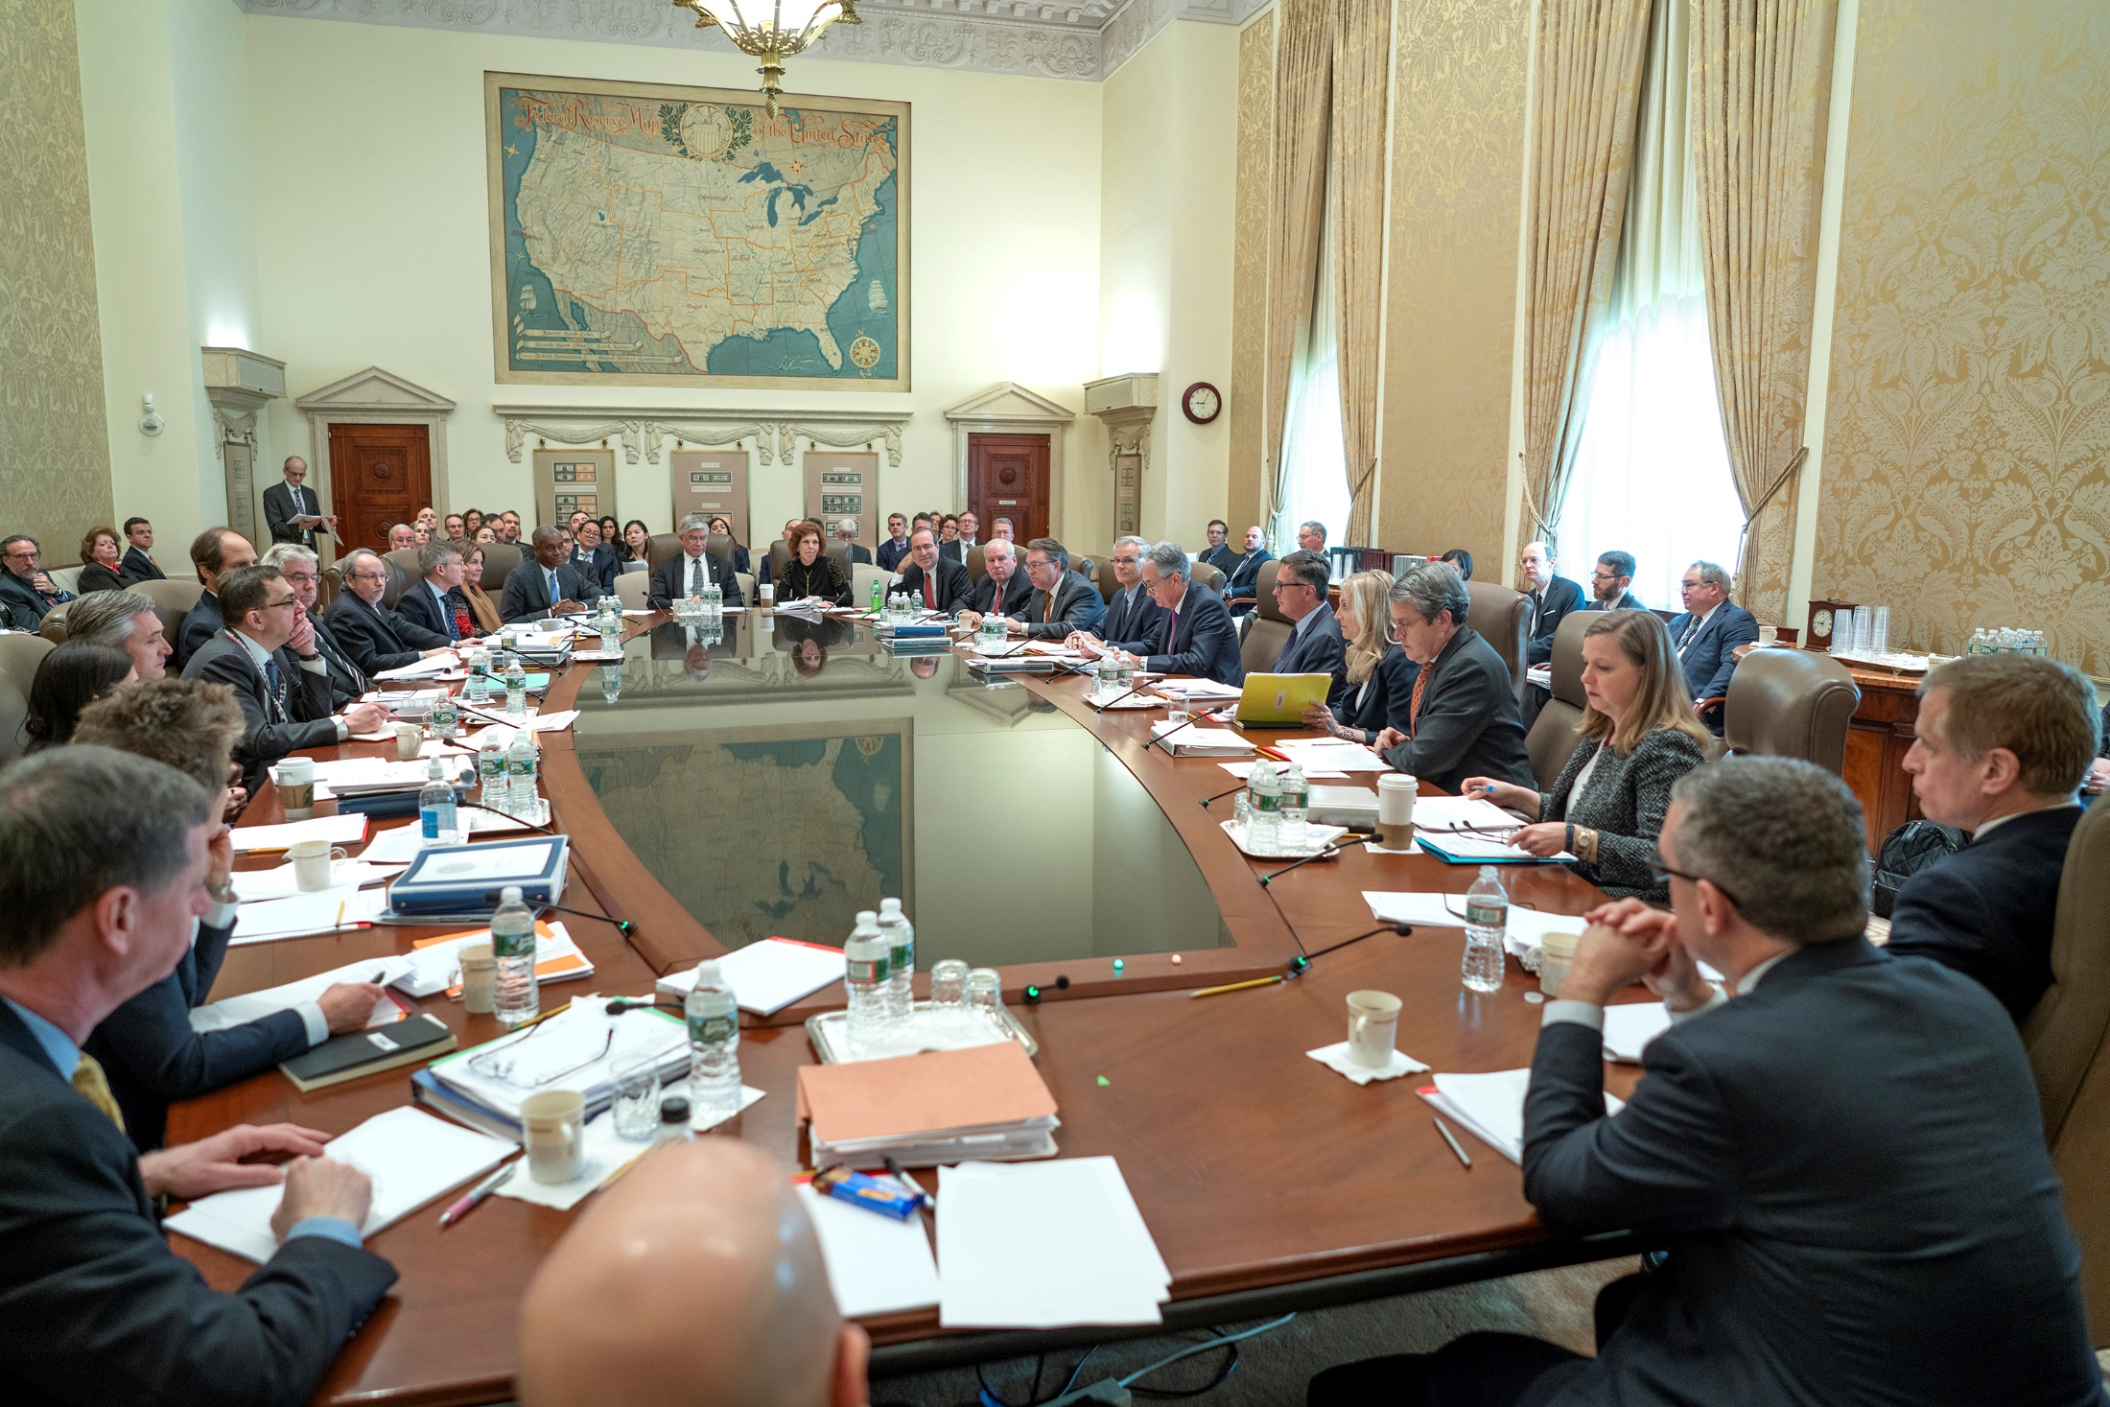
Research Staff
Governors
12 Bank Presidents
Notes:
Then Charlie, our President, travels to Washington DC to meet with the other Bank Presidents, the Governors and then there are also Research Staff in the room.
Everyone at the table from the different regions gives their perspective on the economy, and shares information from their regions.
Then a smaller subset of the people at the table, called the FOMC (Federal Open Market committee) votes on whether to raise interest rates, lower interest rates, or keep them the same.
Other notes:
* Votes to lower, raise, or make no change to the Federal Funds Rate
Most recently since COVID-19 started, they lowered the rate twice in March. Since then, they have maintained that low rate target (0 – 0.25%) https://www.federalreserve.gov/monetarypolicy/openmarket.htm
-Lowering the rate -> incentivizes lending and investing
-Raising the rate -> disincentivizes lending and investing /encourages saving

Slide 31
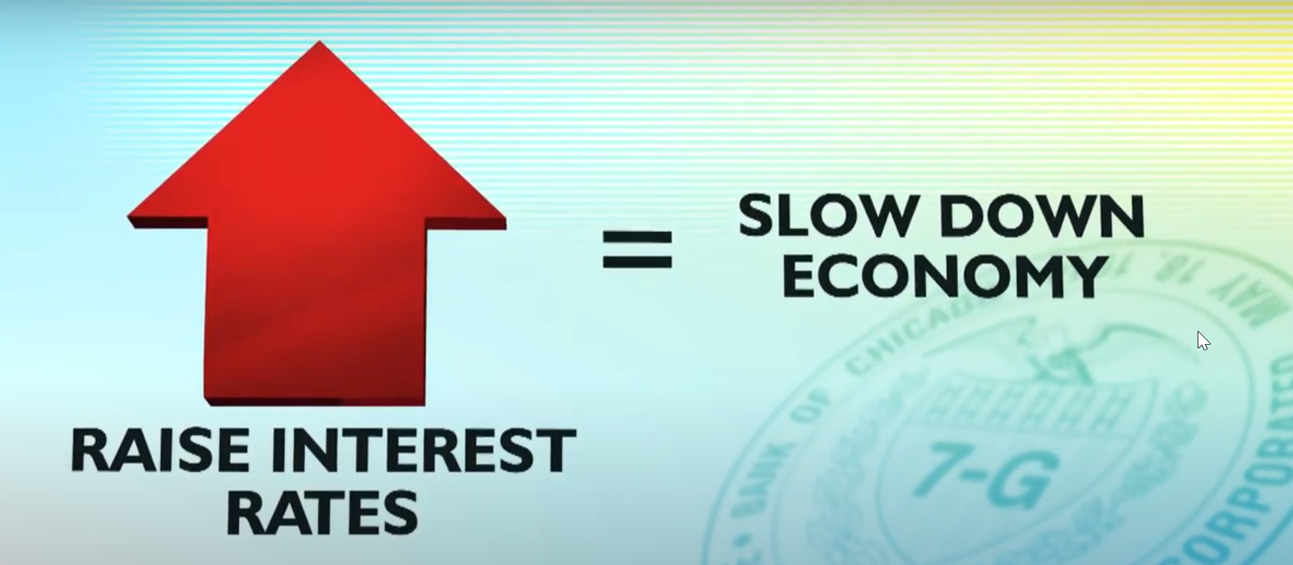
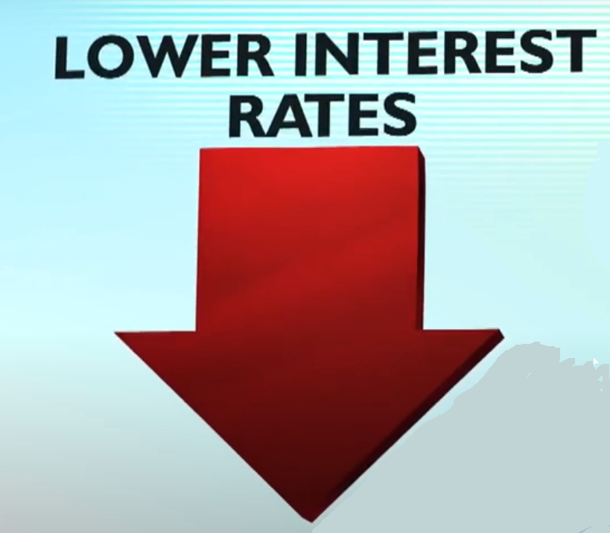
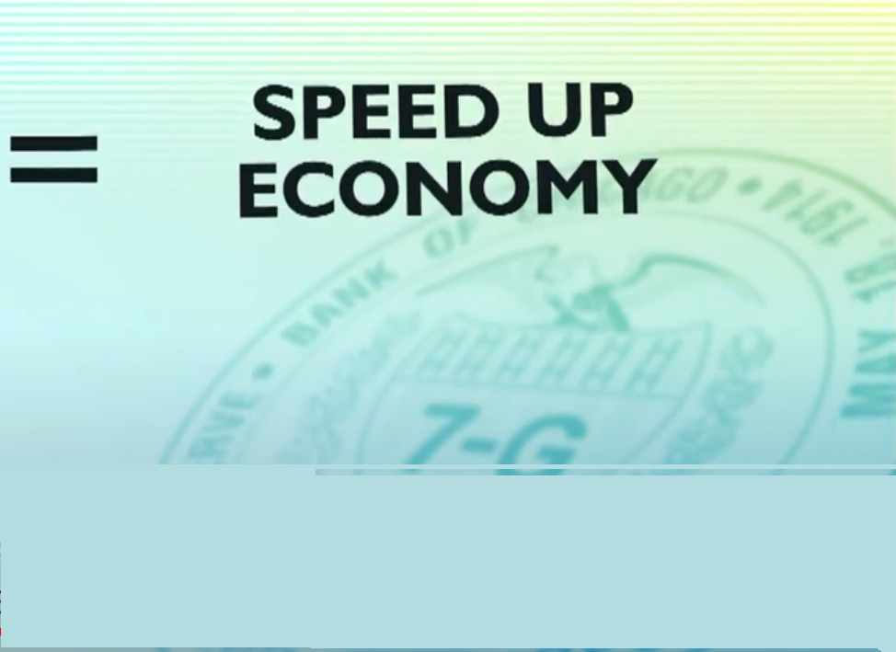
Setting Interest Rates
2
Notes:
-Lowering the rate -> incentivizes lending and investing
-Raising the rate -> disincentivizes lending and investing /encourages saving
Most recently since COVID-19 started, they lowered the rate twice in March. Since then, they have maintained that low rate target (0 – 0.25%) https://www.federalreserve.gov/monetarypolicy/openmarket.htm
-Lowering the rate -> incentivizes lending and investing
-Raising the rate -> disincentivizes lending and investing /encourages saving
OK, now we’ve covered the three main roles I wanted to talk about with you in terms of the work of the Federal Reserve: payment services, bank examinations, and monetary policy.
Let’s turn now to look at what the Federal Reserve is doing in terms of these times during COVID-19.

Slide 32
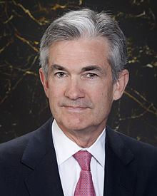
Chair Jerome Powell
Notes:
You also might be hearing Janet Yellen’s name in the news lately. She used to be the Chair of the Federal Reserve before Jerome Powell. She has been nominated to be the Secretary of Treasury under the Biden administration.

Slide 33
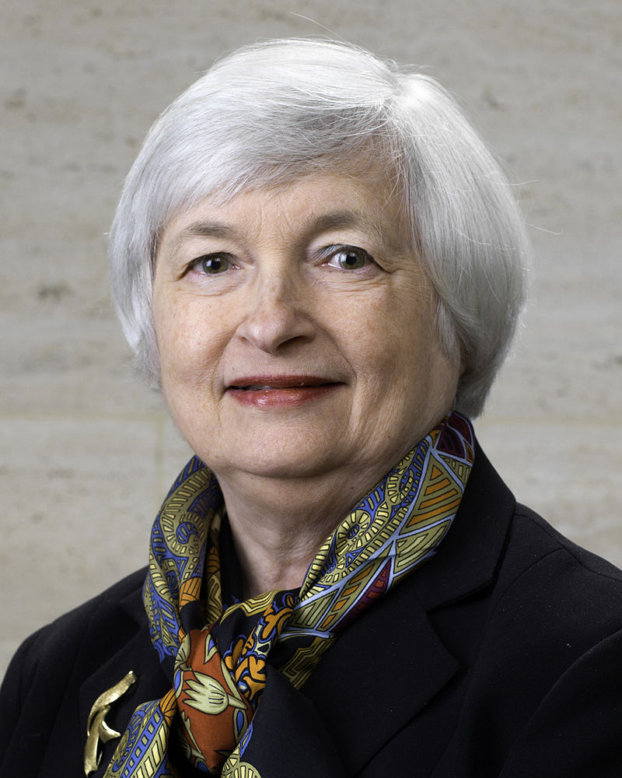
Janet Yellen
Former Chair of the Federal Reserve
Current Treasury Secretary

Slide 34
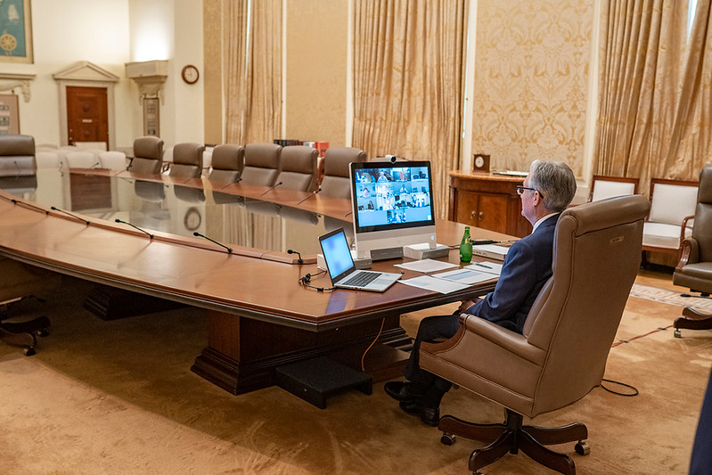
Notes:
This is an example of how the Federal Reserve’s work has changed because of the pandemic.
Federal Open Market Committee (FOMC) participants meet via video conference for a two-day meeting held on June 9-10, 2020.

Slide 35
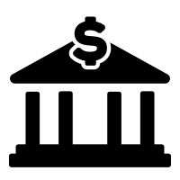
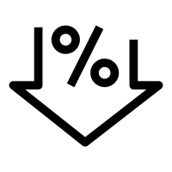
Actions Taken by the Fed
Actions Taken by the Fed
Near-zero interest rates
Supporting financial
markets
Encouraging banks to
lend
Notes:
COVID-19 is both a public health crisis and an economic crisis. What is the Fed doing to help cushion the financial impact?
They’ve set the interest rates to near-zero.
They are encouraging banks to lend– making it easy for banks to take out loans from the Federal Reserve, so that the banks have more liquidity to be able to give out their own loans.
They are also in general supporting financial markets – I think of the Federal Reserve as the plumbers of the financial system. They are making sure that money can flow, and that loans are being given out, to try to support the financial markets.

Slide 36
Questions?

Slide 37
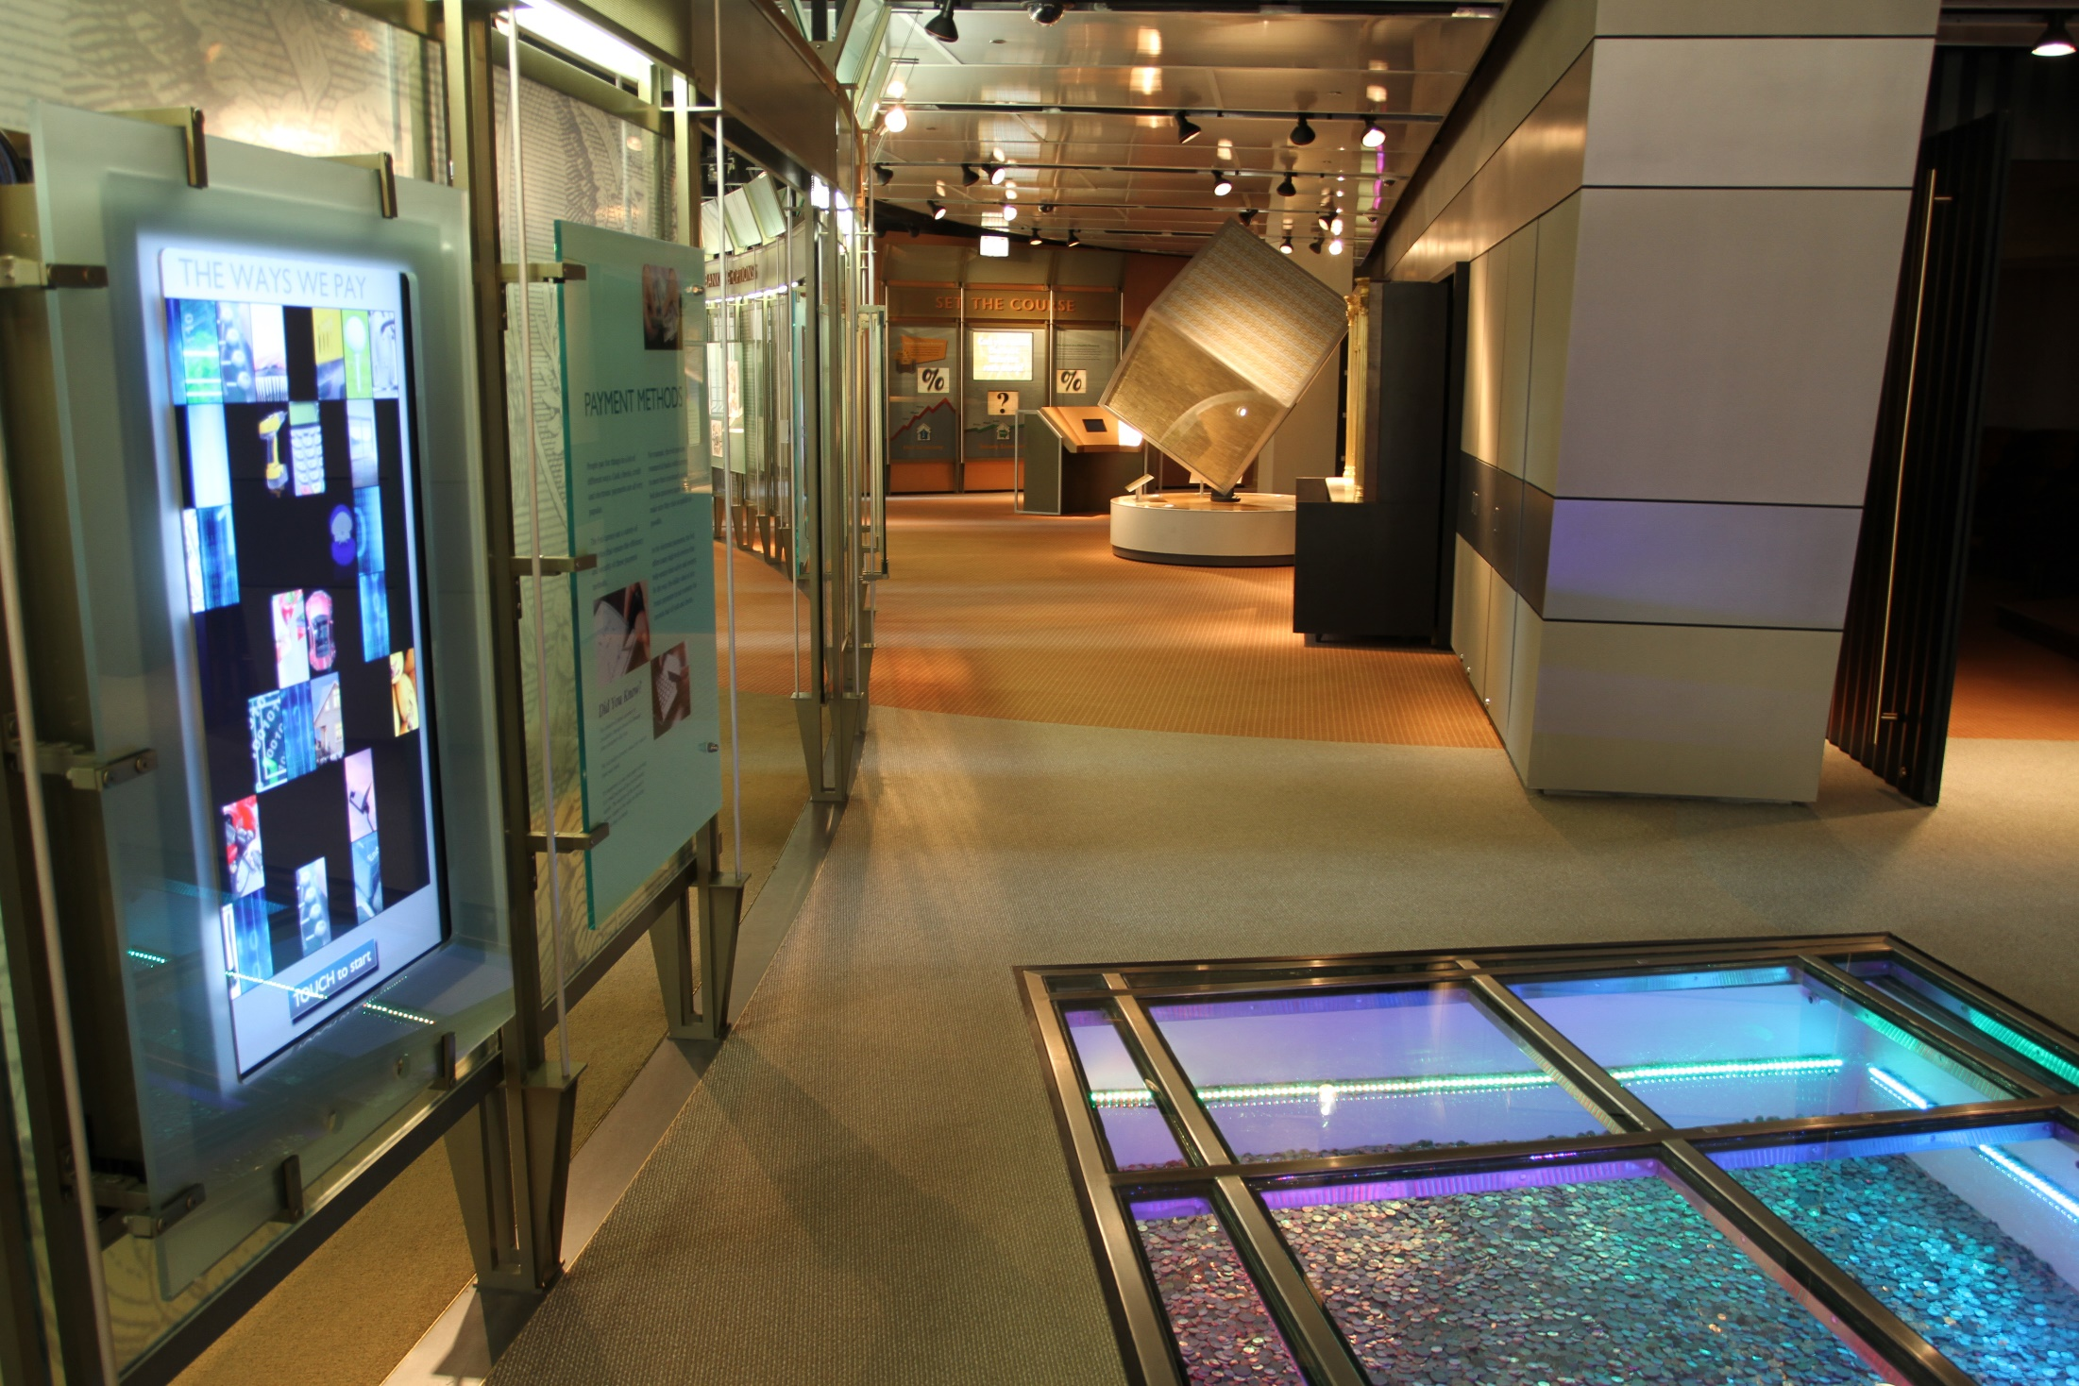
Notes:
First, as a Fed Ambassador I work with visitors to the Federal Reserve at the Money Museum, and I wanted to share a little bit about where I work. Here is the first floor of the building – our Money Museum. The Money Museum is currently closed—so we were glad to have this opportunity to give this presentation to you online.
When you enter, you see exhibits both on the history of money as well as the core functions of the Federal Reserve.
When you first enter, you see a coin pit here that has $50,000 worth of coins. When you walk on it, it lights up different colors.
In the background, we have our cube to show you what a million dollars looks like in ones.

Slide 38
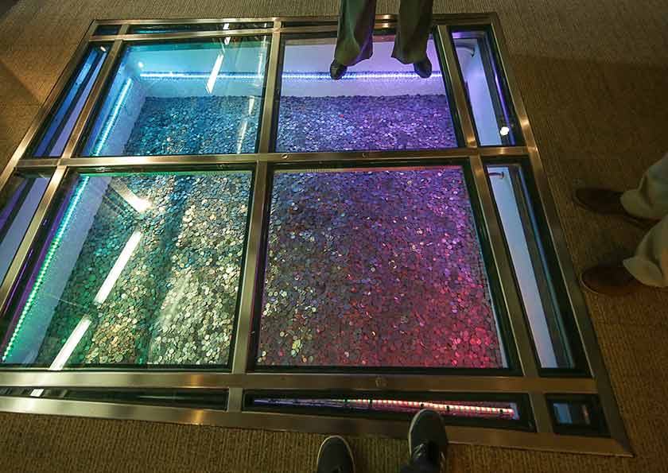
Notes:
There are $50,000 worth of coins here, more close-up.

Slide 39
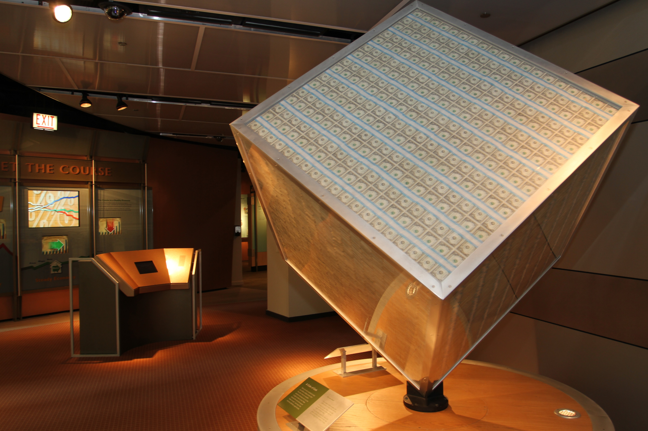
Notes:
Here is a cube in the money museum to show you what a million dollars looks like in ones.
While the first floor of the building is open to the public for the Money Museum, most of the rest of the Chicago Fed building is offices with cubicles and conference rooms.

Slide 40
Careers at the Federal Reserve

Slide 41
Notes:
In addition to being a Fed Ambassador, I am also… (talk about your background, what job you have)
Here are some other examples of co-workers I will see at the Federal Reserve:
Jeffrey - Senior Statistical Reports Analyst in Supervision & Regulation – analyzing data from banks and bank holding companies (Business & Entrepreneurship major)
Jocelyn – Internal Communications, Strategic Communications, Employee Engagement (Writing/Journalism major)
Swanandi – Senior Human Resources Business Partner (Business Management major)
Anita - Manager with the Marketing Operations, Monitoring and Analysis unit, technically works for the NY Federal Reserve but in Chicago (Theology major, then Business). You can see from her example that people can major in one thing, and then take a different path and end up at the Federal Reserve!

Slide 42
Notes:
Maureen – Senior Software Project Analyst (Bachelor of Science)
Chris – Federal Reserve Police, K9 Handler (Criminal Justice)
Keri – Project Manager and Designer (PE and Exercise Science, then Interior Design) (Again, a case of someone majoring in one topic and then deciding on a different path)
Ping – Senior Creative Designer (Fine Arts)

Slide 43
Q: What job would you like if you worked at the Fed?
Cash Worker
B. Bank Examiner
C. Economist
D. IT Professional
E. Law Enforcement
F. Facilities
G. Public Affairs/Communications
H. Other

Slide 44
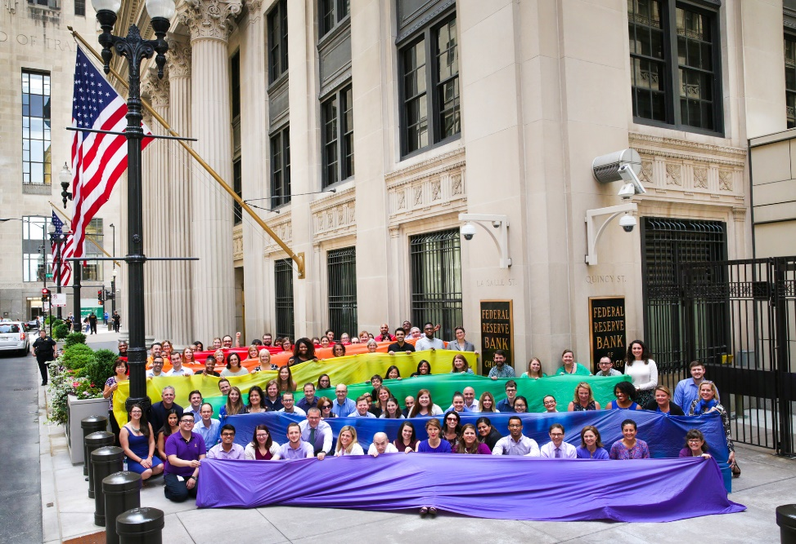
Why Work for the Fed?
Why Work for the Fed?
Mission-driven organization
Focused on diversity + inclusion within the workplace
Great benefits

Slide 45
Resources
Career Resource
Financial Services Pipeline
Free Toolkit to explore careers in financial services industry https://www.fspchicago.org/
Notes:
Financial Services Pipeline: “Recognizing that the lack of diversity in the Chicago-area financial services sector has a negative impact on the competitiveness and equity of the region, and on the organizational cultures and financial firms’ “bottom lines,” a group of Chicago-based financial institutions joined forces with The Chicago Community Trust—the region’s community foundation—to form the Financial Services Pipeline (FSP) Initiative in 2013.”
This website has a lot of great information about these types of careers, so it can help you figure out if you want to go into this field!

