Slide 1
What is the Federal Reserve?
Q+A with a Fed Ambassador
Fed in your Classroom

Slide 2
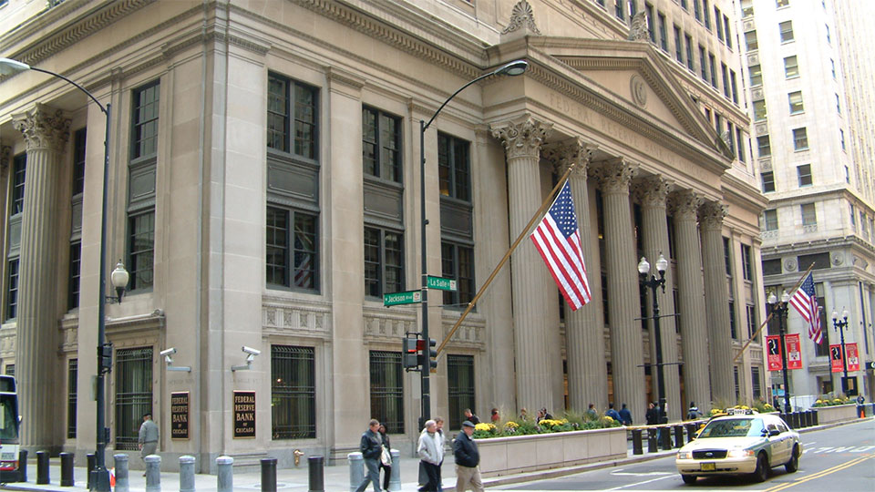
Notes:
This is the Federal Reserve Bank of Chicago – it is located downtown in the financial district of Chicago.
The Chicago Federal Reserve is one of 12 Banks that make up the Federal Reserve System.

Slide 3
What is the Federal Reserve?
Central Bank of the United States
“Bank of banks”
Notes:
The Federal Reserve is the independent central bank of the USA.
We are the bank of the U.S. government and the “Bank of banks.” Individuals do not have accounts here, but banks do. Also, the U.S. government uses the Federal Reserve as its bank.

Slide 4
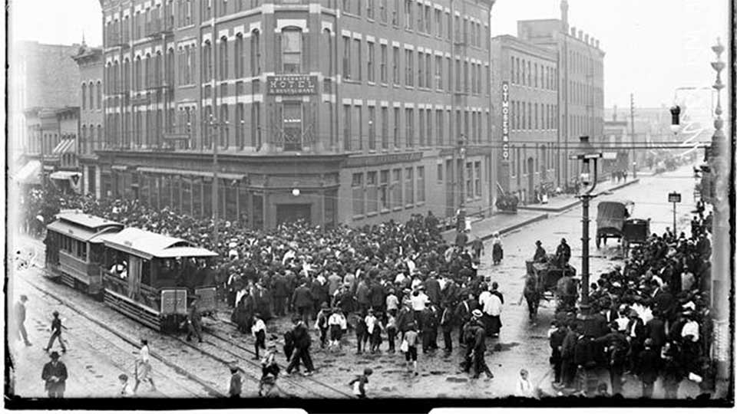
Notes:
How were we founded? Congress passed the Federal Reserve Act in 1913 to create the central bank after a series of bank panics and recessions. This was a way to stabilize the banks and to stabilize the economy.
The photo we see here is from a “run” on a bank in 1906 in Chicago on Milwaukee Avenue where there are many people outside of a bank on the sidewalk trying to get their money out, all at once. This created a problem because banks typically only have a fraction of their money on hand, while the rest is loaned out for profit. (photo source: https://explore.chicagocollections.org/image/chicagohistory/71/q81503b/ )
Without a central bank, there was no way to quickly change the money supply in response to demand.
One of the important functions of a central bank is to act quickly as a lender to banks when they need it. The central bank is called “lender of last resort.”
Deep Dive (only include if there’s time):
In 1933, another organization, the Federal Deposit Insurance Corporation (FDIC) was created to insure the money you put in a bank so that you will always be able to withdraw it, even if a bank closes.

Slide 5
Q: Which actions would you most like to do at a bank?
Please respond A, B or C
Withdraw cash
Save money and earn interest
Get a loan
Notes:
Now, let’s talk more about banking and how the Federal Reserve is similar to, but different from, other banks.
First, I have a poll question for you.
Thanks for your responses. It’s interesting to see how you all are responding!
These are all ways that banks serve their customers. I highlighted these, because these same services your bank provides you are ones that the Federal Reserve provides to banks, as the Bank for banks.
The central bank is a place for banks to deposit and withdraw cash; they can save money (called reserves) and earn interest with the Federal Reserve (the Fed gives them a percentage on how much they save) and they can also take out loans from the Federal Reserve.

Slide 6
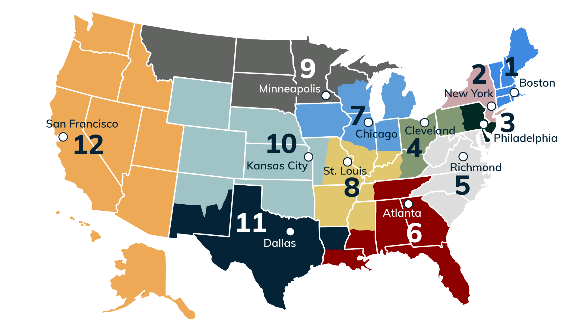
Q: What do you notice about the locations?
Notes:
Congress created a central bank that had multiple locations. Different regions report on the economy in their area so the Fed can decide what’s best for the country as whole. Our Board of Governors is located in Washington, D.C.
When you look at this map, what do you observe in terms of where the Banks are located? Any word or phrase is fine. There aren’t wrong answers- tell me what you are observing first by typing it into the chat box.
Yes, great--cities. Yes, there’s more Banks on the East Coast! That’s because when we were founded in 1913, the East Coast was considered the hub of economic activity, and there was more population in the east than the west. These cities were located on train lines, so it would make it easier to transport money to them and use them as hubs.
We still have the same main 12 Banks located in the same cities that we had in 1913. However, branches have been added to help out the Banks that have more population to cover. So San Francisco, for example, covers a really wide area; it has branches in L.A., Phoenix, Portland, Salt Lake City and Seattle—all part of the SF Fed, in addition to the main SF location.
In Chicago, our area has an office in Des Moines, IA and a branch in Detroit in addition to our main location in Chicago.

Slide 7
Structure of the Federal Reserve
THE FEDERAL RESERVE ACT
creates the Federal Reserve System and specifies how Board members and Reserve Bank presidents are chosen.
PRESIDENT
SENATE
nominates members of the Board of Governors, the chief governing body of the Federal Reserve System, and nominates one Board member to be Chair and one to be Vice Chair.
confirms Board members appointed by the President to staggered 14-year terms, and confirms the nominations of Board members to be either Chair or Vice Chair.
BOARD OF GOVERNORS
FEDERAL RESERVE BANKS
FEDERAL OPEN MARKET COMMITTEE
Seven Board members guide all aspects of the operation of the Federal Reserve System and its five key functions.
12 Reserve Banks examine and supervise financial institutions, act as lenders of last resort, and provide U.S. payment system services, among other things.
Seven Board members and five Reserve Bank presidents direct open market operations that sets U.S. monetary policy to promote maximum employment, stable prices, and moderate long-term interest rates in the U.S. economy.
Notes:
The Federal Reserve is independent within the U.S. government.
That means that I am a “Bank” employee, and I am not considered a Federal employee.
You can see on this chart that the President of the United States chooses the Board of Governors in Washington, DC. Those presidential selections for the Board are approved by Senate.
But the 12 Reserve Banks are independent, and the Presidents of the Banks are not chosen by the Executive office but are chosen by the Boards of our individual Banks.
You also see the FOMC on there. We’ll get into the Federal Open Market Committee a bit later in the presentation.

Slide 8
Roles of the Federal Reserve
Promote a Trusted Financial System
Payment Services
Supervision and Regulation
Advance a Strong Economy
Monetary Policy
Notes:
Our main goals at the Federal Reserve are to promote a trusted financial system and to create a strong economy.
Today we are going to be talking about three of the core ways we do that: Payment Services, Supervision and Regulation, and Monetary Policy.
We serve the public good working by working for our region and nation through analysis and action.

Slide 9
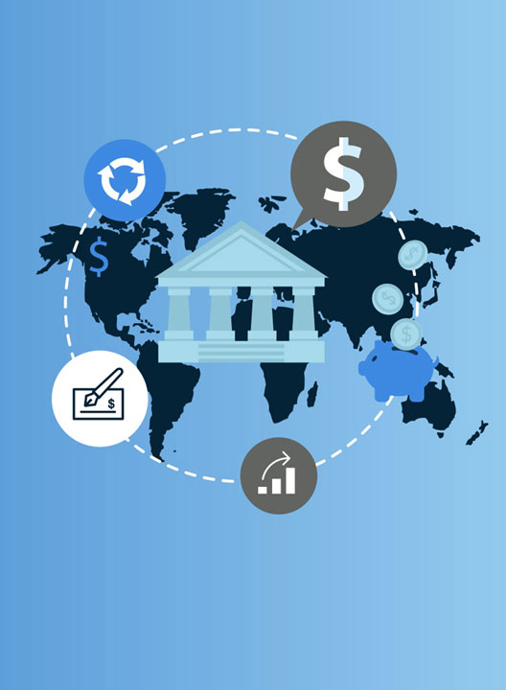
Payment Services
Bank for banks
Notes:
Let’s look a little more at this first role: payment services. As the Bank for banks, the Federal Reserve provides infrastructure for electronic payments for banks, check collection for banks, and cash services.

Slide 10
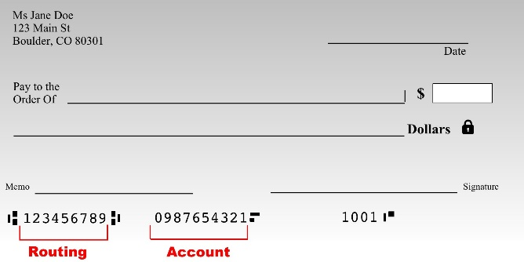
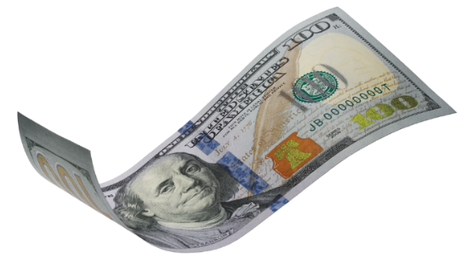
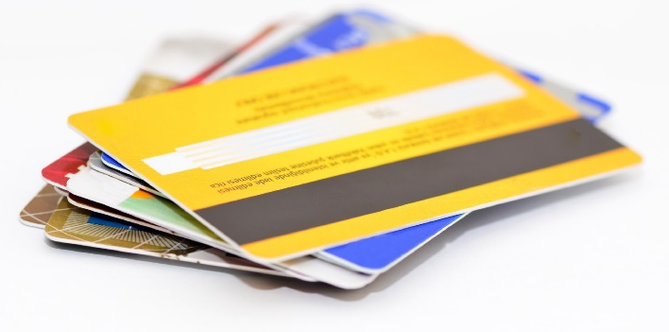
Q: Which of these are you most likely to use?
A
B
C
D
Notes:
OK, let’s talk about payments. But first, a poll. Which of these are you most likely to use on a given day?
Commentary: I’m not surprised that no one mentioned checks.
That is a trend we’ve been noticing throughout the classes we’ve been working with—and it is true throughout the US too.
We are still using a lot of cash and credit or debit cards, but as a country we are using fewer checks than before. That means that the Federal Reserve has decreased the number of people assigned to process checks.

Slide 11
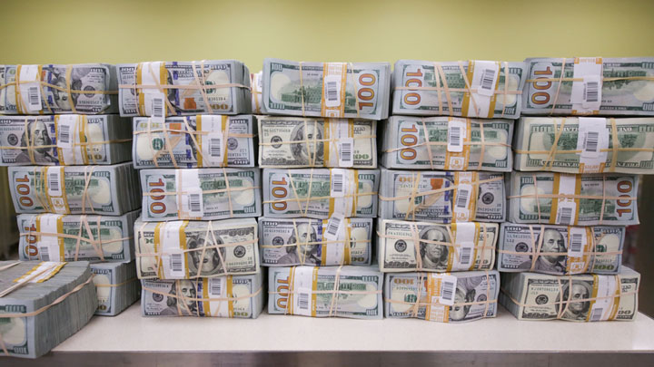
Notes:
I know that many of you mentioned you use cash. We’re going to now look at how the Fed deals with cash as the Bank for banks.
When banks have excess cash, they deposit it at their Federal Reserve Bank or branch. The cash arrives in armored trucks to our doors.
Between the Chicago and Detroit cash processing centers, we have been processing around $188 million per day.

Slide 12
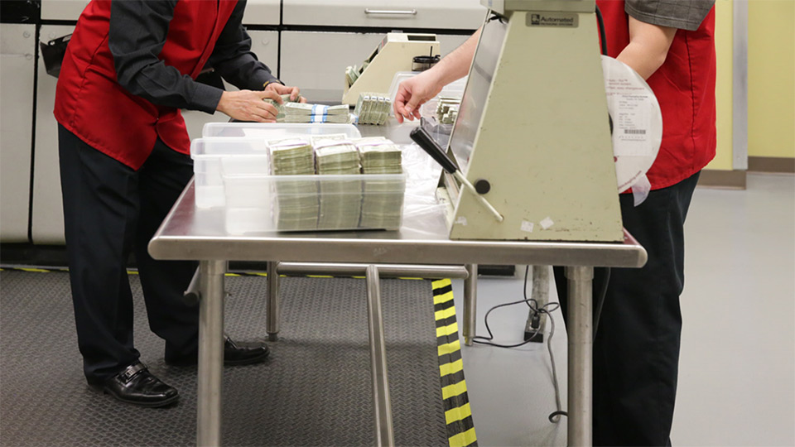
Notes:
First, our workers count the bills to make sure that it’s the amount the depositing bank said it was.

Slide 13
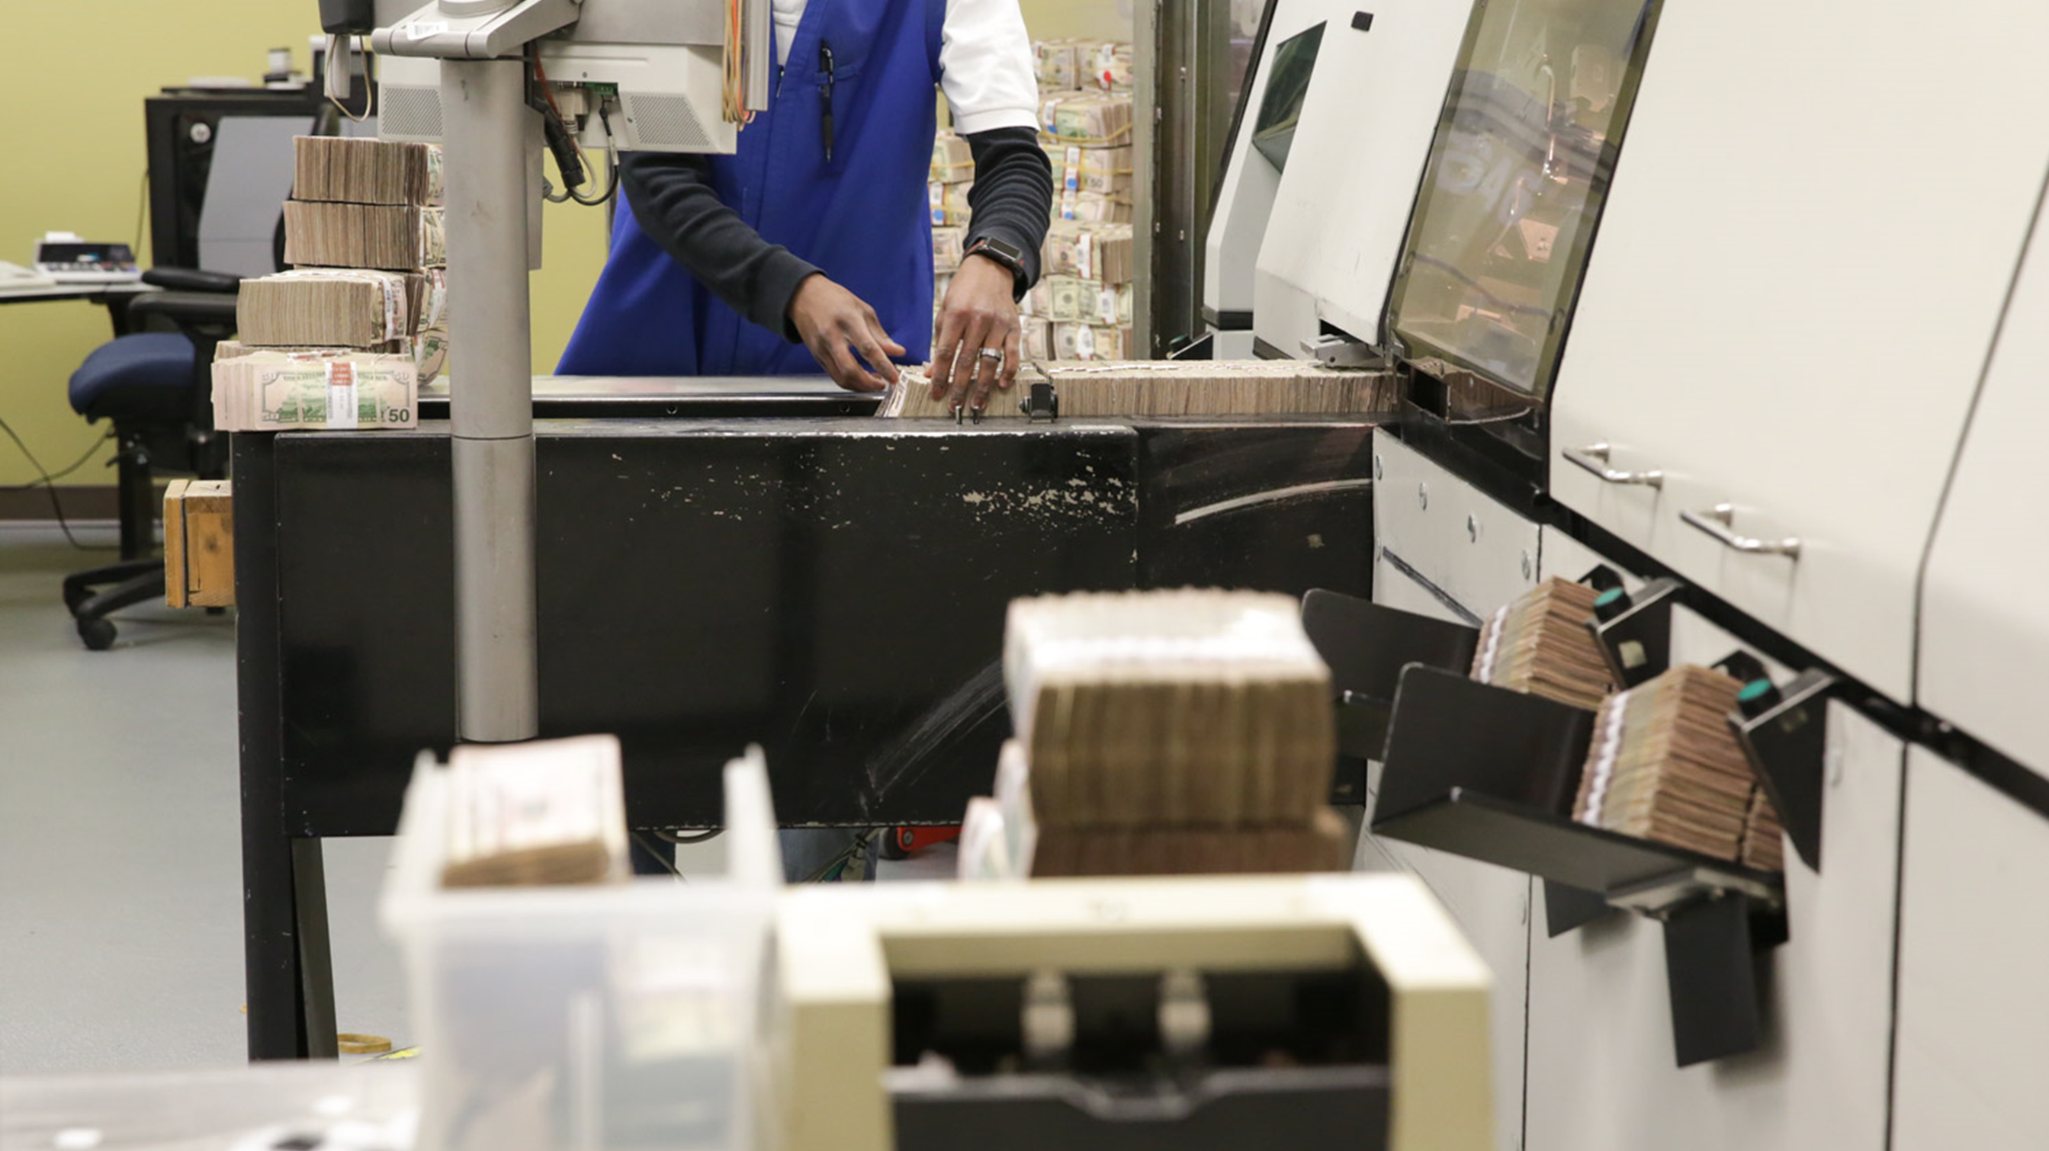
Notes:
Then we run the cash through high-processing machines so that we can separate out the cash that is fit to be circulated.

Slide 14
Q: What makes a bill “unfit” for circulation?
Type your answer in the chat box
Worn out, old
Torn
Written on
All of the above
Notes:
What factors might make a bill “unfit” for circulation?
You’re right if you said “all of the above.”
With the ones that are worn out, old, torn, or written on, we go ahead and destroy those.

Slide 15
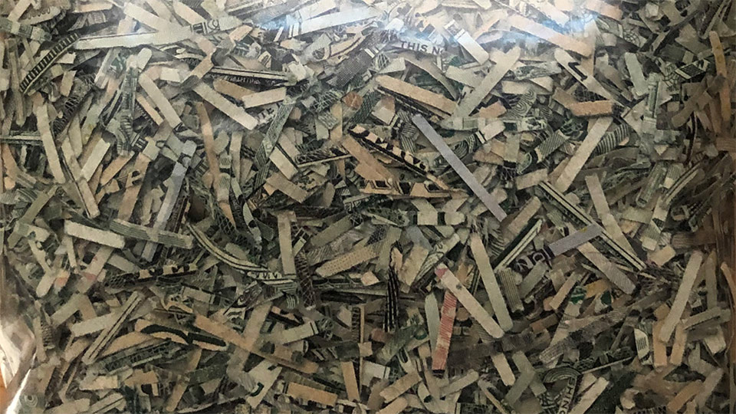
Notes:
Here’s what the shredded bills look like.
In 2023, we shredded on average in Chicago $528.6 thousand per day out of the 118.5 million/day that we process. That’s about 0.4 % of the total!
Don’t worry, although that number may sound like a lot, we replace the shredded money with new money that we order from the Treasury Department. It is printed in Washington DC, and in Fort Worth, TX at the Bureau of Engraving and Printing.
We store all the cash in the vault, so that the new cash is ready to go when banks make withdrawals.

Slide 16
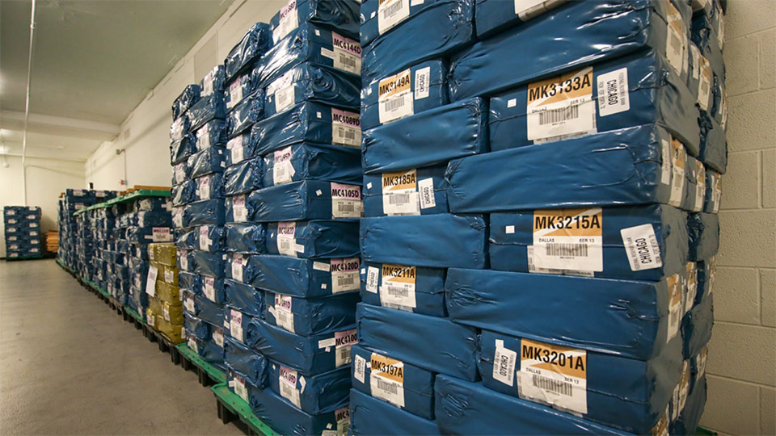
Notes:
This is what the new money looks like from the Treasury Department/Bureau of Engraving and Printing. It is shrink-wrapped and stored in the vault in the basement of the Federal Reserve.
The colorful labels tell us which denomination of currency is stored inside. The orange labels are for hundreds, while the purple/pink ones are for twenties.

Slide 17
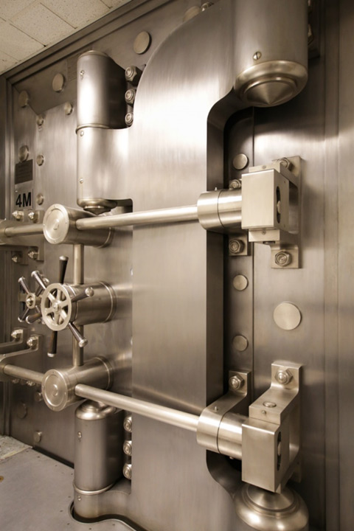
Q: How much money is stored in the Chicago Fed’s vault?
Please respond A, B or C
Millions
Billions
Trillions
Notes:
OK, now time for another poll: how much money do you think is stored in our vaults?
(This photo is of the door to the vault.)

Slide 18
Q: How much money is stored in the Chicago Fed’s vault?
B. Billions!
Notes:
If you said in the billions, that’s right. The number fluctuates, but it is in the billions.
We need to keep an adequate reserve of cash so that when the banks need to withdraw currency for their customers, we have it on hand.
Amount we processed each day in 2023
Chicago $118.5 Million per day
Detroit $69.8 Million per day
Amount shredded each day in 2023
Chicago $528.6 thousand per day
Detroit $329.7 thousand per day

Slide 19
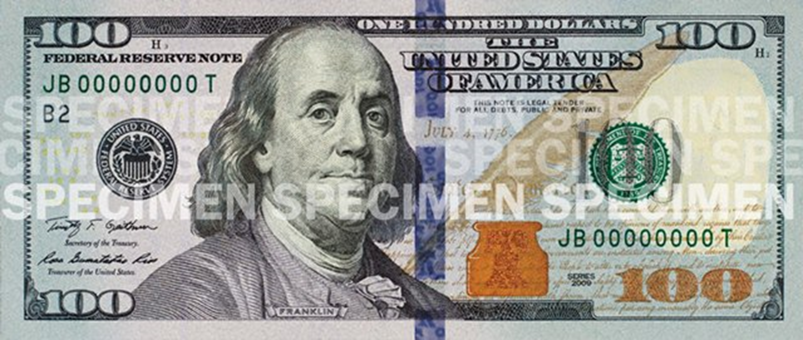
Q: What details do you think help determine if this is real?
Notes:
Another job in the cash department, besides separating out the unfit bills, is to separate out the counterfeit bills and send them to the Secret Service for investigation. The machines scan for every security feature.
On average, we are finding about 14 counterfeit bills a day in Chicago, and 7 in Detroit.
This changes over time as new security features are added to the currency's designs.
Now, what details do you think help us determine if this bill is real?

Slide 20
Watermark
color-changing ink
Notes:
Yes, the blue line is a 3D image. When you look at it straight on, it shows the number 100 multiple times. Then when you tilt it, you see the number 100 morph into liberty bells.
The watermark you can see if you shine a light behind the bill. In this case, it is another image of Benjamin Franklin. It is an image that is pressed into the fabric of the paper.
You can also see color-changing ink. This is on the number “100” in the lower right-hand corner as well as the liberty bell image in the ink pot. When you look at it straight on, the color is copper-orange. When you tilt the bill, the color is green.
Another fun feature, that I’ve circled in red, is that B2 number. The B2 number represents which of the Fed Banks the bill was issued from – in this case the Federal Reserve Bank of New York. If it said G7, that would mean it was from the 7th district, the Federal Reserve Bank of Chicago.
We’ve been talking now a lot about being the “Bank for banks” and working with cash.
Let’s turn now to how we also conducting bank oversight—testing banks to make sure that they are healthy.

Slide 21
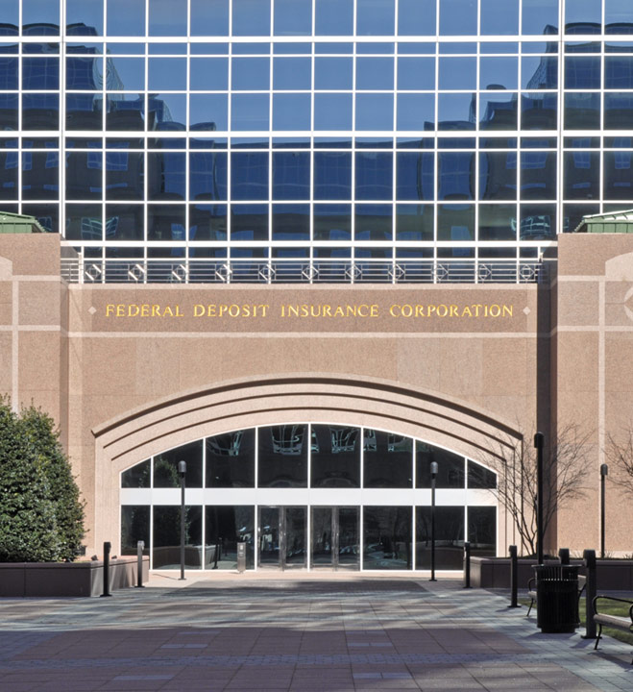
Supervision + Regulation
Safety + Soundness
Notes:
The single largest group of employees at the Chicago Fed works in Supervision and Regulation (about 1/3 of staff.)
The Federal Reserve is like a referee, making sure banks are following the rules.
What are some things that you might want to find out as a bank examiner?
Are deposits safe?
Is the bank making good investments with people’s money, and taking care of it?
If the bank gets a poor rating, then they get guidance on how to improve, and if they do not make corrections the bank may need to close.
The FDIC insures that whatever money you had in the bank is still available to you, though, up to $250,000.
Our job is to protect consumers
Bank examiners check that the bank is judging whether to give out loans to people based on the person’s ability to repay the loan, not based on their religion, race, neighborhood, or any other factors.
They also make sure the bank is posting the correct interest rates– and people can file complaints to the Federal Reserve if something is amiss.
We are one financial regulator among other agencies who also perform bank examinations including:
Office of the Comptroller of the Currency (OCC)
Federal Deposit Insurance Corporation (FDIC)
We supervise and regulate:
Bank-holding companies
State-chartered member banks of the Federal Reserve
Foreign branches of member banks
Foreign banks operating in the United States

Slide 22
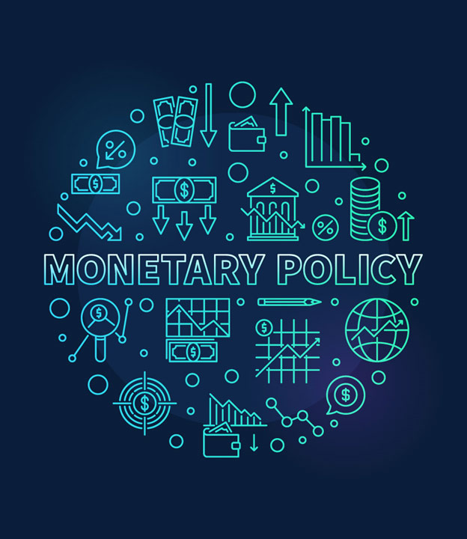
Influencing the Growth of the Economy
Notes:
The area where you will hear about the Fed the most in the news is monetary policy.
Monetary policy is the policy set by a central bank to regulate the money supply in the economy.

Slide 23
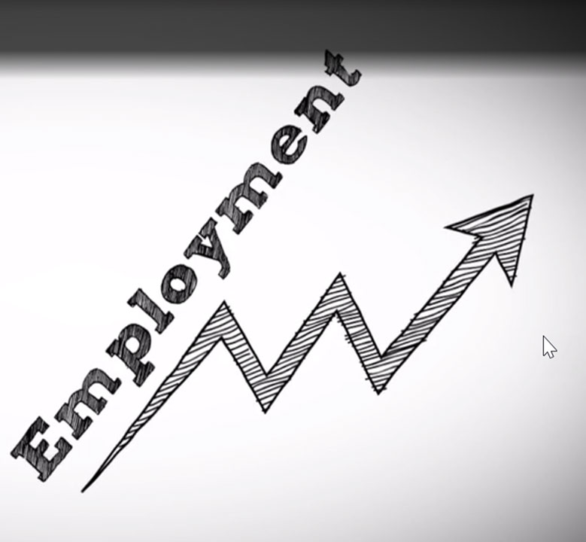
Dual Mandate from Congress
Stable Prices
What you pay today will be similar to tomorrow
Full Employment
Anyone who wants a job can find a job
Notes:
Congress has given the Federal Reserve a dual mandate (in other words, two jobs, or goals)
Stable prices: the goal is to have prices remain stable so that people can plan and make good financial decisions for their futures. Knowing what to expect when it comes to how much things will cost in the future helps people to make better financial decisions.
The goal of the Fed is for prices to go up at a 2 % rate of inflation, on average. That means if you buy something today for $100, it would be around $102 next year—not $80, or $200.
Full employment: the goal is for anyone who wants a job, to be able to find a job. The Federal Reserve works to promote full and inclusive employment. At the same time, they are also working to make sure that employers can hire people when needed.

Slide 24
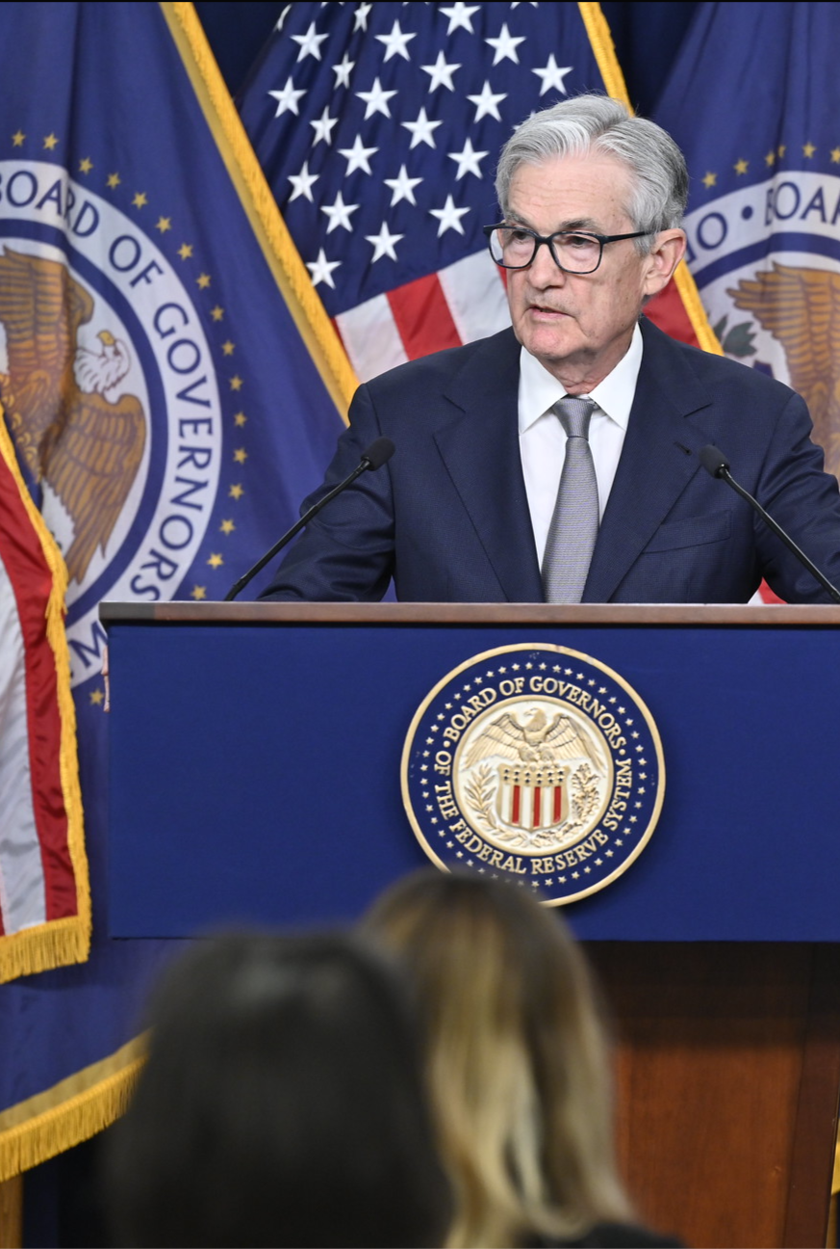
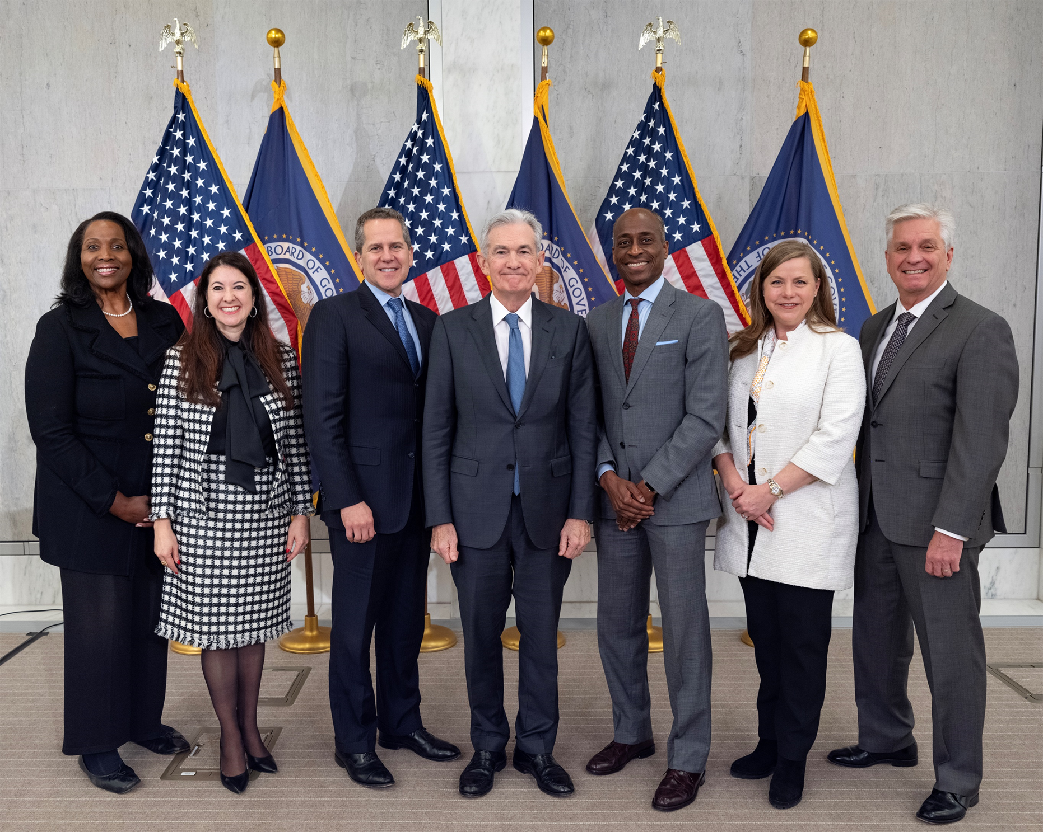
Fed Chair
Notes:
Chair “Jay” Jerome Powell is the person you are most likely to see in the news when it comes to monetary policy. He is the Chair of the Board of Governors of the Federal Reserve. His office is in Washington DC. He will make announcements to the media when it comes to the decisions of the Board of Governors and the Presidents of the Federal Reserve Banks. Next to his photo, you’ll see a photo of the full board of governors.

Slide 25
Notes:
There is a ton of work that goes on behind the scenes before the Chair of the Federal Reserve announces any decisions on policy.
At every Federal Reserve Bank, researchers meet with their presidents to share information about the prices and employment numbers in their regions, and what predictions they might have for the future.
Our president at the Chicago Fed is Austan Goolsbee.
Then the Bank president will fly to DC and will meet with everyone at the FOMC meeting. These meetings occur 8 times a year.

Slide 26
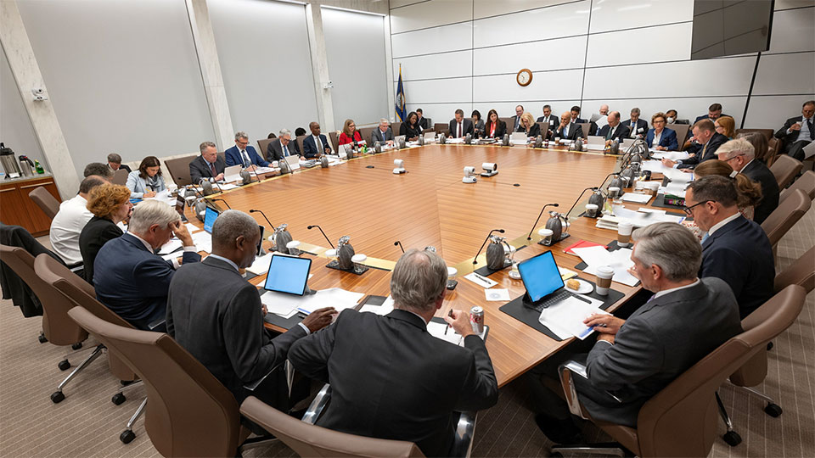
Notes:
In DC, everyone at the table from the different regions gives their perspectives on the economy, and shares information gathered from their Bank.
Then a smaller subset of the people at the table, called the FOMC (Federal Open Market Committee) votes on whether to raise interest rates, lower interest rates, or keep them the same.
Deep Dive (only include if there’s time)
The Federal Open Market committee is made up of the 7 Board of Governors and 5 Bank presidents that rotate yearly.
Every President of every Fed Bank sits around the table with the Governors and has a say, presenting their case with research for how the committee should vote. But then out of that whole group, there are only 12 voting members.
For the five presidents: The NY Fed votes every year, while the Chicago Fed is a voting member every other year (we switch off with Cleveland).
Voting members of the committee in 2024 are: the presidents of the NY, Atlanta, San Francisco, Cleveland, and St Louis Fed Banks.

Slide 27
Influencing Interest Rates
= Slow Down Economy
Raise Interest Rates
= Speed Up Economy
Lower Interest Rates
Notes:
-Lowering the rate -> encourages lending and investing
-Raising the rate -> encourages saving
Deep dive (only include if there is time)
Starting in March of 2022, the FOMC voted to raise interest rates at 11 meetings in a row to bring down inflation. Then, at the July 2023 meeting, and in the three subsequent meetings, the FOMC voted to hold rates at the same level. (As of January 2024). The current Fed Funds rate is 5.25 % to 5.50 %.
If there is time: let's talk about careers at the Federal Reserve.

Slide 28
Questions?
Notes:
Now that you have heard all about the main roles of the Federal Reserve, do you have any questions for me?

Slide 29
Careers at the Federal Reserve
Notes:
Now I will share some information about careers at the Federal Reserve.
This is your opportunity as a Fed Ambassador to talk about your personal career path and what role(s) you have had at the Federal Reserve Bank of Chicago.
In addition to being a Fed Ambassador I…
This is how I got my job at the Federal Reserve…
This is what I learned in high school/middle school that I still use today in my job…

Slide 30
Notes:
Here are some examples of co-workers I see at the Federal Reserve:
Chris – In the Law Enforcement Unit, trains the dogs that sniffs all deliveries to the Fed (they are checking for explosives and help keep us safe)
Jocelyn – Internal Communications, Strategic Communications, Employee Engagement (Writing/Journalism major)
Jeffrey - Senior Statistical Reports Analyst in Supervision & Regulation – analyzing data from banks and bank holding companies (Business & Entrepreneurship major)
Swanandi – Senior Human Resources Business Partner (Business Management major)

Slide 31
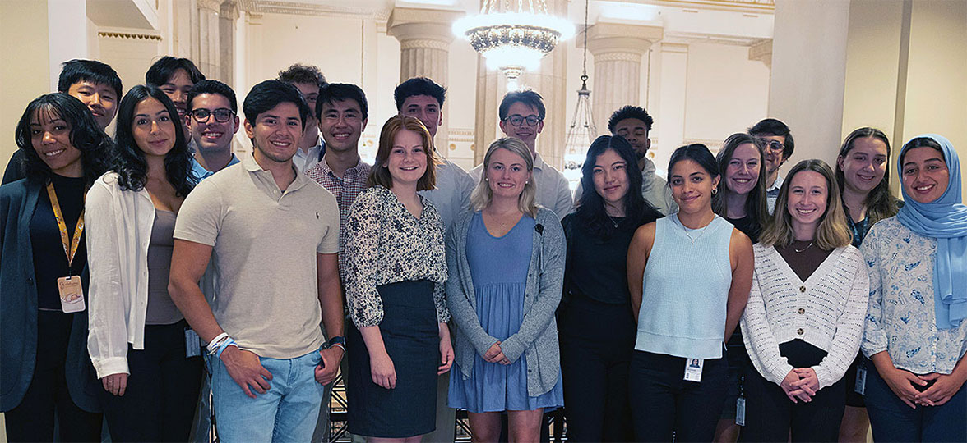
Internship program
October – January: Apply
June: Internships Begin
Notes:
Apply as early as your first year of college
Compensation is based on your grade level
Applications open October – January
Internships begin in June

Slide 32
What we look for in interns
Leadership and teamwork abilities
Strong communication skills
An appreciation for diversity, inclusion and community
Knowledge of Microsoft Office
The ability to work 40 hours per week
Notes:
Leadership and teamwork abilities
Strong communication skills
An appreciation for diversity, inclusion and community
Knowledge of Microsoft Office
The ability to work 40 hours per week

Slide 33
Why work for the Fed?
Inclusive, people-first culture
Connection to vital purpose
Opportunities to grow
Notes:
Inclusive, people-first culture: Lots of different groups that you can become part of and activities that promote getting to know colleagues and supporting each other
Connection to vital purpose: I know that every day when I wake up, I am going to be helping our economy
We have many opportunities for growth. (Fed Ambassador can talk about what they have personally taken part in for professional development.)

Slide 34
Career Resources
Financial Services Pipeline
https://www.fspchicago.org
Federal Reserve Careers
https://www.chicagofed.org/careers
Notes:
Financial Services Pipeline: This website has a lot of great information about these types of careers, so it can help you figure out if you want to go into this field! It's specifically focused on increasing the number of women and people of color in Chicago financial firms
More background: “Recognizing that the lack of diversity in the Chicago-area financial services sector has a negative impact on the competitiveness and equity of the region, and on the organizational cultures and financial firms’ “bottom lines,” a group of Chicago-based financial institutions, [including the Federal Reserve Bank of Chicago,] joined forces with The Chicago Community Trust—the region’s community foundation—to form the Financial Services Pipeline (FSP) Initiative in 2013.” https://www.fspchicago.org/
Federal Reserve Careers: The Chicago Fed has a ton of different job postings, as do the other 11 Banks and the Board of Governors. You can look at the qualifications on each job to see what they are asking for, and this can guide you in your studies if you would like to eventually get a job with the Federal Reserve.
For internships, each department will post a separate job listing/description on the Careers page. You can look for the type of internship that best fits your career goals.

