Slide 1
Money Smart Week ® @ your library
A partnership between the Federal Reserve Bank of Chicago and the American Library Association
Michael Dowling, Director Chapter Relations Office
and International Relations Office
American Library Association
mdowling@ala.org

Slide 2
Mission “To provide leadership for the development, promotion, and improvement of library and information services and the profession of librarianship in order to enhance learning and ensure access to information for all.”
Headquarters in Chicago (founded 1876)
Largest library association in the world (60,000 members)
Represent all types of libraries and librarians (public, school, academic,
special)
Chapters in all 50 states

Slide 3
Why Libraries?
Mission
Part of the Solution
Good Partners
Access and Visibility
Ecosystem (state libraries, state and regional associations, regional systems, public libraries, school libraries, academic libraries, special libraries)

Slide 4
Great Partnership Fit for ALA
Collaborate with Trusted Partner- Federal Reserve Bank of Chicago
Take Successful Regional Program National- Get libraries across the county involved.
All types of libraries can participate- Libraries can assist their communities at any level
Literacy is a key ALA Action Area - assists and promotes libraries in helping children and adults develop the skills they need-the ability to read and use computers- the ability to seek and effectively utilize information resources is essential in a global information society.
ALA and Libraries Love to Celebrate Weeks-
National Library Week, Banned Books Week, Teen Read Week, Privacy Week, etc.
Incorporate ALA ‘@ your library’ branding

Slide 5
Reach New Partners for Libraries and ALA
Federal Government (FED, SEC, FDIC, Social Security Administration, SBA)
State Government (Treasurer, Banking, Insurance, Employment)
Associations (Business, CPA, Financial Services)
Companies (Credit Unions, Banks)
Media (Newspapers, Radio, Television)
University (Student Services, Finance/Business Dept., Extensions)
School (PTA, Junior Achievement)

Slide 6
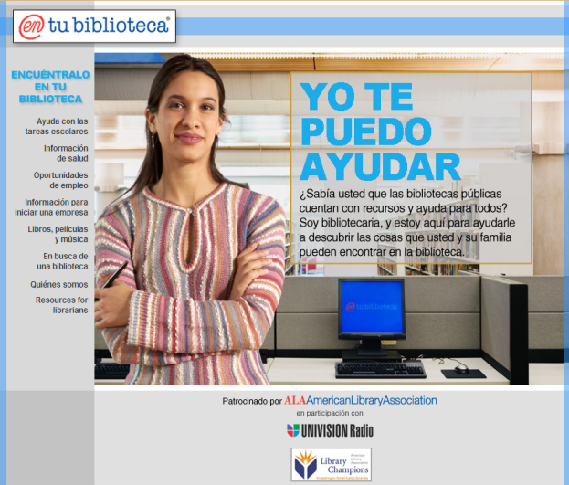
The Campaign for America’s Libraries is the American Library Association’s public awareness campaign that promotes the value of libraries and librarians. Thousands of libraries of all types – across the country and around the globe - use the Campaign’s @ your library® brand.
Get answers @ your library, Homework help @ your library, Government information @ your library, Free Internet @ your library,

Slide 8
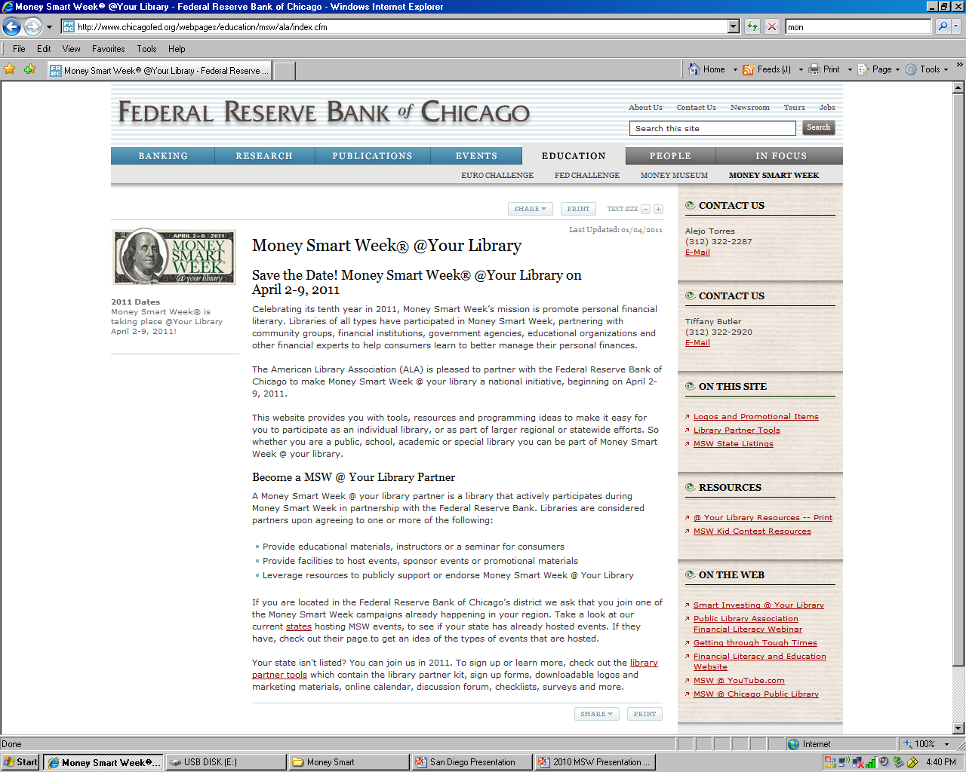
Money Smart Week @ your library website

Slide 10
Specific MSW @ your library downloadable materials

Slide 11
2011 Money Smart Week @ your library results
Libraries in 30 states participated (mainly public libraries)
47% surveyed had not done financial literacy programming before
83% found partners for programming
70% said MSW @ your library efforts met expectations
86% will participate in 2012

Slide 12
Money Smart Week @ your library 2012
Increase overall participation, but especially more academic and school libraries
Fall promotion through webinar and state library conference presentations
Connect state library associations and state libraries to MSW coalitions

Slide 13
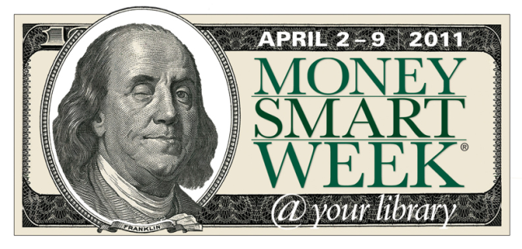
Money Smart Week® @your library
Bobbie Rudnick, Business Librarian
Naperville Public Library
Naperville, Illinois

Slide 14
Libraries & Financial Literacy
Commitment to improved quality of life and economic development
Increasing relevance during hard times
Providing trustworthy information, resources, technology, expertise

Slide 15
...in addition to contributing to community economic strength, the business community has come to recognize our library as a strong force in melding the local spheres of influence. The library can serve as neutral territory for the private, governmental, and public sectors to address common concerns.
Small Business and the Public Library: Strategies for a Successful Partnership. Weiss, Serlis-McPhillips, Malafi: American Library Association, 2011.

Slide 16
Money Smart Week® Coalitions
Federal Reserve
ALA
Libraries
Nonprofits
Businesses

Slide 17
Partnering with Libraries
Promotion and publicity
Financial resources, databases, tools
Library staff expertise
Web presence to support financial education and programming

Slide 18
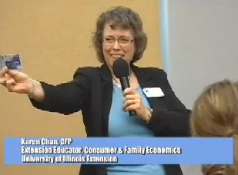
Designing Money Smart Programs
Partners
Topics
Credit and debt
Financial emergencies
Investing
Housing
Identity theft
Kids and money
Retirement planning
Unemployment
Banks and credit unions
Credit counseling services
University Extension offices
City & State Treasurers
Professional associations
Government agencies

Slide 19
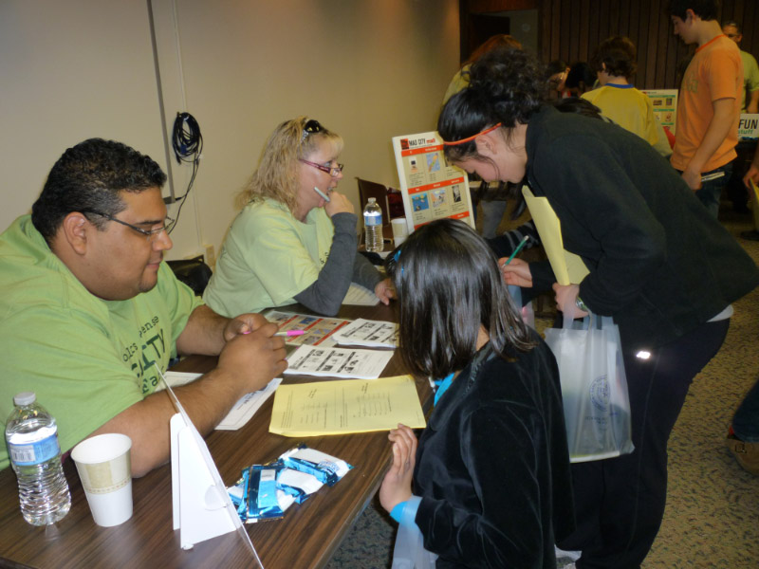
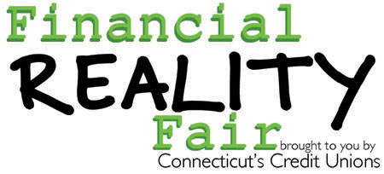
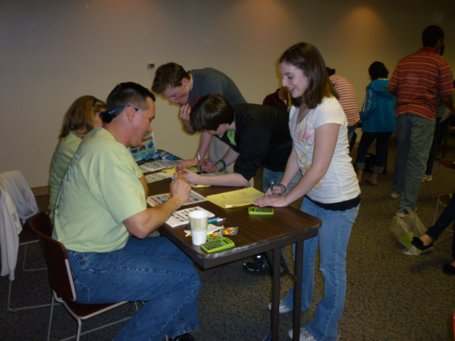
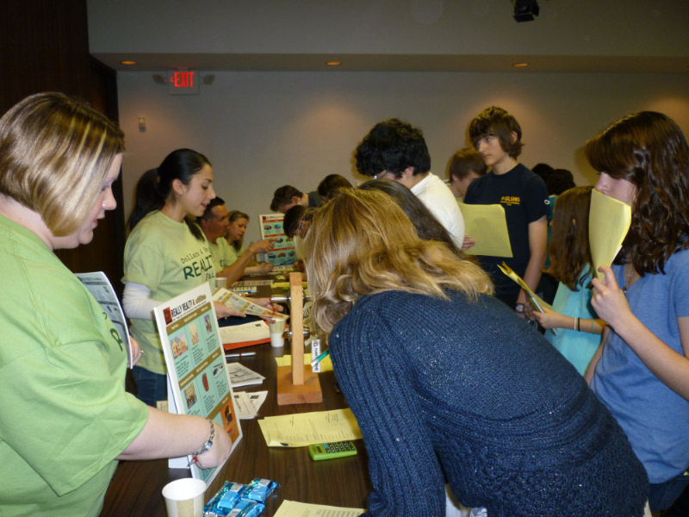

Slide 20
Building Relationships
...
Through sustainable partnerships with nonprofits, agencies, government, and the business community, libraries will continue to promote financial stability and improved quality of life.
Bobbie Rudnick
brudnick@naperville-lib.org
Notes:
Share resources and expertise

