Slide 1
The Go Direct® Campaign
September 9, 2011
Presented by:
Walt Henderson, Director, EFT Strategy Division,
U.S. Department of the Treasury, Financial Management Service
Jim Holland, Senior Vice President, Weber Shandwick Worldwide
The Direct Express® logo, Go Direct® and Direct Express® are registered service marks, and the Go DirectSM logo is a service mark, of the U.S. Department of the Treasury, Financial Management Service (used with permission).
Notes:
WH/JH

Slide 2
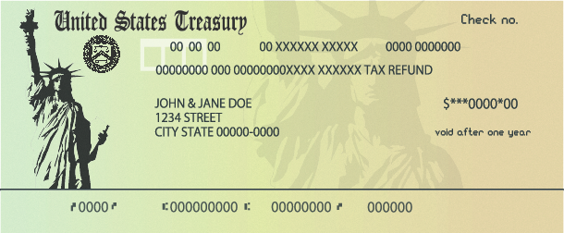
Overview
About 10 million Americans still receive federal benefit payments by paper check each month.
Eliminating the paper check will save federal taxpayers $120 million annually and $1 billion over the next decade.
Notes:
WH

Slide 3
Important Change
The U.S. Department of the Treasury issued a final rule in December 2010 announcing that all federal benefit and non-tax payments must be paid electronically.
The rule will impact:
People newly applying for benefits. Anyone applying for benefits will receive their payments electronically.
Current check recipients. People already receiving Social Security and other federal benefits by check will need to switch to direct deposit by March 1, 2013.
Notes:
WH

Slide 4
Which Federal Benefit Payments Are Impacted?
Social Security Administration (Social Security and SSI)
Veterans Affairs (VA)
Railroad Retirement Board
Office of Personnel Management
Department of Labor (Black Lung)
Notes:
WH

Slide 5
Two Electronic Options
Direct deposit. People with checking or savings accounts can sign up for direct deposit. Their money will go straight to their account on payment day each month.
Direct Express® Debit MasterCard® card. People who prefer a prepaid debit card can sign up for the Direct Express® card. No bank account or credit check is required. Money is posted to the card account on payment day each month.
Notes:
WH

Slide 6
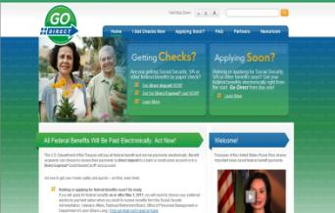
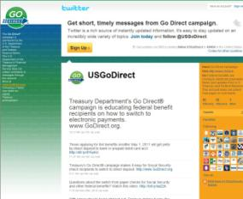
Go Direct® Public Education Campaign
The Treasury Department is committed to helping Americans be prepared for and make the transition to the electronic payment of federal benefits.
The Treasury Department will raise
awareness through:
Partners
Media outreach and PSAs
Materials and website
Social media
Check inserts
Notes:
WH

Slide 7
Switching to Electronic Payments: Fast, Easy and Free
The Go Direct® campaign makes it fast, easy and convenient for people to switch from paper checks to electronic payments online at www.GoDirect.org.
People can also sign up by calling the U.S. Treasury Processing Center on weekdays at (800) 333-1795.
Notes:
WH

Slide 8
Go Direct Campaign Partners
Notes:
WH

Slide 9
The Power of Partners
Notes:
WH https://rcpt.yousendit.com/1213109609/c64c4b45f4b0bd3b1976e07a5ae1aed5
Video needs to be relinked and saved on computer

Slide 10
Best Practices
METRICS
BRANDED
RESEARCH
INLINE
TURNKEY
TARGETED
Notes:
JH

Slide 11
Research Drives the Campaign
Notes:
JH

Slide 12
Fish Where the Fish Are
Notes:
JH

Slide 13
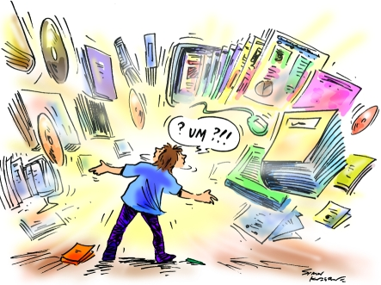
Branding: What’s the Value of a Name?
Notes:
JH

Slide 14
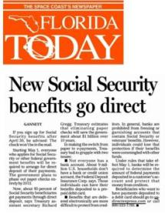
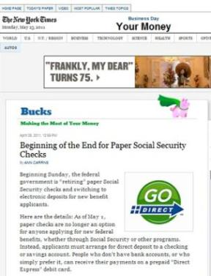
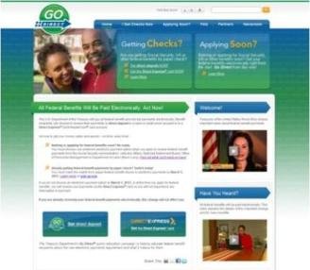
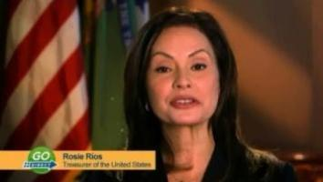
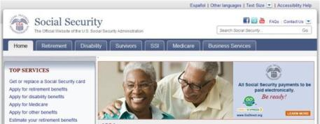
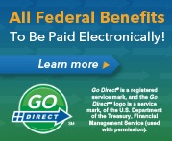
2
Value of a Name: Go Direct
Notes:
JH

Slide 15
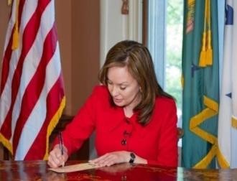
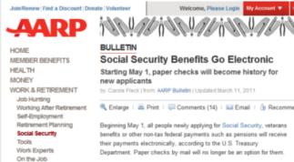
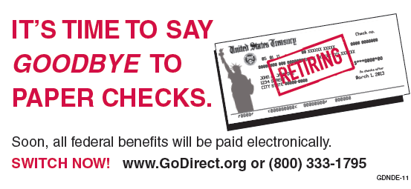
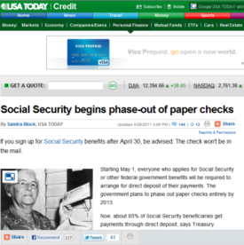
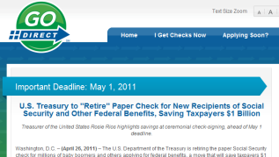
Retire the Check: In line Approach
Notes:
JH

Slide 16
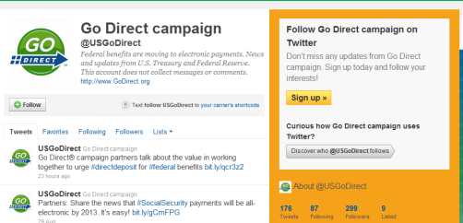
Go Direct Campaign and Social Media
@CaliforniaDFI: RT @USGoDirect: Partners play an important role in the Go Direct® campaign. Watch a video about the power of partners http://t.co/u9tnnTR
@Gleaners: Paper #SocialSecurity checks are retiring- Get info on the switch 2 electronic payments 4 federal benefits: http://ow.ly/4IRq9 (@USGoDirect)
NYC Office of Emergency Management
Here’s some helpful information for people who receive federal benefits checks…
Notes:
JH

Slide 17
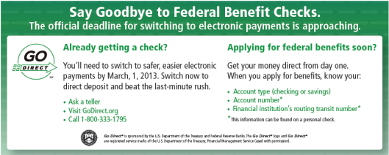
Turnkey Programming and Materials
Go Direct Month
Disaster Preparedness
Crime Prevention
Financial Literacy
Notes:
JH

Slide 18
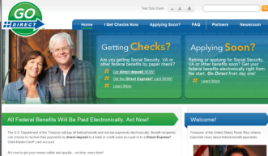
Metrics
Primary Metric: Conversions
Secondary Metrics
Financial institution conversions
Partners
Media impressions
Website traffic
Collateral materials
Notes:
WH

Slide 19
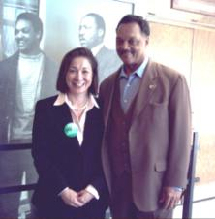
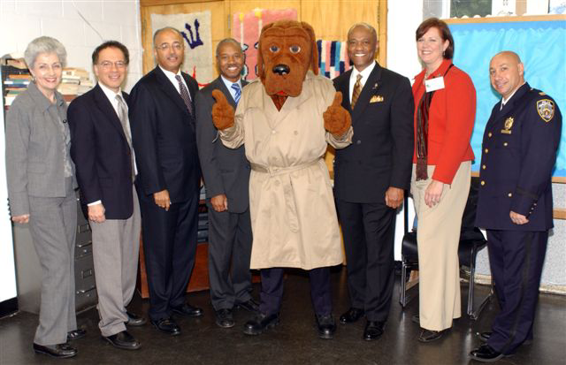
Community Engagement
Notes:
JH

Slide 20
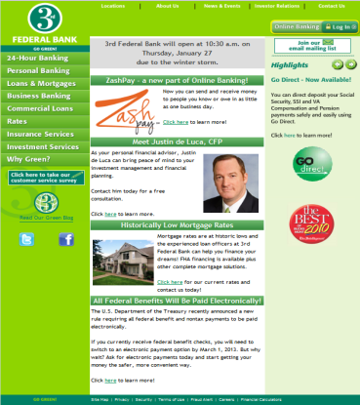
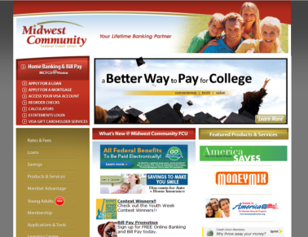
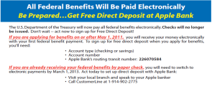
Financial Institutions
Notes:
JH

Slide 21
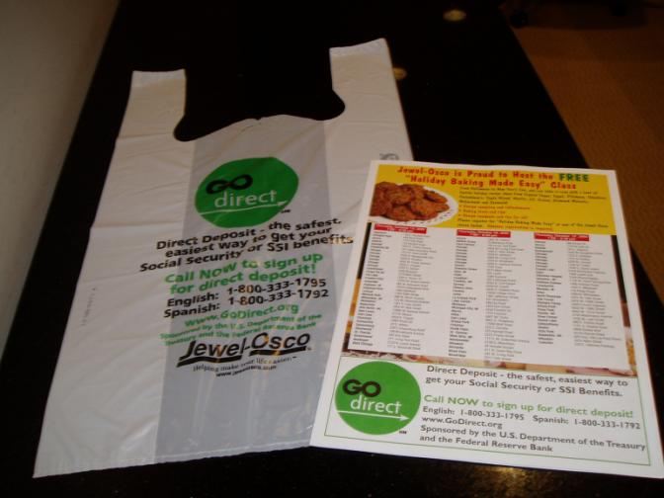
Corporations: Jewel-Osco
Notes:
JH

Slide 22
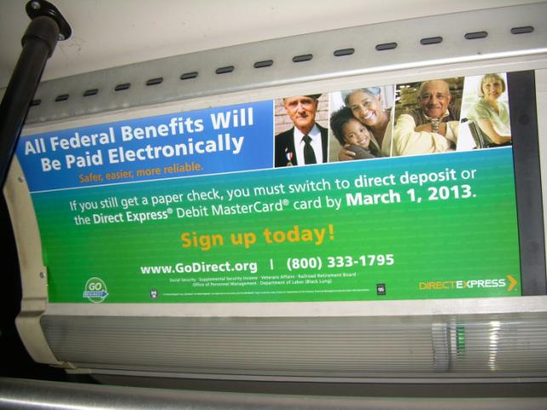
City Government: SMART Bus
Notes:
JH

Slide 23
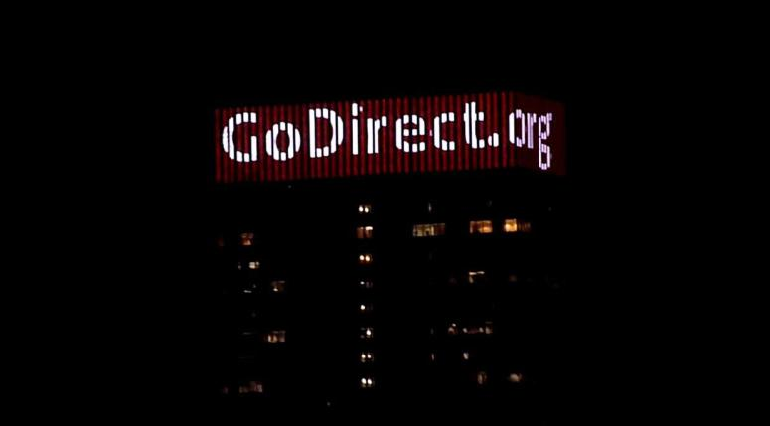
Corporations: Philadelphia PECO Building
Notes:
JH

Slide 24
QUESTIONS?
Notes:
JH

Slide 25
Breakout Sessions
Three sessions to choose from
Regoup in this room for lunch
All three sessions will repeat after lunch
Notes:
In the process of updating

