Slide 1
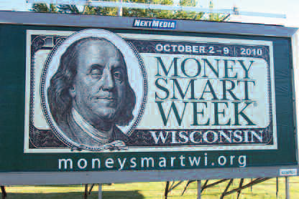
Setting a course for
Financial Literacy
Notes:
Remarkable—this conference represents…
Thank you – vision, passion, recognition of nano-economics
Financial literacy is about giving people the tools they need.
Money Smart Week is a great tool to get a community, state and now the nation to focus on their own financial fitness.
There courses and activities but from my observation of conducting a statewide campaign the effects of MSW go well beyond the week.

Slide 2
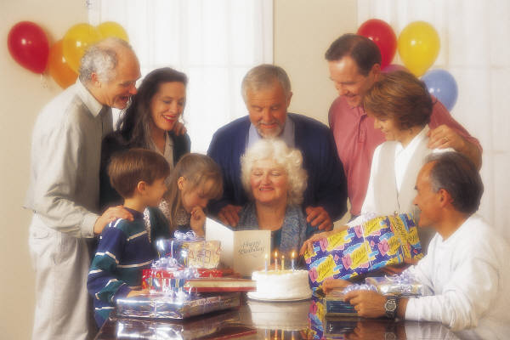
Expanding Opportunities
through
Financial Education

Slide 3
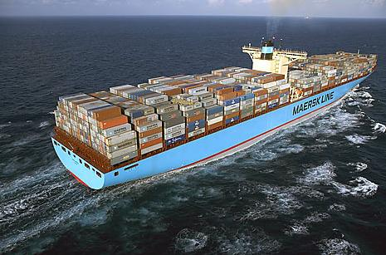
Notes:
Emma Mærsk is a container ship owned by the A. P. Moller-Maersk Group. When she was launched, Emma Mærsk was the largest container ship ever built, and as of 2008 the longest ship in use. Officially, Emma Mærsk is able to carry around 11,000twenty-foot equivalent units(TEU) according to the Maersk company's method of calculating capacity, which is about 1,400 more containers than any other ship is capable of carrying.

Slide 4
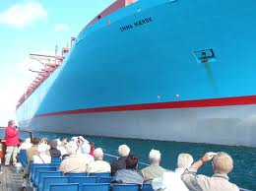
Notes:
Emma Mærsk is a container ship owned by the A. P. Moller-Maersk Group. When she was launched, Emma Mærsk was the largest container ship ever built, and as of 2008 the longest ship in use. Officially, Emma Mærsk is able to carry around 11,000twenty-foot equivalent units(TEU) according to the Maersk company's method of calculating capacity, which is about 1,400 more containers than any other ship is capable of carrying.

Slide 5
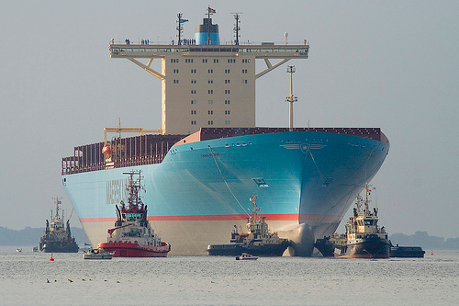
Notes:
Emma Mærsk is a container ship owned by the A. P. Moller-Maersk Group. When she was launched, Emma Mærsk was the largest container ship ever built, and as of 2008 the longest ship in use. Officially, Emma Mærsk is able to carry around 11,000twenty-foot equivalent units(TEU) according to the Maersk company's method of calculating capacity, which is about 1,400 more containers than any other ship is capable of carrying.

Slide 6
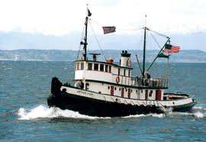
Notes:
Themes:
*Get Started—gather a group and agree to do something than do it (do something you already know how to do)—that alone is a success, start with one community than another—that’s the makings of a statewide campaign
*State government—consider involving state government—1. has purview in so much 2. therefore has a lot of reach, and 3. is unbiased and usually has no turf
Here’s how WI got started, Gov. Council (involved state gov.), Governor’s Proclamation, membership drive at the Residence (invited 200 organizations)
*Celebrate successes along the way—kick off events, financial literacy awards, statewide wrap up meetings (local wrap up meetings, parties, lunch, after work outings)
*Learn what works in your community—learn from others and by doing (we learned that more events does not mean more attendance).
*Kept it fresh—after a few years

Slide 7
Main Measures
 |  | 2006 | 2007 | 2008 | 2009 | 2010
Events |  | 463 | 761 | 597 | 667 | 616
Attendance |  | 6,487 | 8,673 | 13,987 | 10,327 | 15,543
Teams |  | 5 | 12 | 13 | 21 | 27
Partners |  | 453 | 579 | 515 | 1,043 | 2,796
Surveys |  | 687 | 1,437 | 1,986 | 1,352 | 2,057
Notes:
Notice that more events do not mean more attendance.
Can organize events all at one place a couple of nights or scatter them
2008 we had a over a 1200 phone calls on two hotlines NO place for attendance just a phone number
2010 includes 70 municipalities
Finally, after a couple of years its important to keep interest high so *Kept it fresh

Slide 8
Green Bay Packer Donald Driver

Slide 9
Wisconsin State Capitol in Green

Slide 10
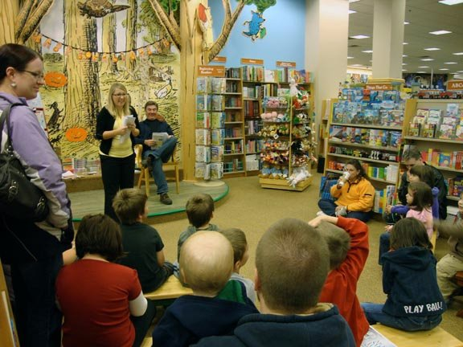
The Big Read

Slide 11
Oprah’s Debt Diet Coach

Slide 12
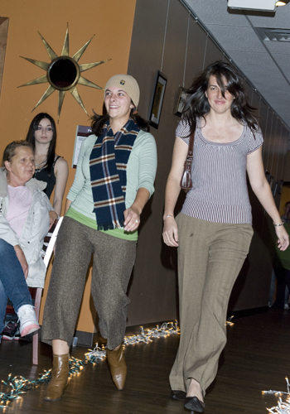
Notes:
Billboard or yard signs
Penny the Pig presentations—the four slotted piggy bank that helps young students learn ways to budget money
Financial makeover—a local reality TV family agrees to be monitored and helped to become financial fit TV viewers watch
Thrift store fashion shows
Grocery store shopping contest
What ever the activity ultimately it all comes back to people and giving the tools they need to realize their own goals.

Slide 13
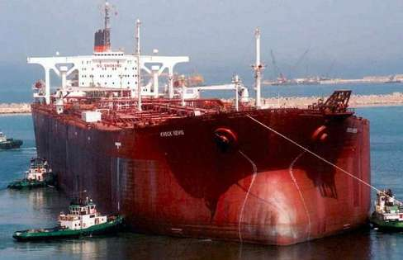
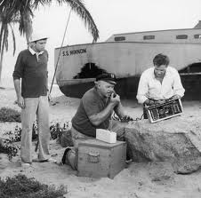
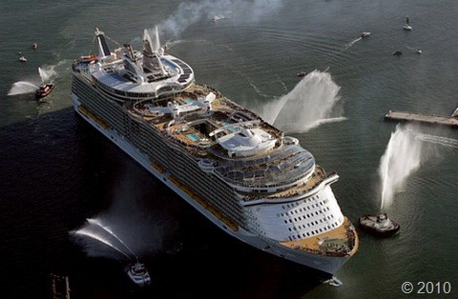
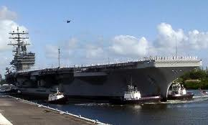

Slide 14
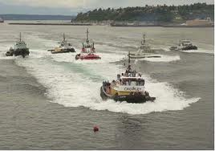
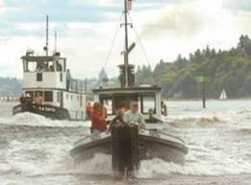

Slide 15
Setting a course for
Financial Literacy
Presentation by David D. Mancl
Director, Office of Financial Literacy
Wisconsin Department of Financial Institutions
345 W. Washington Ave., Madison, WI 53703
(608) 261-9540, david.mancl@wisconsin.gov

