Slide 1
Federal Reserve Bank of Chicago
Money Smart Week
Money Smart Week Leadership Conference
September 8 & 9 Chicago, IL

Slide 2
Money Smart Week
What is it?
Public awareness campaign
  – helps consumers better manage their personal finances.
Community Building
  – Involves businesses, financial institutions, schools, libraries, not-for-profits, government agencies, media.
Education
  – Offers free educational seminars/activities throughout the week.
Inclusive
  – Covers all facets of personal finance from establishing a budget to first time home buying to estate planning as well as reaches all demographics and income levels.
Outreach
  – Provides Fed opportunity to be visible in the media and community working with a wide variety of organizations.

Slide 3
Money Smart Week
How did it get started?
Chicago Fed & Money Smart Advisory Council
Members agreed to share resources and ideas to achieve greater public awareness of the programs and services available in Chicago.
Result: Money Smart Week 2002 –
30 organizations; 40 programs

Slide 4
Money Smart Week
Why it works?
Asking partners to do what they do already
MSW is all things for all people
Fosters creativity
No cost for participation but there are guidelines
Proven model/best practices
Coalition of the willing
Association with the Fed
Network infrastructure & community building
Scalable

Slide 5
Money Smart Week
What’s the impact?
Tens of thousands reached through class room instruction each year
Hundreds of thousands reached through media and online messaging/resources each year
Consumer surveys consistently yield high marks, each year; each city/state
More than 2,000 partner organizations around the country
Community building and network infrastructure is invaluable

Slide 6
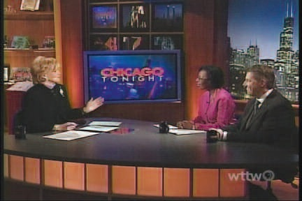
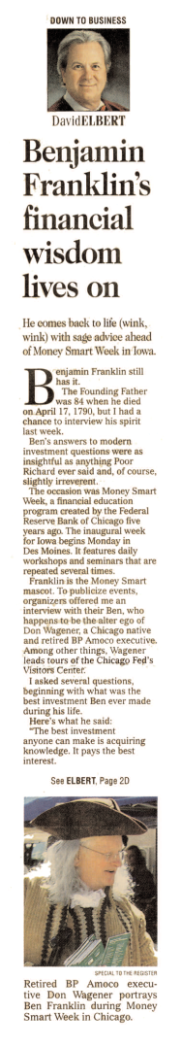
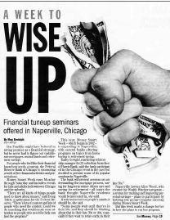
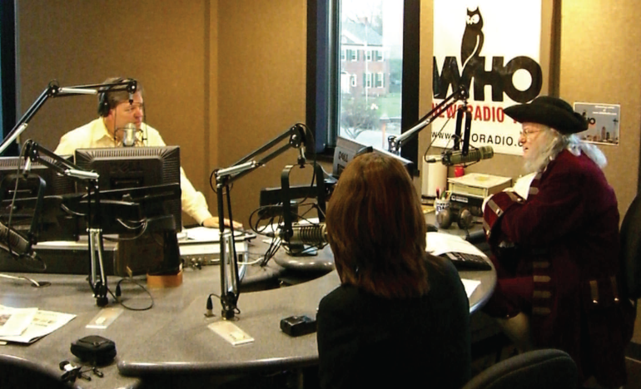
Money Smart Week
Media involvement

Slide 7
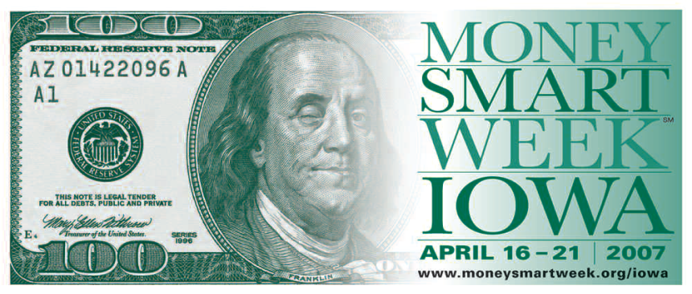
Money Smart Week
Promotion

Slide 8
Money Smart Week
Key Cities
Charleston, WV
Chicago, IL
Denver, CO
Detroit, MI
El Paso, TX
Fort Wayne, IN
Houston, TX
Indianapolis, IN
Kansas City, MO
Kearny, NE
Lafayette, IN
Lansing, MI
Madison, WI
Milwaukee, WI
Olympia, WA
Omaha, NE
Peoria, IL
Portland, OR
Rockford, IL
Seattle, WA
Springfield, IL
When is Money Smart Week?
April
Colorado, Illinois, Iowa, Michigan, Missouri,
New Jersey, Oregon, Texas, Washington,
West Virginia
October
Indiana, Wisconsin
November
Nebraska
Initial Talks: Arizona, Florida, New York, Ohio, Virginia

Slide 9
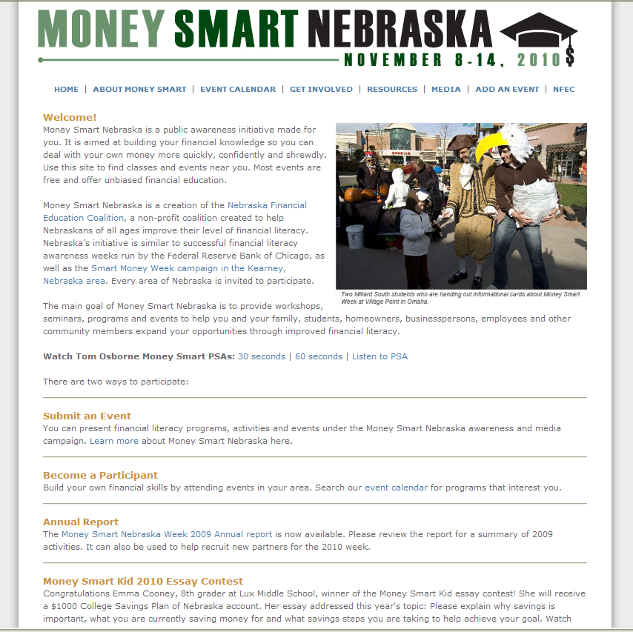
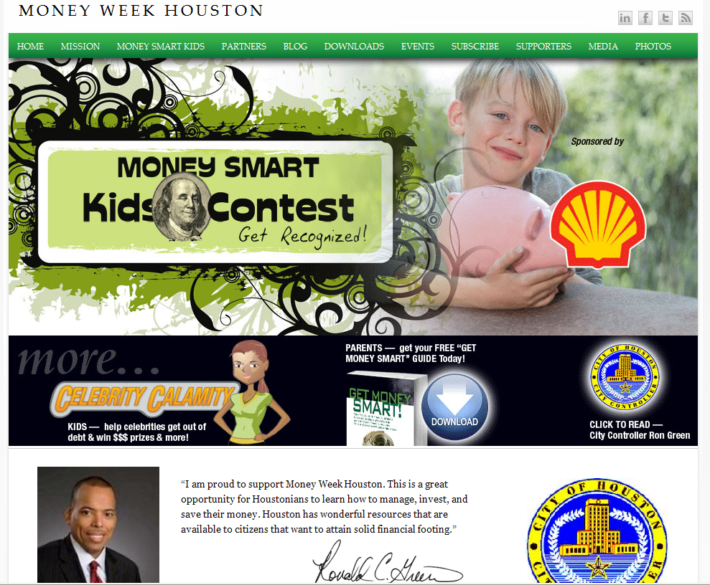
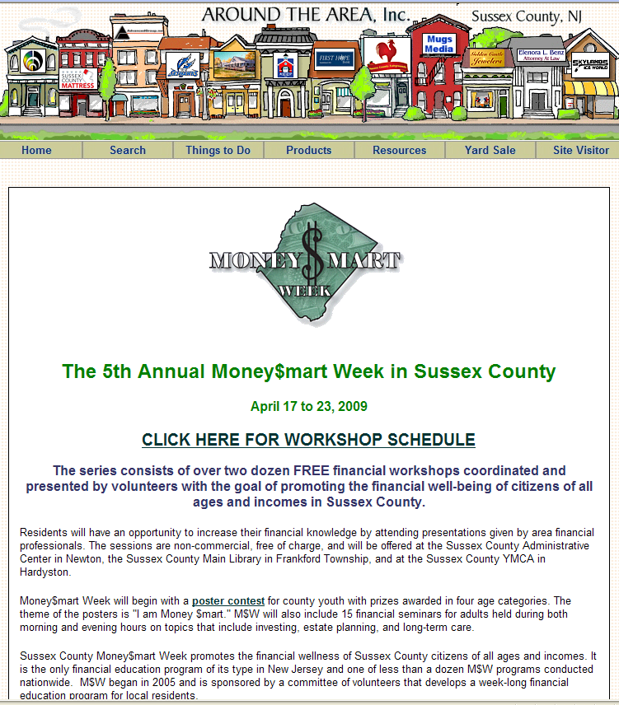
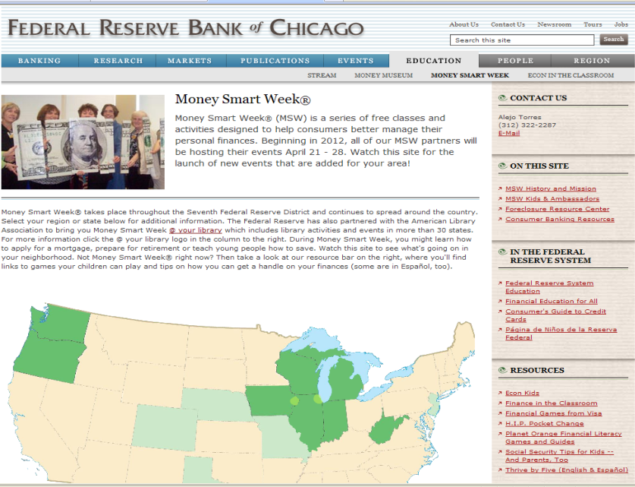
Money Smart Week

Slide 10
Money Smart Week
Enhanced coordination among states?
  Demand
  Branding
  Efficiencies & Resource Sharing
  Partners with National Reach
  Growth has national potential
  10 Anniversary MSW – Chicago
What could this look like?
  Chicago Fed to continue advisory role
  National steering committee
  Same schedule for all states
  New website and rebranding
  National Partnerships – ALA and other opportunities

Slide 11
Money Smart Week
What resources are currently made available to states?
Rights to name, logo and promotional materials
Customizable planning and operational documents:
  History, talking points and guidelines
  Sample agendas, timelines and committee structures
  Sample press releases and media best practices
  Measurement and survey materials
Use of online database and MoneySmartWeek.org
Ongoing consultation and guidance from Chicago Fed
First Money Smart Week leadership conference
– fall 2011

Slide 12
Money Smart Week
What’s new for the 2012 campaign?
Leadership Conference Report
Best Practices Report
Improved usability and restructure of website
New calendar and partner sign-up database
Facebook
Logo Refresh
Structured Statewide Chairperson Calls
(Chicago Fed district)
National Steering Committee

Slide 13
Money Smart Week
-Opening Thoughts/Questions?
-What attracted you to this conference?
-How can this conference be valuable?
-What do you expect as outcomes?

