Slide 1
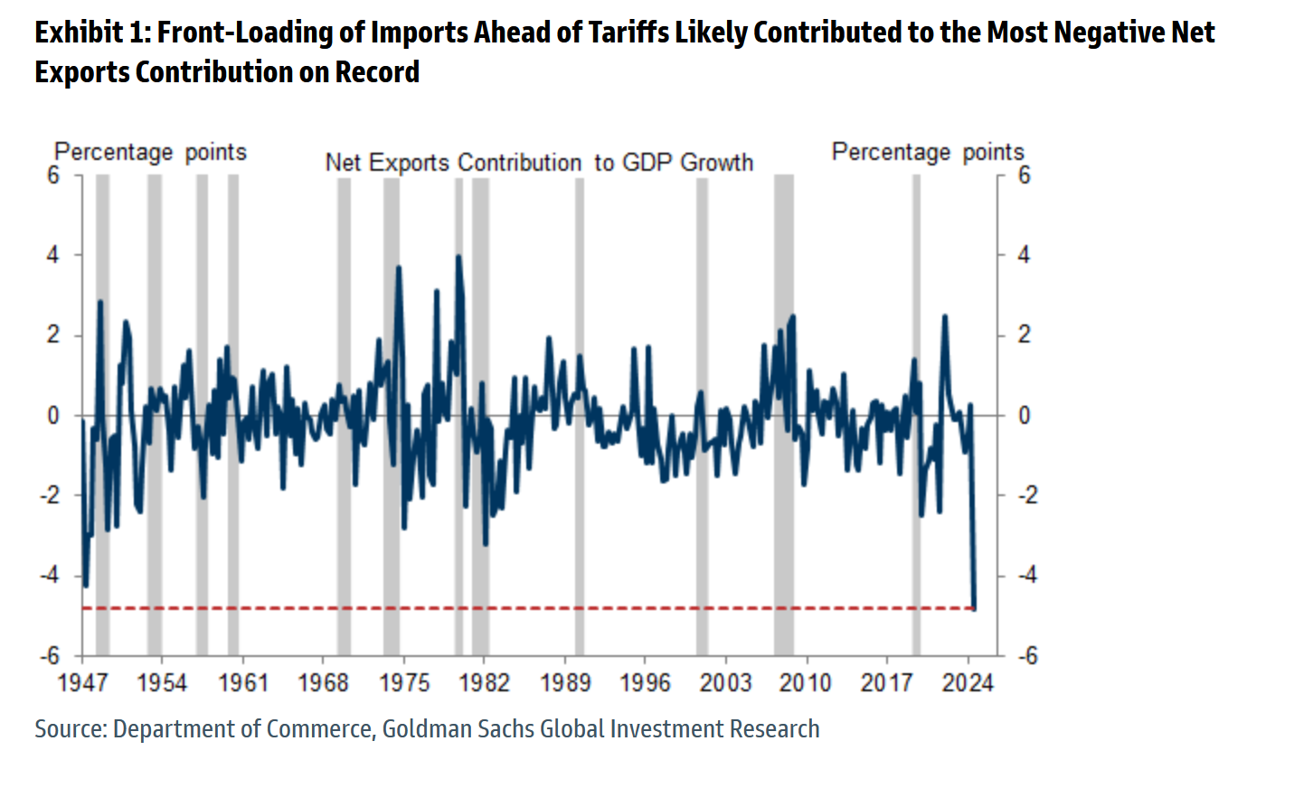
The May 2025 GDP report for Q1
GDP fell by 0.3% in Q1 (Advance)
Consumption rose by 1.8%
Inventories were up
G fell 1.5%
Fixed investment rose 10%
Equipment investment rose 22% and electronics/communication 70%
Notes:
Equipment was up 22% and electronics/communication was up 70%
Residential I was up 1.3%

Slide 2
Nonresidential and Residential

Slide 3
Non-res: Equipment, IP, Structures

Slide 4
2021-25: Equipment and IP
IP: software and R&D

Slide 5
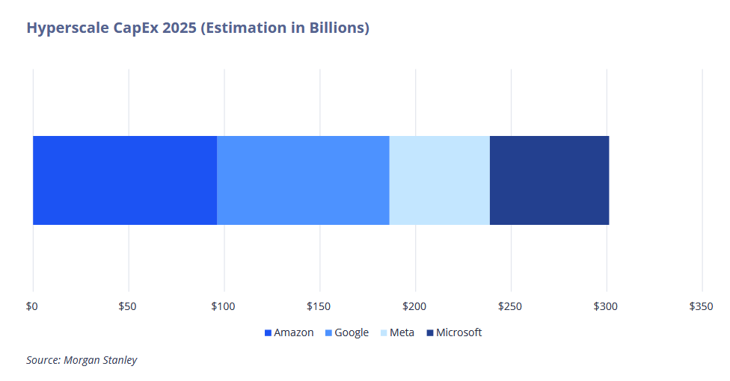
Most recent investment is accounted for by information processing and software, about a quarter from AGMM, more if Nvidia added.
 | 2025
% contrib to private fixed I | Q1 | Q2
Private fixed investment | 7.1 | 4.4
Nonresidential I | 7.27 | 5.57
Private info processing and software | 7.55 | 4.51
Intellectual property products | 2.00 | 4.38
Private info processing and software was ~1,300 billion in H1
(Information processing and software is an AI proxy)

